Slide 1





安全数字链接
Secured Digital Link
活性与智能包装
ACTIVE & INTELIGENT PACKAGING
亚洲峰会
SUMMIT ASIA
中国上海
Shanghai China
June 19th, 2024
2024年6月19日
解决方案供应商和技术专家
solution providers and technical experts
洛朗·托内利耶 - mobiLead，首席执行官
laurent.tonnelier@mobiLead.fr
Laurent TONNELIER - mobiLead, CEO
laurent.tonnelier@mobiLead.fr
Notes:
Good afternoon
I’m Laurent TONNELIER, CEO of MOBILEAD, a software company based in France
Thank you for this opportunity to talk about a new approach to security in the field of Interactive packaging
Not only links between products and related content could be done in a secure way but also using international standards, innovative patents and best practicises.

Slide 2
mobiLead, each unique product item is connected mobiLead——连接每一单品
  mobiLead participates in the drafting of norms, standards and best practices, while developing a set of specific invention patents in the optimal implementation of standards.
  mobiLead参与了规范、标准制定的全过程，同时为实施最新标准申请了一组特定的发明专利。
  Expert member of AFNOR, CEN CENELEC (JTC24) and ISO (CN31, TC292), co-chair of the GS1 Digital Link, IP owner (including China), mobiLead provides software solutions on standards that it helps to design, in the field of interactive packaging.
Tech to Augment Product
    ISO/IEC 18004 and ISO/IEC 15415, QR Code
    ISO/IEC 14443 and NDEF, NFC
    ISO 22385, for establishing a framework for trust and interoperability,
    ISO 22376, for visible digital seals (VDS)
    ISO/IEC 20248, for DigSig digital signatures.
  Tech to improve safety and sustainability fitting with Digital Product Passport
June 19th, 2024
2024年6月19日
Notes:
Created in 2008, Mobilead is involved in standards body contributions and international lecturing ans speaking engagements
mobiLead participates in the drafting of norms, standards and best practices, while developing a set of specific invention patents in the optimal implementation of standards.

Slide 3
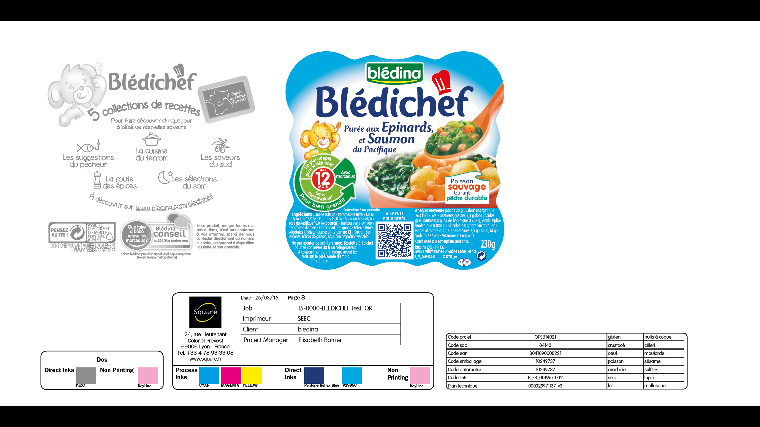

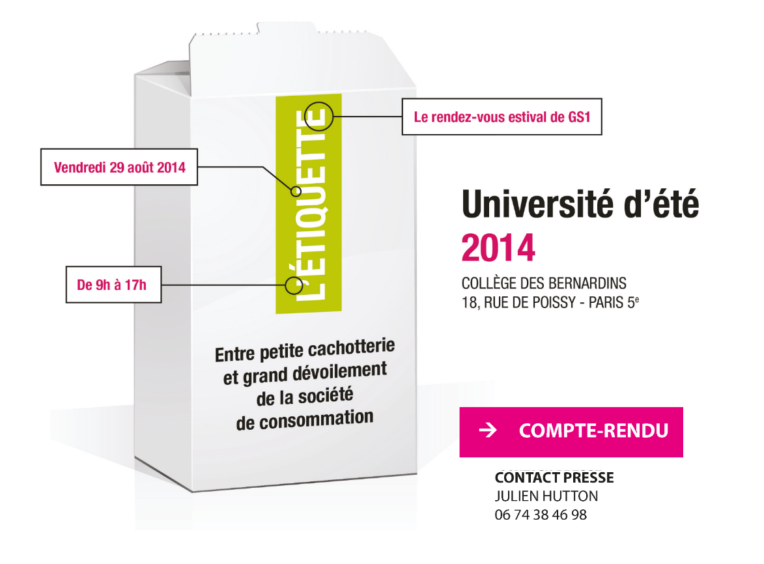
2014 “Concept Pack” Blédina : Logistic, Marketing, Commerce
物流, 营销,销售
August 29, 2014
GS1 University - Paris FRANCE
November 2-4, 2014
PackExpo - Chicago USA
June 19th, 2024
2024年6月19日
Notes:
In august 2014, MOBILEAD presented a new approach in Paris during GS1 France summer university :
A product without a linear UPC barcode, but a QR Code.
In november 2014, MOBILEAD was kindly invited by AIPIA in Chicago to showcase this innovation.
This is exacly what becames, 4 years after, the GS1 Digital Link

Slide 4
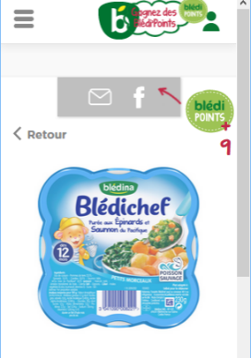
2014 “Concept Pack” Blédina : Logistic, Marketing, Commerce
物流, 营销,销售
ERP 10249737
EXP. 14/02/17
June 19th, 2024
2024年6月19日
Notes:
The concept behind this innovation is quite simple :
Instead of having a linear UPC barcode, that only contains the reference number of a product
Instead of having informations such an internal identifier, or the expiration date
You can gather every information in to on single code, as a QR Code.
Not only the QR will contain all the data needed offlin,
but will also contain a link to some related content avaliable online that aby mobile phone could read
This is what MOIBLEAD did with the BLEDINA on babyfood.

Slide 5
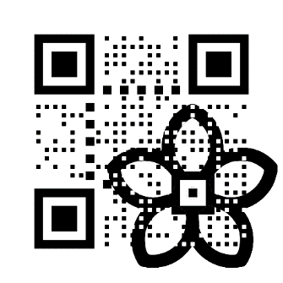
From 1974, to 2027
从1974到2027
1974:
UPC / EAN
1989:
Web URL
2008:
QR Code
2018:
GS1 Digital Link
2009:
NFC
2012:
QR plus
2014:
Concept Pack
2022:
Digital Link VDS
June 19th, 2024
2024年6月19日
Notes:
This timeline helps to understand how we got from the linear barcode to the Digital Link VDS standard
In 1974: the 1st bar code was used at a cash register, a product identifier into a linear bar code
In 1989: Over the Internet network Tim Burners Lee invents the web, the http protocol, domain names, the html doc
In 2008: DENSO WAVE – a TOYOTA Company - created the QR Code, from a patent designed by 2 Japanese engineers, to an international ISO norm
In 2009: came of NFC for Near Field Communication
In 2012: MOBILEAD patented a reliable process to merge any QR code with any image, while keeping the quality grade unchanged
In 2014: MOBILEAD, BLEDINA – a brand of DANON, created the first packaging identification based on a QR Code
In 2018: the GS1 Digital Link specification, written by several experts around the world, was published, and made available
Combining the best of product identification and the best of the web in a single 2D barcode
In 2022: came the first proposal in order to secure any content, any link, including GS1 digital Links

Slide 6
从传统条码迁移 migrate from traditional barcodes
传统条形码
  Traditional barcode (1D)
数字链接（二维码）
  Digital Link (2D)
http://zt.ag/01/ /...
3 779000 004901
3 779000 004901
From one code, one service, in 1974, to one code, several services, in 2027
从1974年的一个编码链接一项内容，到2027年的一个编码链接多项内容
June 19th, 2024
2024年6月19日
6
Notes:
While a 1D barcode, such an UPC bacode, could only contain a limited amount of data, such the Global Trade Item Number (GTIN)
A 2D barcode such a QR code, a Datrmatrix, a Hanxin code, a jabcode, could contain a link, with several parameters including the Global Trade Item Number (GTIN)

Slide 7
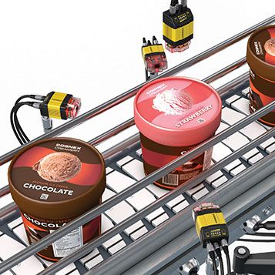
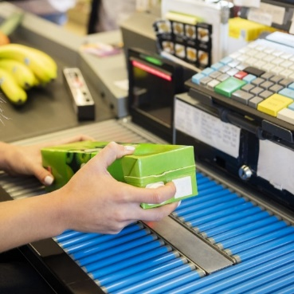
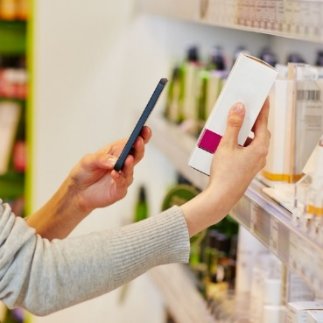
从传统条码迁移 migrate from traditional barcodes
Logistic - Track and Trace物流跟踪
Commerce – checkout 销售-商品结账
Marketing - Interactive Packaging营销-交互式包装
Commerce – checkout
销售 - 商品结账
http://zt.ag/01/ /...
3 779000 004901
3 779000 004901
From one code, one service, in 1974, to one code, several services, in 2027
从1974年的一个编码链接一项内容，到2027年的一个编码链接多项内容
June 19th, 2024
2024年6月19日
Notes:
Not only this 2D barcode could be used in Commerce at checkout, as any existing UPC barcode
but also, could be used in Logistic for Track and Trace, coudl be used in Marketing for Interactive Packaging
Consumers will be able to access a variety of information about a product by simply scanning a QR Code with their smartphone: from specifications, to expiration dates, nutritional data, and warranty registration.
If correctly marked, each Consumer Good Packaged, may be able to deliver the voice of the brand, a personalized voice, tailored to the consumer needs.

Slide 8
mobiLead each unique product item is connected mobiLead——连接每一单品
  mobiLead is involved in standards-body contributions and international lecturing and speaking engagements.
  mobiLead参与了标准化组织的工作，以及多个国际会议与讲座。
  Based on 10 years of R&D from mobiLead and 19 international patents and patents pending, mobiLead aim to reinvent to dialogue between customer and brand using each product as a permanent link to several services.
  基于mobiLead10年的研发经验，19项国际专利以及正在申请的专利，mobiLead致力于将每种产品永久链接至多项内容与服务。
  mobiLead holds several patents, in Europe, China and US, in the field of Automatic Identification, Security, and Blockchain.
  mobiLead合作，在欧洲、中国和美国获得了自动识别、安全和区块链领域的多项专利。
Notes:
Based on 10 years of R&D from mobiLead and 19 international patents and patents pending, mobiLead aim to reinvent to dialogue between customer and brand using each product as a permanent link to several services.
mobiLead holds several patents, in Europe, China and US, in the field of Automatic Identification, Security, and Blockchain.

Slide 9
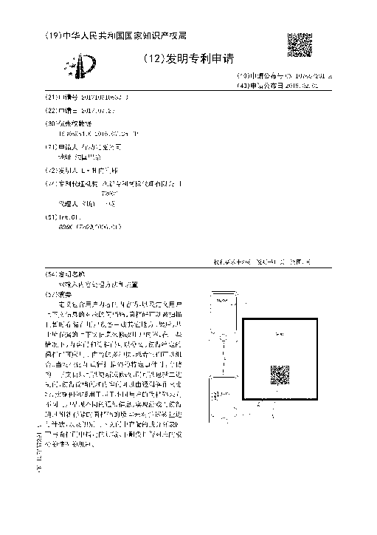
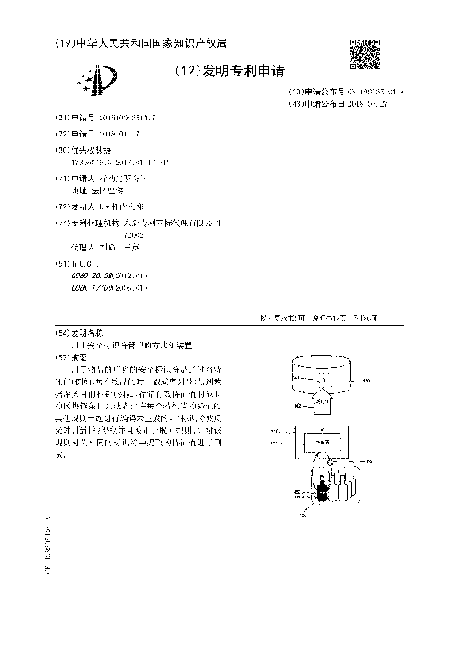
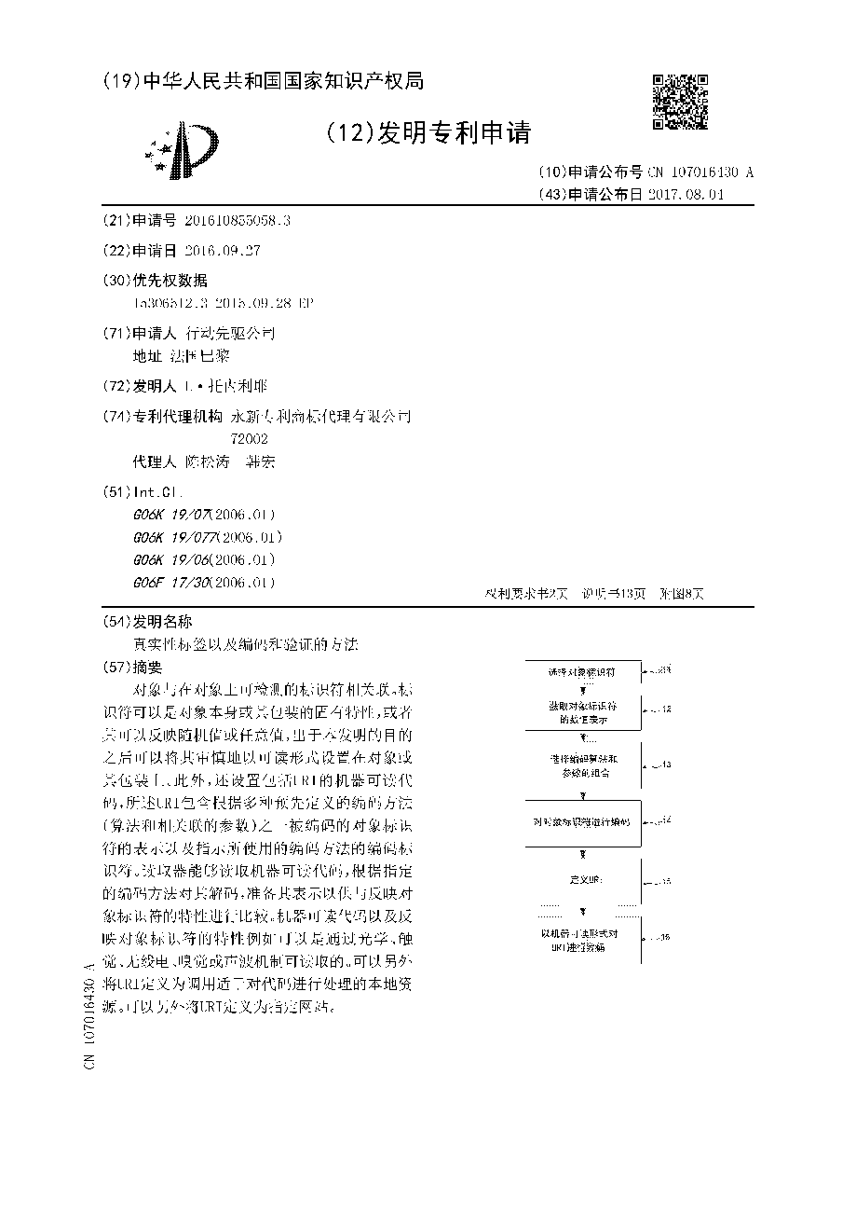
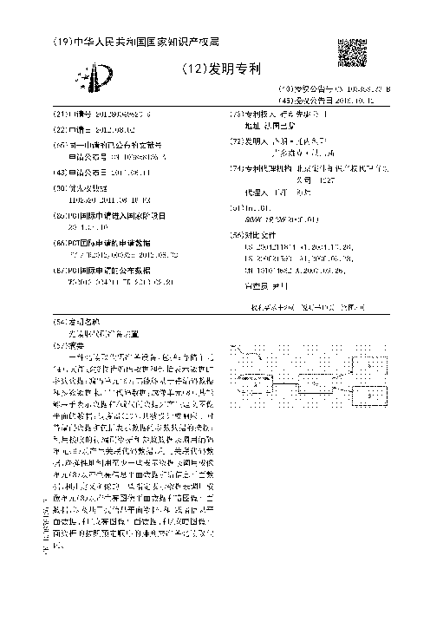
专利: 欧洲，美国，中国
Patents : Europe, USA, China
CN107657291 - 双输入内容处理方法和装置
  Dual input content processing method and device
CN108335104 - 用于安全标识符管理的方法和装置
  Method and apparatus for secure identifier management
CN107016430 - 真实性标签以及编码和验证的方法
  Authenticity tag and methods of encoding and verification
CN103858136 - 光读取代码准备装置
  Optical-reading code preparing means
June 19th, 2024
2024年6月19日
Notes:
Each innovation, is either granted for free, or under FRAND licence.
Fair Reasonable and non-discriminatory license

Slide 10
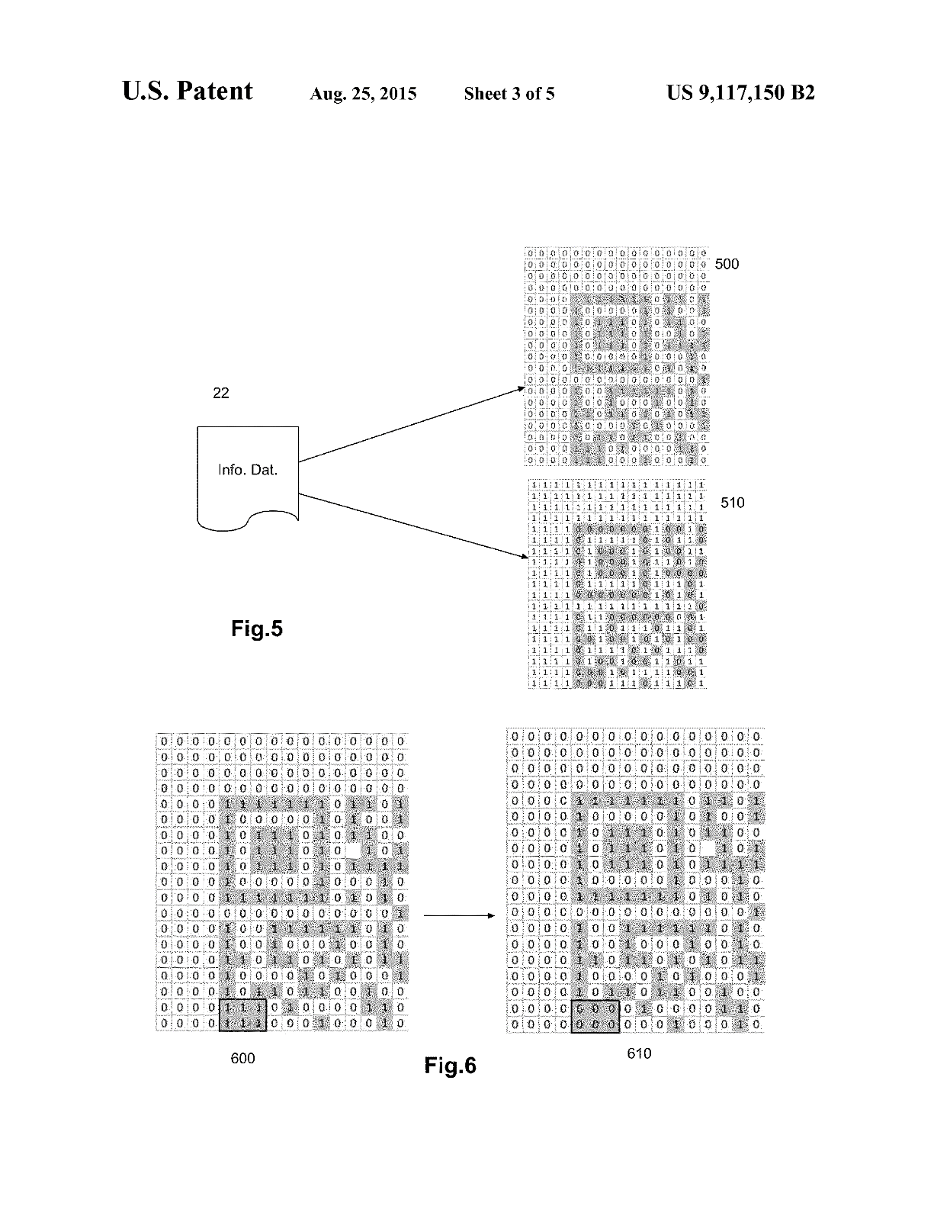

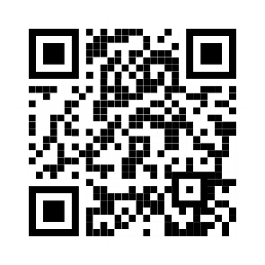
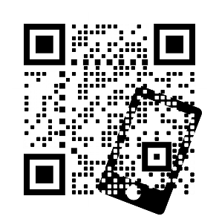
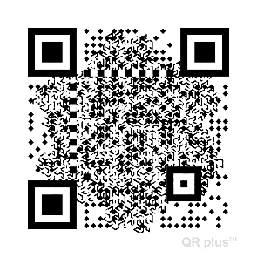
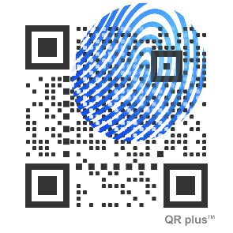
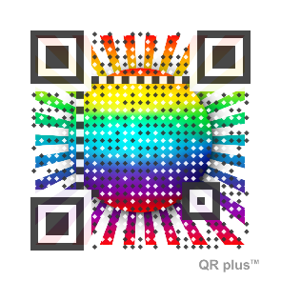

Optical-reading code preparation device
Light reads code preparation device
069365 Visual QR+ / QR plus (2011/08)
Optical-reading code preparation device
Light reads code preparation device
(ISO/IEC 18004 compliance, grade A)
https://id.gs1.org/01/614141123452
June 19th, 2024
2024年6月19日
10
Notes:
With Visual QR Codes such QR plus,
You may want, for marketing purpose, to inprint a logo in a QR Code
You may want, for security purpose, to obscure a QR Code,
always readable, very complex to conteirfit

Slide 11
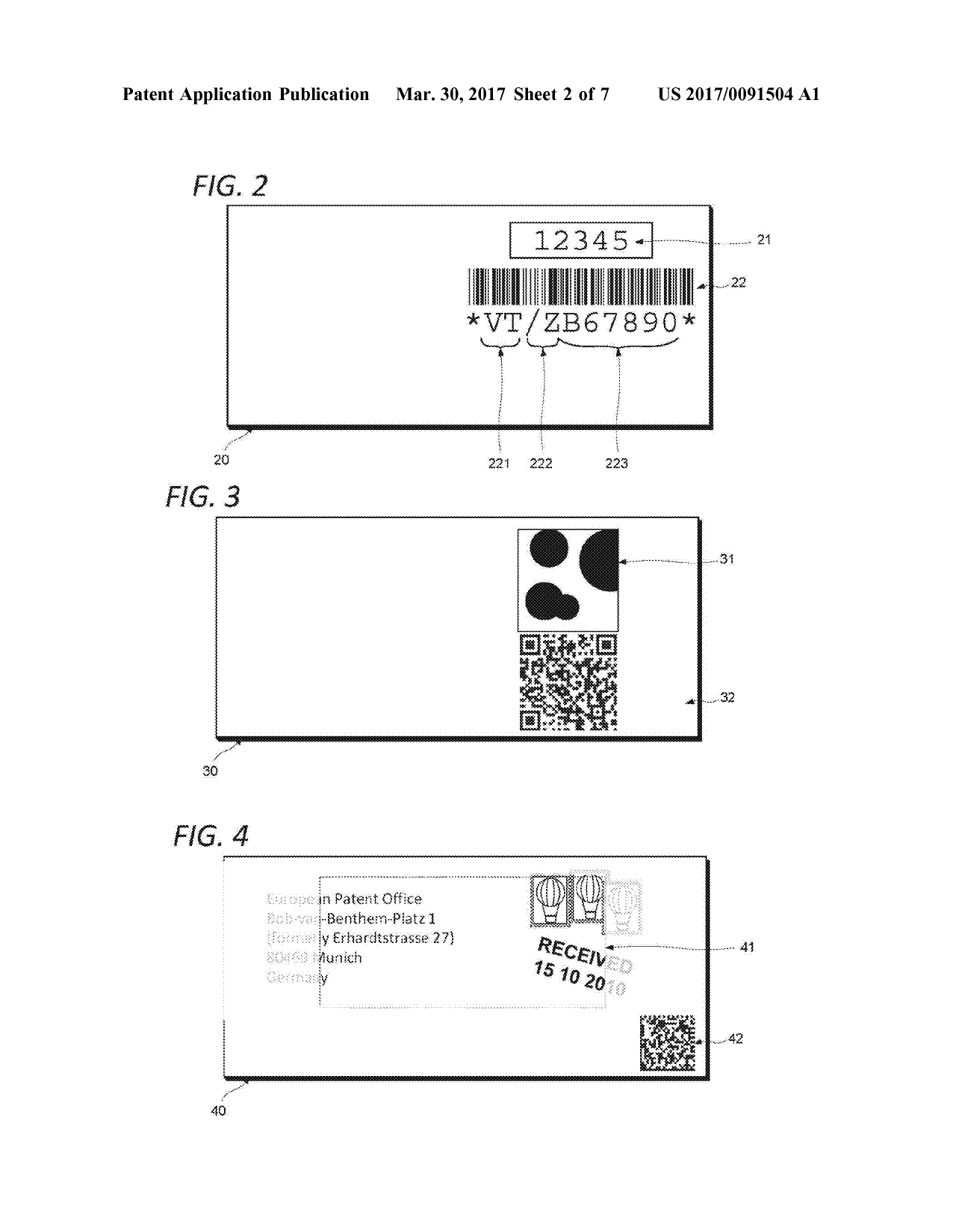


070008 Anti-counterfeiting
Authenticity label, coding and method
070008 Validation and anti-counterfeiting (2015/09)
Hierarchical URI / Compressed / Cyphered
Linked Ids, Num. / Graphical / Hidden
Public/Private
Scan QR Code (local avec App)
Scan QR Code (distant sans App)
June 19th, 2024
2024年6月19日
11
Notes:
You may also want to couple a security features with the content of the code to enable online control but also offline control

Slide 12
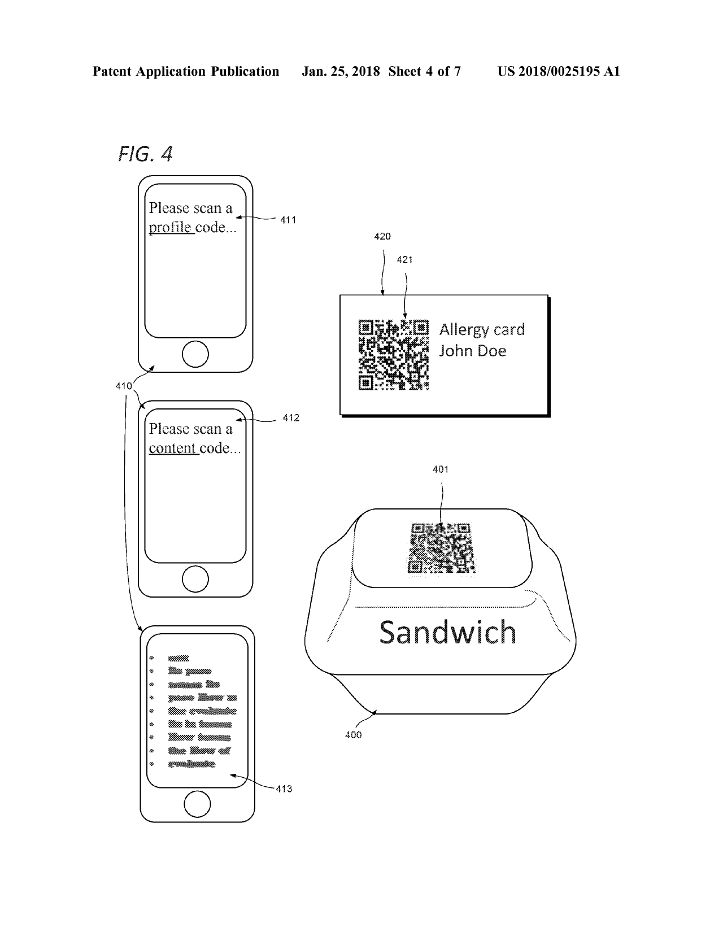
070526 Local Profile
Dual input content processing method
070526 Context and local profile (2016/07)
Context
Grant access
Personal Profile
Product Informations
Tailored content
either OFF LINE, or ON LINE
June 19th, 2024
2024年6月19日
12

Slide 13
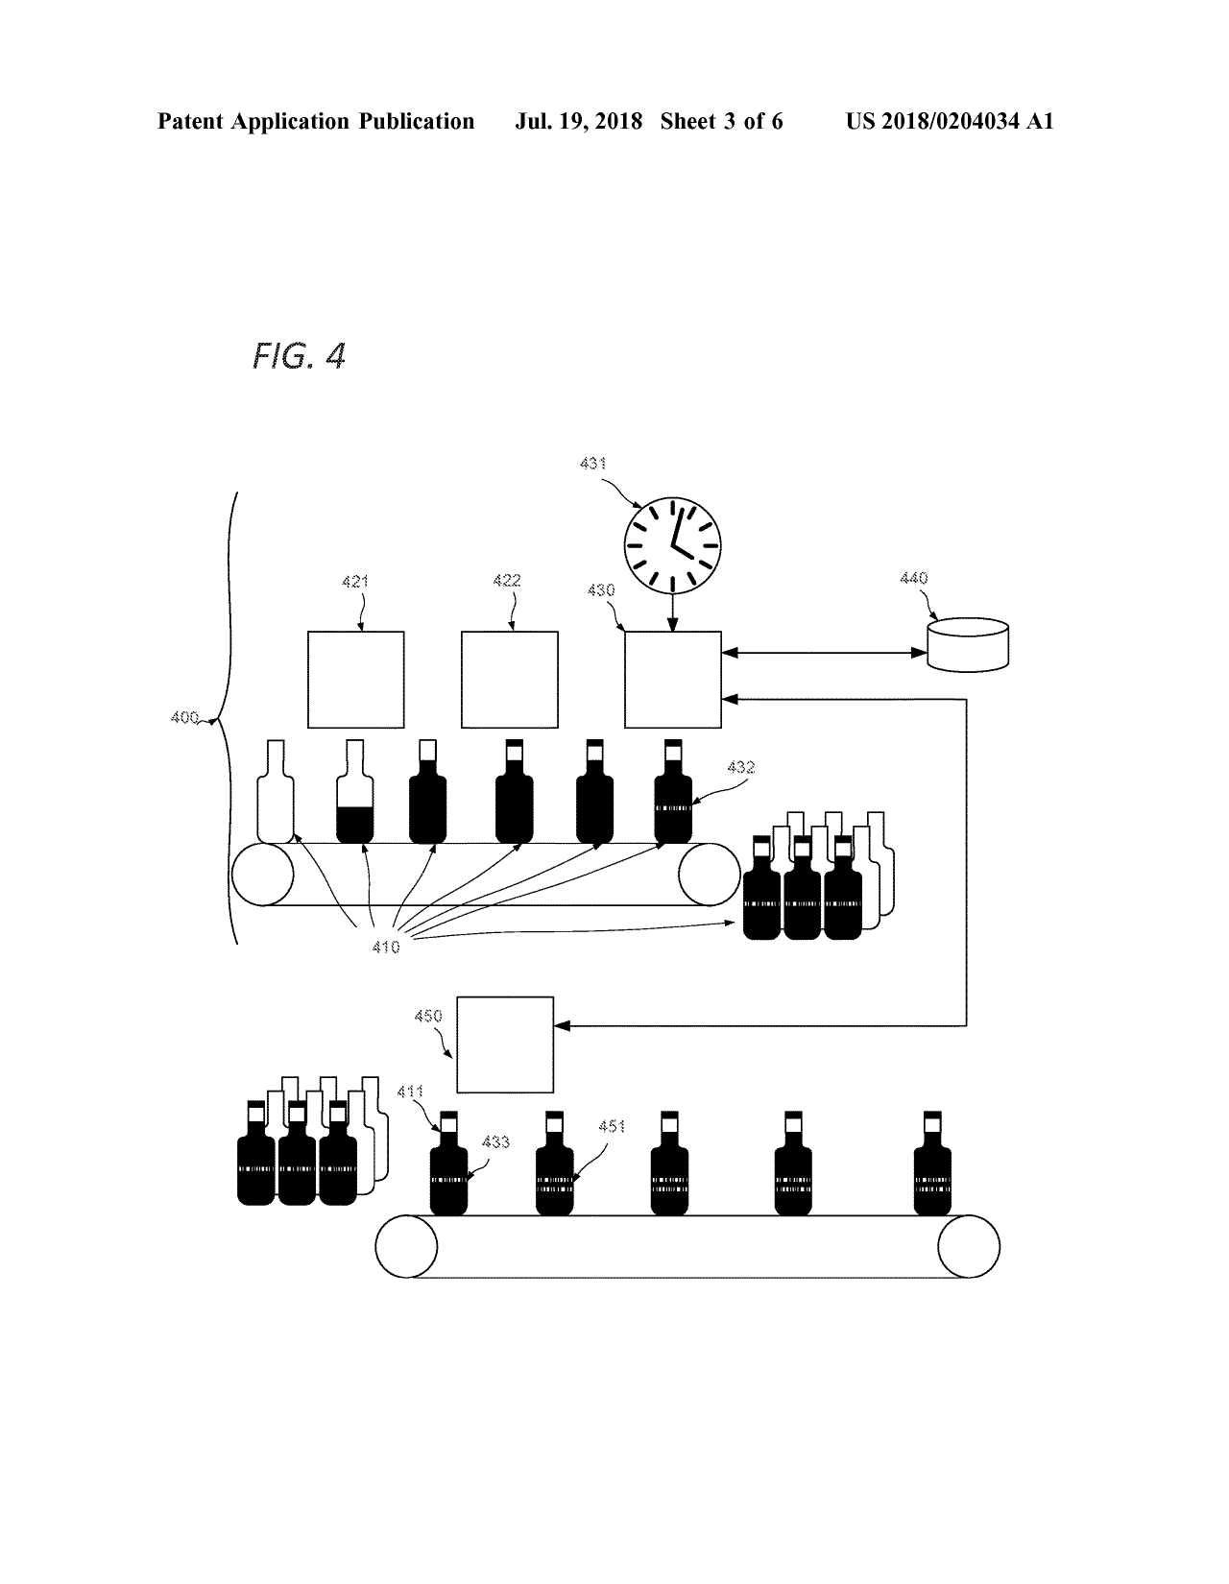

070744 Optimal unitary tracking and public blockchains
Method and apparatus for secure identifier management
070744 Optimal unitary tracking (2017/01)
Optimal unitary tracking and public blockchains
Rules (Regex), not {IDs} in Database
Scan QR Code (local with App)
Scan QR Code (remote without App)
June 19th, 2024
2024年6月19日
13
Notes:
https://patents.google.com/patent/US20180204034A1/en?oq=15.871287

Slide 14
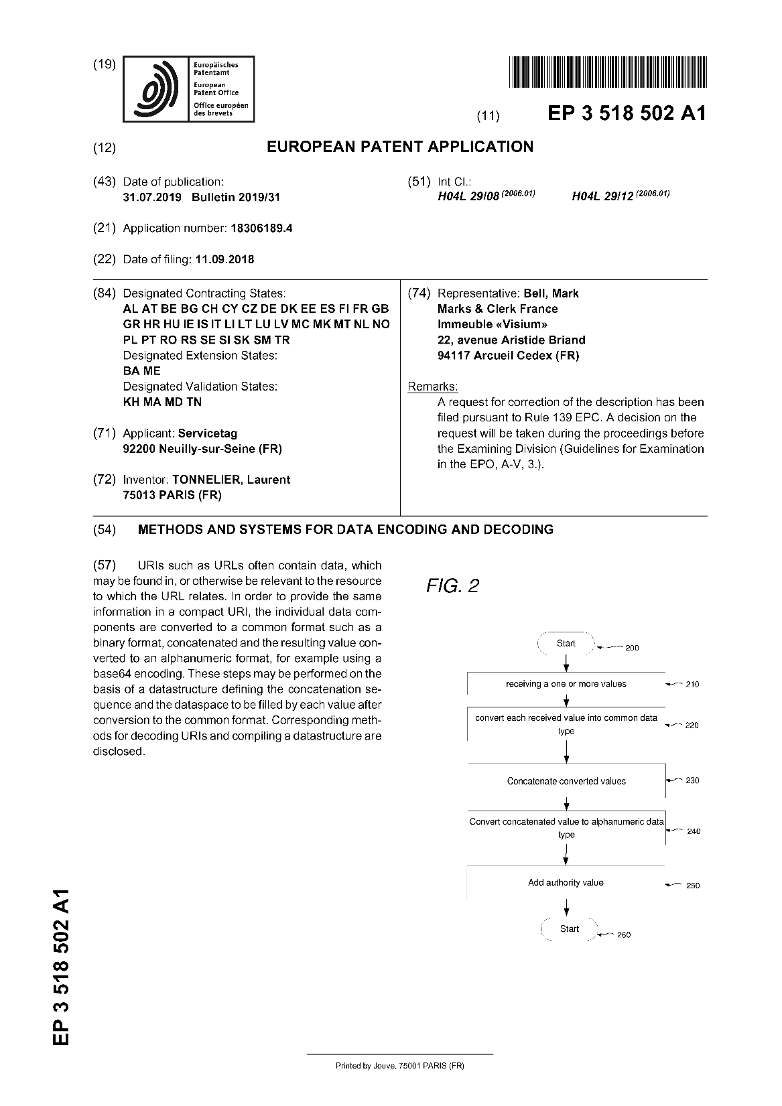
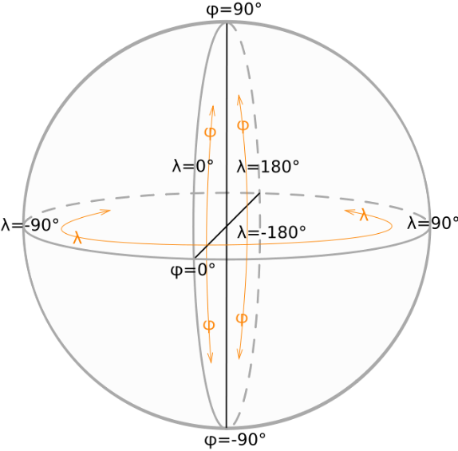
071901 EP Compression
Methods and systems for data encoding
071901 EP Compression
Semantic base compression
June 19th, 2024
2024年6月19日
14

Slide 15

mobiLead involved in several initiatives around the world mobiLead 参与多项全球计划
    Expert member of ISO/IEC JTC 1/SC 31/WG1, WG2, WG8 (Automatic identification and data capture techniques)
    ISO/IEC JTC 1/SC 31/WG1, WG2, WG8
    自动识别与数据采集标准化
  Liaison to ISO/TC 292 (Security and resilience)
  Expert member of CEN (European committee for standardization) on M/XXX DPP "Digital Product Passport“ and JTC 24, WG2 and WG3
  Expert member of AFNOR (French Standardization Association) at CN 31, TC 292, and GE PPC
Involved in ISO/FDIS 22376 (Visible Digital Seal), ISO 22385 (Trust and Interoperability), ISO/IEC 20248 (Digital signature), ISO/IEC 15459 (Unique identification, including GS1), ISO/IEC NP 18975 (Encoding and resolving identifiers over HTTP),
    Chinese National Standard
    GB/T 33993-2017
  2D code for commoditiy
  中国国家标准
  GB/T 33993-2017商品二维码
    GS1 China – ANCC
    GS1 Digital Link
    中国GS1-中国物品编码中心
  GS1数字链接标准
mobiLead aim to work with China, ISO and GS1,
to provide a consistent solution
mobiLead旨在与俄罗斯、中国、ISO和GS1合作，
以提供一致的解决方案
Notes:
Best practices, standard, norms are key to the success of any project
It gives a common language, a better understanding of the technology, a better understanding of any usage
MOBILEAD is involved in several organizations :
At the local level in France at AFNOR, at the European level at the CEN CENELEC, at the International level at ISO
The US approach, the german one, the Chinese one are similar but have some differences
mobiLead aim to work with China, ISO and GS1, to provide a consistent solution

Slide 16

ESPR (Ecodesign for Sustanable Products Regulation)
  Norms and Standards
    ISO/IEC 18004 and ISO/IEC 15415, QR Code
    ISO/IEC 14443 and NDEF, NFC
    ISO 22385, for establishing a framework for trust and interoperability,
    ISO 22376, for visible digital seals (VDS)
    ISO/IEC 20248, for DigSig digital signatures.
  Digital Product Passport
    Standardization Requests – Ad-hoc Group (SRAHG)
    Standardization Request – SREQ (8 modules)
    Joint Technicial Comity at CEN CENELEC (JTC24)
    Working Group 3 (WG3)
    New Work Item Proposal (NWIP) for Module 7
  Data authentication, reliability and integrity
    Secure the carrier (QR Code, NFC)
    Secure the link (URL)
    Secure the data (local, remote)
Much more than just a hash, more than an electronic signature, as verifiable credentials
    ISO/IEC 18004 and ISO/IEC 15415, QR Code
    ISO/IEC 14443 and NDEF, NFC
    ISO 22385, for establishing a framework for trust and interoperability,
    ISO 22376, for visible digital seals (VDS)
    ISO/IEC 20248, for DigSig digital signatures.
mobiLead offer the same level of security than French ID card, based on ISO norms, to any product including cosmetics, using the very same tool used by the French authorities while verifying an ID card, or an invoice.
June 19th, 2024
2024年6月19日
16
Notes:
In order to be ready by the end of 2025 in the Digital Passport Initiative, related to ESPR (Ecodesign for Sustanable Products Regulation), the European commission created a Ad-hoc Group (SRAHG) – since, MOBILEAD is a part of it. In decmener 2023, the European commission published a Standardization Request – SREQ, with 8 modules. The European commission asked the CEN CENELC to created a Joint Technicial Comity number 24. In the commity are 4 working groups, the Working Group 3 (WG3) is in charge of the module number 7 : Data authentication, reliability and integrity
In order to Secure the carrier (QR Code, NFC)
To Secure the link (URL)
To Secure the data (local, remote)

Slide 17
ESPR (Ecodesign for Sustanable Products Regulation)
Final Sreq DPP - Annex II PART B
Requirements for the standards referred to in Article 1
1. Standard(s) on unique identifiers
    ISO 22385: Guidelines for establishing a Framework for Trust and Interoperability
    ISO 22376: Electronic Storage Specifications for use of Visible Digital Seal (VDS) for the authentication, verification and acquisition of data carried by a document or object
    ISO/IEC 20248: Information technology - Automatic identification and data capture techniques – Digital signature data structure schema
2. Standard(s) on data carriers and links between physical product and digital representation
3. Standards on access rights management, information system security, and business Confidentiality
    ISO 22385: Guidelines for establishing a Framework for Trust and Interoperability
7. Standards on data authentication, reliability, integrity
    ISO 22385: Guidelines for establishing a Framework for Trust and Interoperability
    ISO 22376: Electronic Storage Specifications for use of Visible Digital Seal (VDS) for the authentication, verification and acquisition of data carried by a document or object
    ISO/IEC 20248: Information technology - Automatic identification and data capture techniques – Digital signature data structure schema
8. Standards on Application Programming Interfaces (APIs) for the product passport lifecycle management and searchability
    ISO 22385: Guidelines for establishing a Framework for Trust and Interoperability
Notes:
Module number 7 : « Standards on data authentication, reliability, integrity”
ISO Twenty-two three hundred eighty-five
for establishing a framework for trust and interoperability,
ISO Twenty-two, three hundred seventy-six
for visible digital seals (VDS)
ISO Twenty, two hundred forty-eight
for DigSig digital signatures.

Slide 18
ESPR (Ecodesign for Sustanable Products Regulation)
Interoperable and secure
    ESEDS is already used to verify the integrity of ID cards/passports data and protects citizens as well as governmental and private documents. Based on ISO 22385 (governance) and ISO 22376 (data construct), it can also be used to protect - where deemed necessary or mandatory - DPP data.
Multilingual
    Consequently, a NWIP concerning "Standard on data authentication, reliability, integrity" (Module 7 of SReq) is needed in order to build a common language for all industries and when necessary, going down even to a product type. This framework should be flexible and able to cover a complete range of sectors and use cases – all in multilingual environment – covering 26 languages of European Union.
Tailored to each business requirement
    As the requirements and attributes for each product family will be specific, as in the case of EPREL (European Product Registry for Energy Labelling) which includes tires, ovens, dishwashers… The same will happen in the frame of the DPP.
Notes:
The European commission wants a global approach : Secure, Interoperable, Multilingual and tailored to any business need.
I would like to showcase what was done previously on the “European Product Registry for Energy Labelling” EPREL that cousl easily by used for “Ecodesign for Sustanable Products Regulation” ESPR for the Digital Product Passport

Slide 19
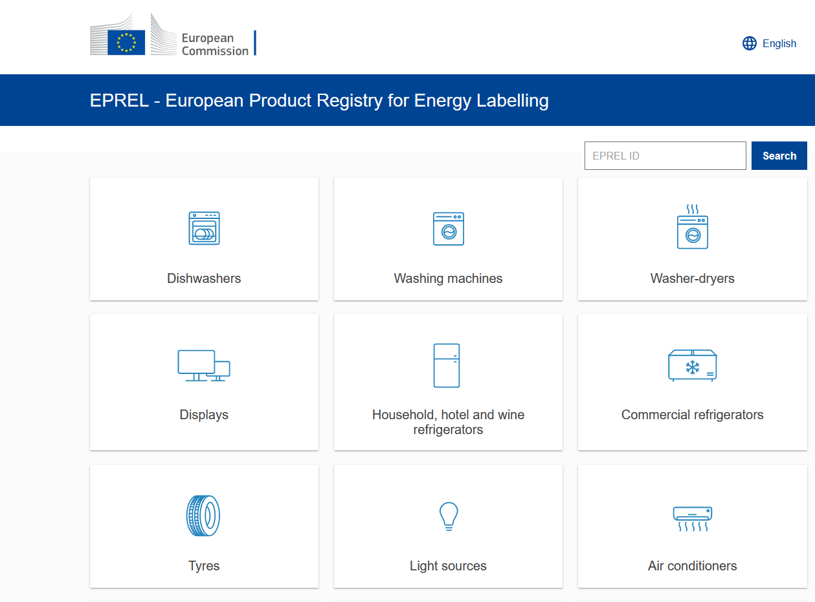
What ESPR could be, a demo based on EPREL
European Product Registry for Energy Labelling
A one-stop-shop of information on energy efficient products targeted at different stakeholders.
Consumers can find detailed information about energy labelled products and models in EPREL. It offers the possibility to identify which products have the best efficiency for a specific need.
The EU energy labelling and eco-design legislation helps improve the energy efficiency of products available in the EU market.
June 19th, 2024
2024年6月19日
19
Notes:
EPREL, for European Product Registry for Energy Labelling, is a database and a website
You have several kind of product including dishwasher, display, tyres… Let focus on tyres, MICHELIN tyres

Slide 20

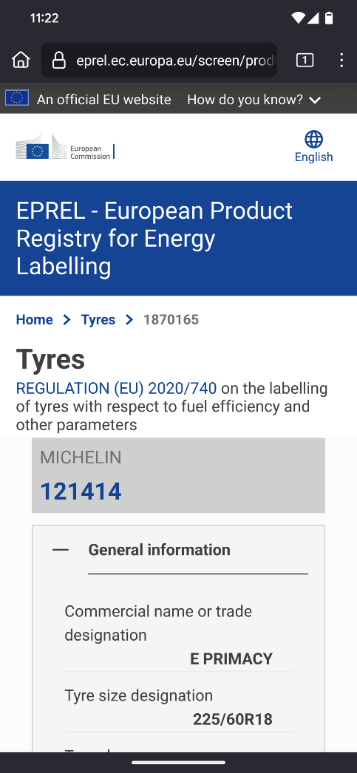
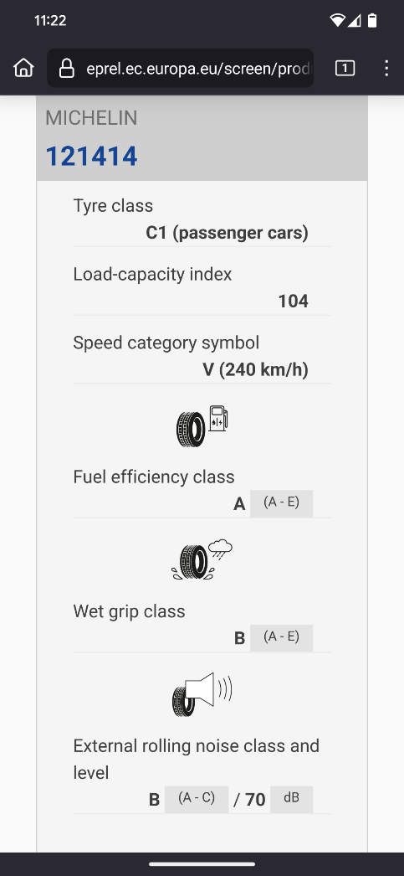
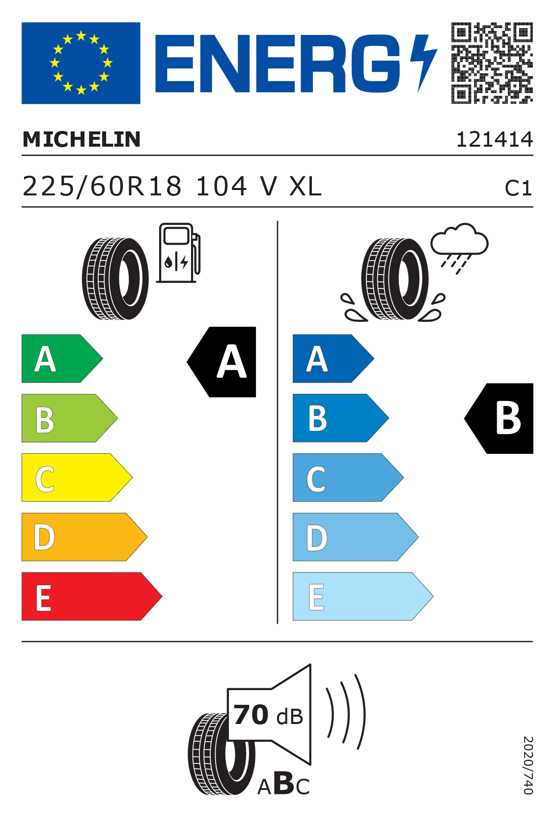
MICHELIN online, a demo based on EPREL
June 19th, 2024
2024年6月19日
20
Notes:
You may already have seen those stickers.
Each sticker has a QR code that leads to EPREL website, to get detailed information about the product : here, MICHELIN tyre.
But there is no specific security in place

Slide 21

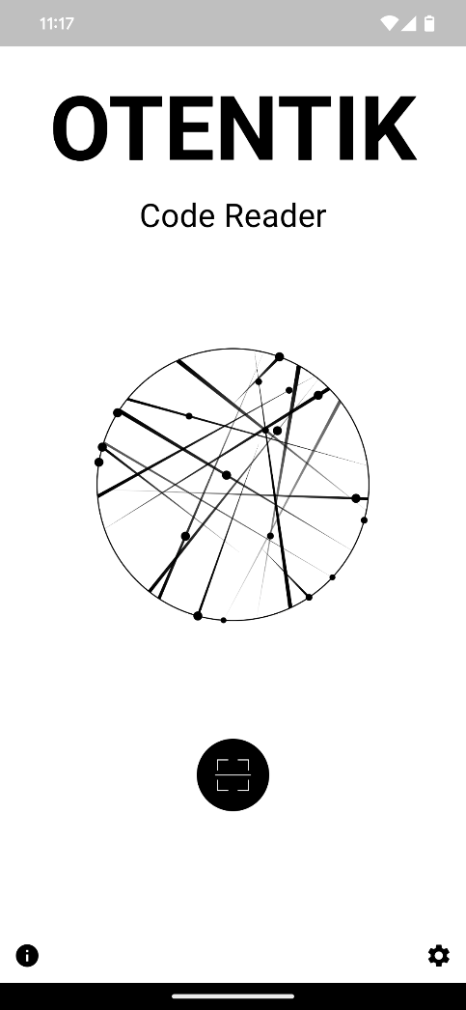
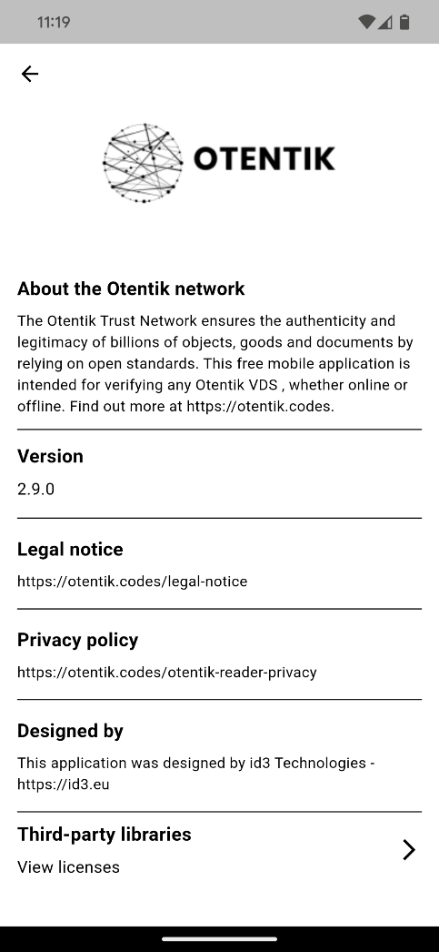
OTENTIK Network / trusted environment
OTENTIK Network
ISO/IEC 16022, Datamatrix
ISO/IEC 18004, QR Code
Data Format in accordance with ISO 22376, for visible digital seals (VDS)
Secured by ESEDS (Electronically Signed Encoded Data Set)
Governance in accordance with ISO 22385, for establishing a framework for trust and interoperability
June 19th, 2024
2024年6月19日
21
Notes:
This is the OTENTIK Code reader, connected to the OTENTIK network.
It is based on ISO norms twenty-two three-hundred-seventy-six and twenty-two three-hundred-eighty-five
The first time a new kind of product is scanned, we call it « use case », the reader will learn how to process it.
Not only the reader could display offline informations, but also inform who created it, and invite you to go online in a reliable way.

Slide 22
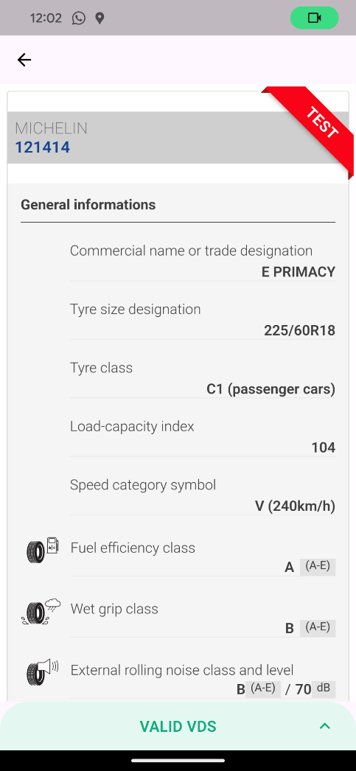
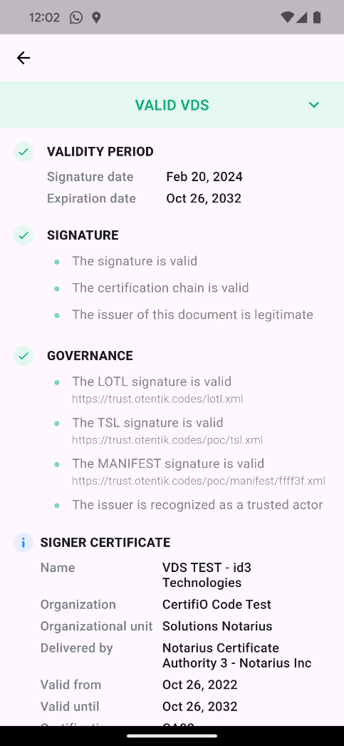
MICHELIN offline EPREL (VDS) then online
trusted environment
June 19th, 2024
2024年6月19日
Notes:
In this trusted environment, the Datamatrix could be read and process by the OTENTIK reader, but could not be read by a Smartphone camera
This could be done on purpose

Slide 23

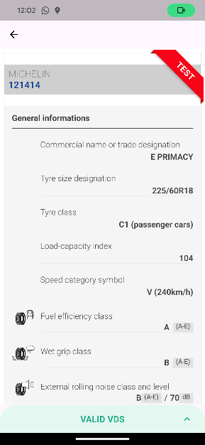
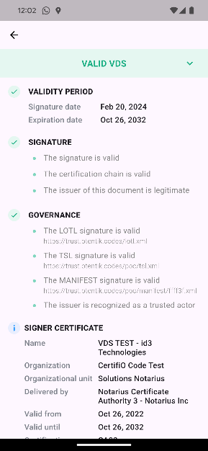
MICHELIN EPREL online (any reader) and offline (VDS)
trusted
environment
June 19th, 2024
2024年6月19日
Notes:
This time, the URL link stored in a QR code could be read by any Smartphone camera, and go online
Only the OTENTIK reader could also process the QR Code offline, display the credential and invite in a secure way to and go online

Slide 24
mobiLead competitive advantages mobiLead的竞争优势
  Pilot projects are now underway in several countries and some solution providers and brands are already cooperating to upgrade their platforms in order to support this new standard.
  目前这项新标准正在多个国家进行项目试点，许多解决方案供应商和品牌商已着手升级平台来应用此标准。
Much more than just a hash, more than an electronic signature, as verifiable credentials
    ISO/IEC 18004 and ISO/IEC 15415, QR Code
    ISO/IEC 14443 and NDEF, NFC
    ISO 22385, for establishing a framework for trust and interoperability,
    ISO 22376, for visible digital seals (VDS)
    ISO/IEC 20248, for DigSig digital signatures.
mobiLead offer the same level of security than French ID card, based on ISO norms, to any product including cosmetics, using the very same tool used by the French authorities while verifying an ID card, or an invoice.
Notes:
More than just a hash, more than an electronic signature, these are verifiable credentials
Pilot projects are now underway in several countries and some solution providers and brands are already cooperating to upgrade their platforms to support this new standard.
mobiLead offers the same level of security as the French ID card, based on ISO standards, for any product, including consumer goods, using the same tool used by French authorities when verifying an ID card or an invoice.

Slide 25
安全数字链接
Secured Digital Link
活性与智能包装
ACTIVE & INTELIGENT PACKAGING
亚洲峰会
SUMMIT ASIA
中国上海
Shanghai China
June 19th, 2024
2024年6月19日
解决方案供应商和技术专家
solution providers and technical experts
洛朗·托内利耶 - mobiLead，首席执行官
laurent.tonnelier@mobiLead.fr
Laurent TONNELIER - mobiLead, CEO
laurent.tonnelier@mobiLead.fr
25
Notes:
Any existing Link stored in a QR Code, a Hanxin Code, a Datamatrix… could be improved
In order to protected a code, a link or any related data;
In order to proof the origin of an information related to a product;
In order to provide a local information with no network needed;
In order to be compliant with the General Data Protection Regulation (GDPR), on privacy and security
ISO provides with a set of norms that are available to any company, especially in the field of interactive packaging.
The European Commission is working on these norms to design the future “Digital Product Passport”.
Limited today to the “Ecodesign for Sustanable Products Regulation”, this could soon be used by any industry in several use cases.
Understand the “Digital Product Passport” initiative today is important to any company doing commerce with Europe.
Thanks you for your attention.
I wish to be in shanghai, with you, next year.
Have a nice event and constructive networking.

