Slide 1


INTERNET of THINGS enabler
from unique identification
to related content and services
Notes:
Team: details on who you are, experience and qualifications
Our DNA: Large companies, Software
Technical expertise IoT, WoT, WoO
Market expertise
Marketing expertise
Existing Problem
Silos
Online offline
No network
Performances
QR Code and NFC are good candidates
• Unique Product/Company
R&D is good to be done from France
IP is protected in France
• Market Opportunity
Each consumer package good, each printed document,
each electonic printed document
• Competition/ co petition
Evrythng
Adent
with FRANCE BREVET
• Business model
IP Licencing
• Traction with users and customers
• Investment received, investment seeking, and what the money is for
Private money 94K€ (to be 150K€ by the end if June)
We want to turn this IP company, into a software company
Please confirm receipt of email and that you have selected a time,
and let me know if you have any questions. We look forward to meeting you!

Slide 2
From MDM data to PRINT and MOBILE Content
Product Information
PRINT
URL
NFC Tag
QR Code
Content

Slide 3
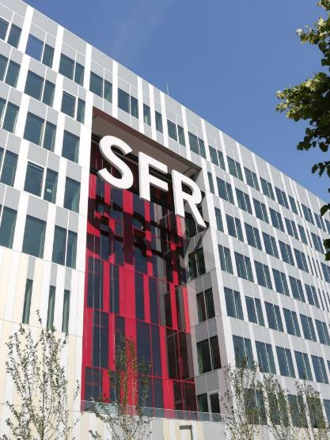
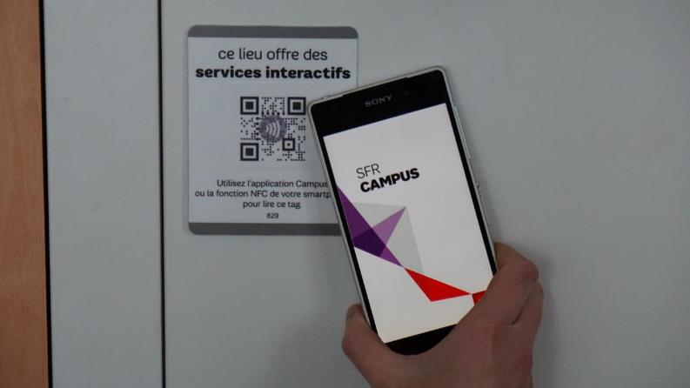
NFC Stickers
25 000 QR+ NFC tags

Slide 4

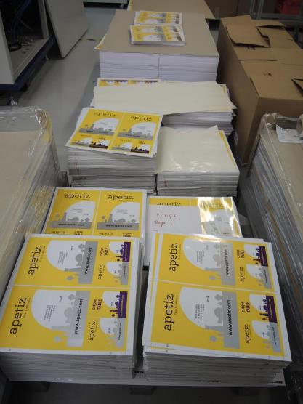
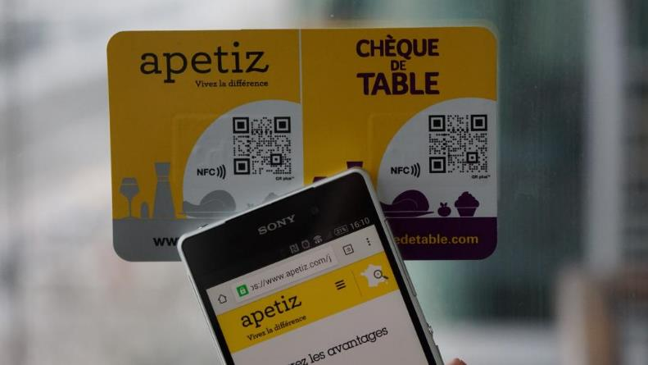
NFC Window Stickers
225 000 QR+ NFC tags

Slide 5

Sensors
” 26 Billion Units by 2020 ” Gartner
Devices
M2M
INTERNET OF THINGS
Unique IDs
URL based
NFC Tags
QR Codes
Audio Tags
Documents
Cards
Labels
Consumer Packaged Goods
Notes:
INTERNET DES OBJETS (IoT)

Slide 6
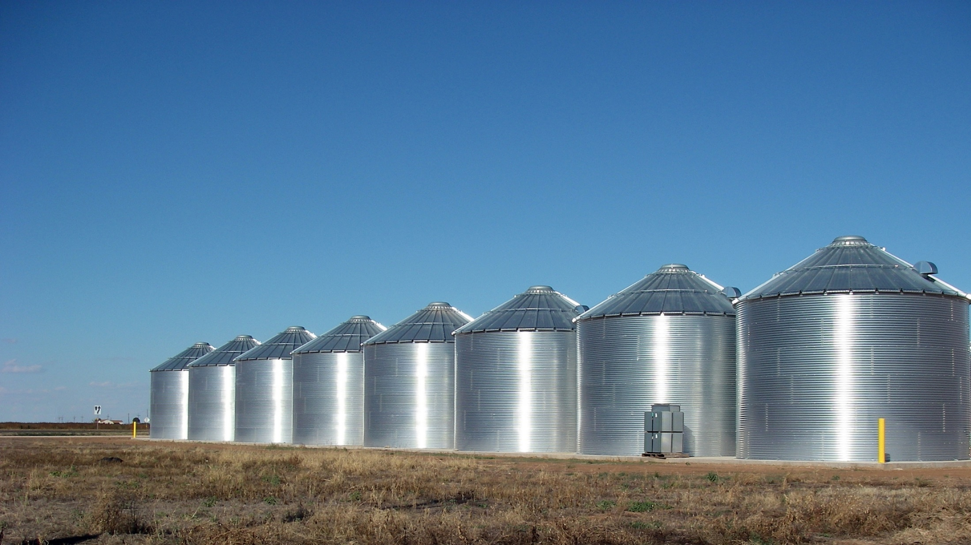
SeveraL USAGES
Marketing, Commerce, Logistic…
Ralls, Texas – Grain silos
Notes:
Existing Problem
Silos
Online offline
No network
Performances

Slide 7
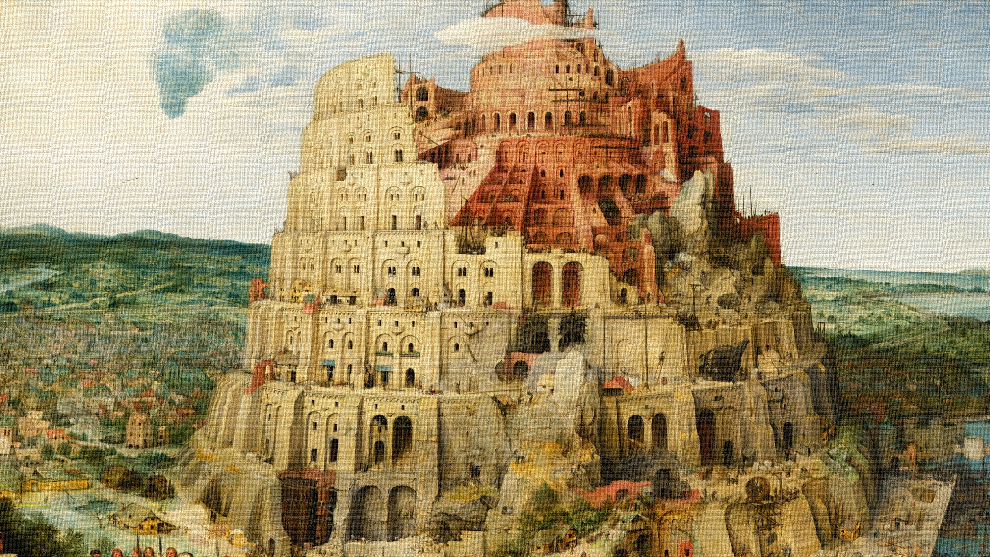
SEVERAL TECHNOLOGIES
QR, DM, UPC, NFC…
Babel Tour, Pieter Bruegel
Notes:
La Tour de Babel (1 563) de Pieter Bruegel
Existing problems
Online offline
No network
Performances

Slide 8
Convergence of Technologies
Anti
counterfeiting
Marketing
3779000000576
Commerce
Identification
Ticketing
Logistics

Slide 9
different Point of Views
Anti
counterfeiting
Marketing
Personalization
Unitary Tracking
One to One Marketing
Commerce
Identification
Ticketing
Logistics

Slide 10
Driven by Innovation, a unique and original approach
Brand
Product
Variant
Batch
Item
SKU / GTIN
Ingredients
Allergens
sGTIN
UUID
Exp.
Every
Each
Cold data
Warm data
Variable Printing
Unitary
Tagging

Slide 11
MOBILEAD, committed to Norms and Standards
Best Practices
SYSTEMATIC
CNRFID
AIPIA
Norms
AFNOR
ISO
Standards
GS1
W3C
Notes:
http://www.centrenational-rfid.com/mobilead-offreurs-fiche-494-fr-ruid-1.html?searchtype=Fulltext&searchstring=A

Slide 12
MOBILEAD, selected by ORACLE Startup Initiative
Integrated with ORACLE
ERP
Pedigree and Serialization Manager
IOT Orchestrator
But not limited to…
Notes:
Team: details on who you are, experience and qualifications
Our DNA: Large companies, Software
Technical expertise IoT, WoT, WoO
Market expertise
Marketing expertise

Slide 13

MOBILEAD, selected by FRANCE BREVETS fund
FRANCE BREVETS is an investment fund dedicated to international patent licensing
MOBILEAD recognize FRANCE BREVETS for its professional technical expertise and long term vision
Notes:
Team: details on who you are, experience and qualifications
Our DNA: Large companies, Software
Technical expertise IoT, WoT, WoO
Market expertise
Marketing expertise

Slide 14
Global Intellectual Property policy
Licensing
Sharing
Influence
Expertise
Long term vision
Knowledge

Slide 15
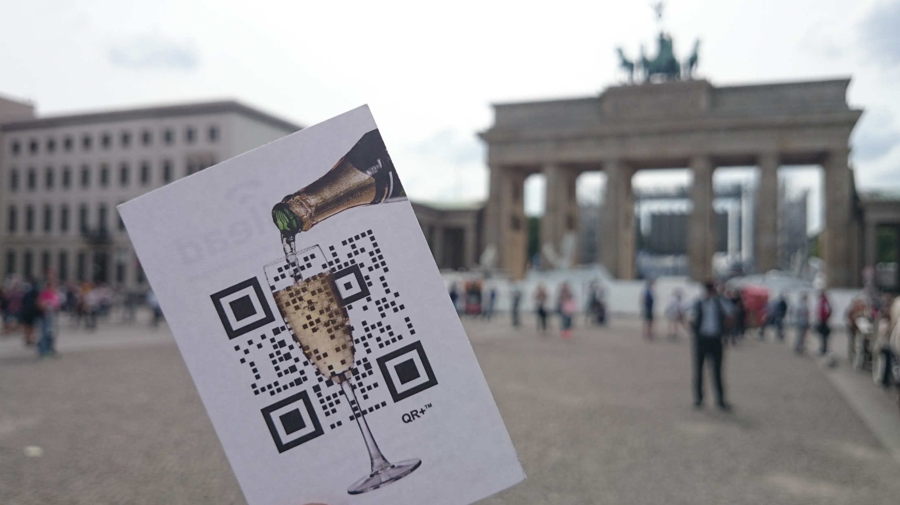
QR+ Image fusion (patent #1)

Slide 16
QR+ Image fusion (patent #1)
« Barcodes do not have to be just cold, emotionless, black and white squares. Solutions nows exist… mobiLead. »
Thomas Husson,
Analyst – Forrester Research
« The QR plus technical feat of strength puts mobiLead well ahead of the competition. »
Bruno Rolland
Axicon, Barcode Expert

Slide 17

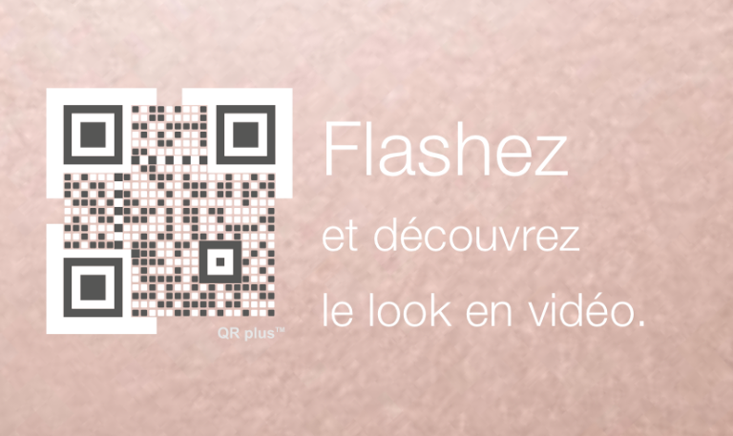
Quality delivered
ISO Certified QR Codes

Slide 18
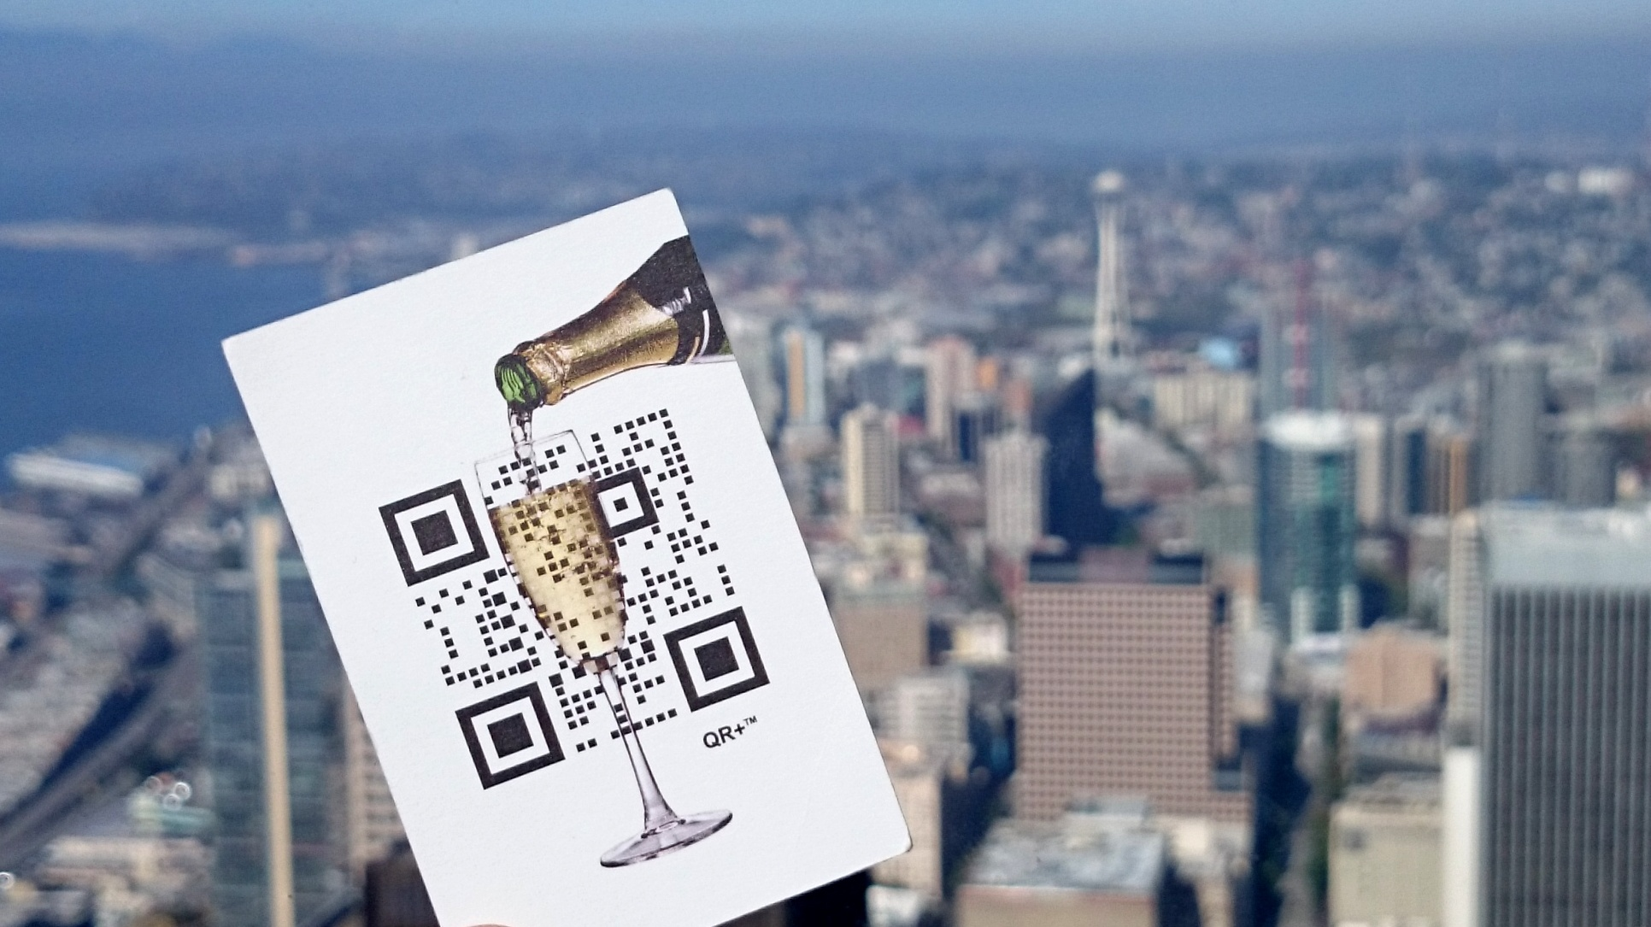
Semantic URLs / IOT (patent #2)

Slide 19
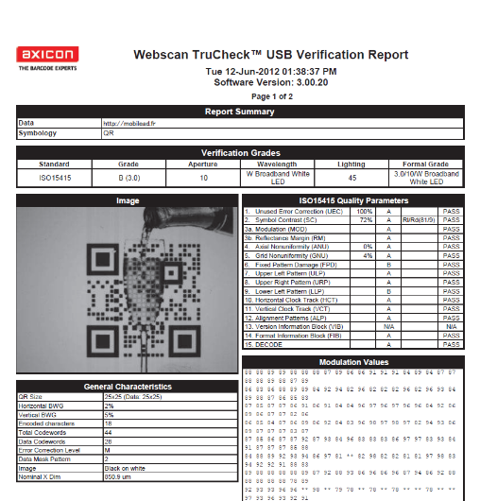
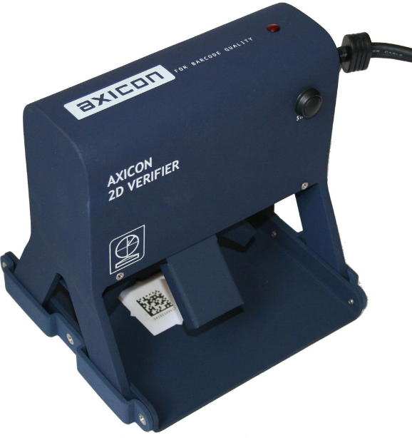

High Quality Grade
Notes:
Highly Graphical QR Code (QR+)
ISO / IEC 18004 compliance
Custom URL domain name
Optimised Codification

Slide 20

GS1 Partner in CPG
Notes:
GTIN: http://mt.ag/5bFEcQ8

Slide 21
Marketing and Commerce combined
URL and GS1 GTIN (EAN/UPC) in a QR
Leverage existing
Identifiers
3779000000576
GTIN
URL (GTIN)
Tag NFC
QR Code
Contenu (GTIN)
Notes:
Mobile
Web Organisation
Salon de l'emballage
GS1 identification
in the physical world, the number used in a UPC barcode
represents the global trade item number or G-ten
that identifies that item around the world
encoding a global trade item number in a URL link

Slide 22
Driven by Innovation, a unique and original approach
Where…
Geocoding
Region
What…
Label Signature
Product Signature
URL based
Unique ID
When…
Timestamp
Period of Time
What…
ERP Identifier
With…
Visual Identifier
What…
GTIN Identifier
Coded
Cyphered

Slide 23
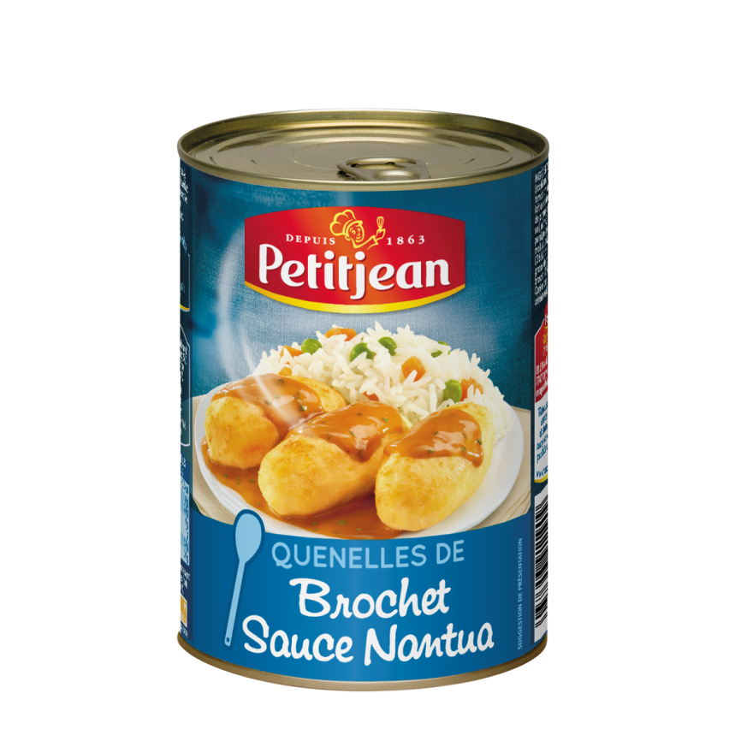
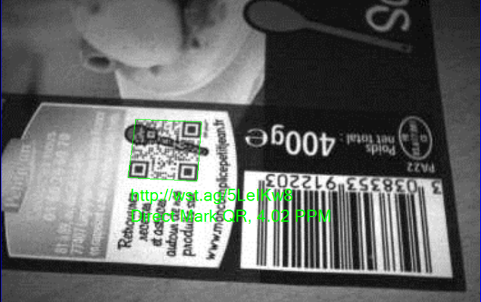
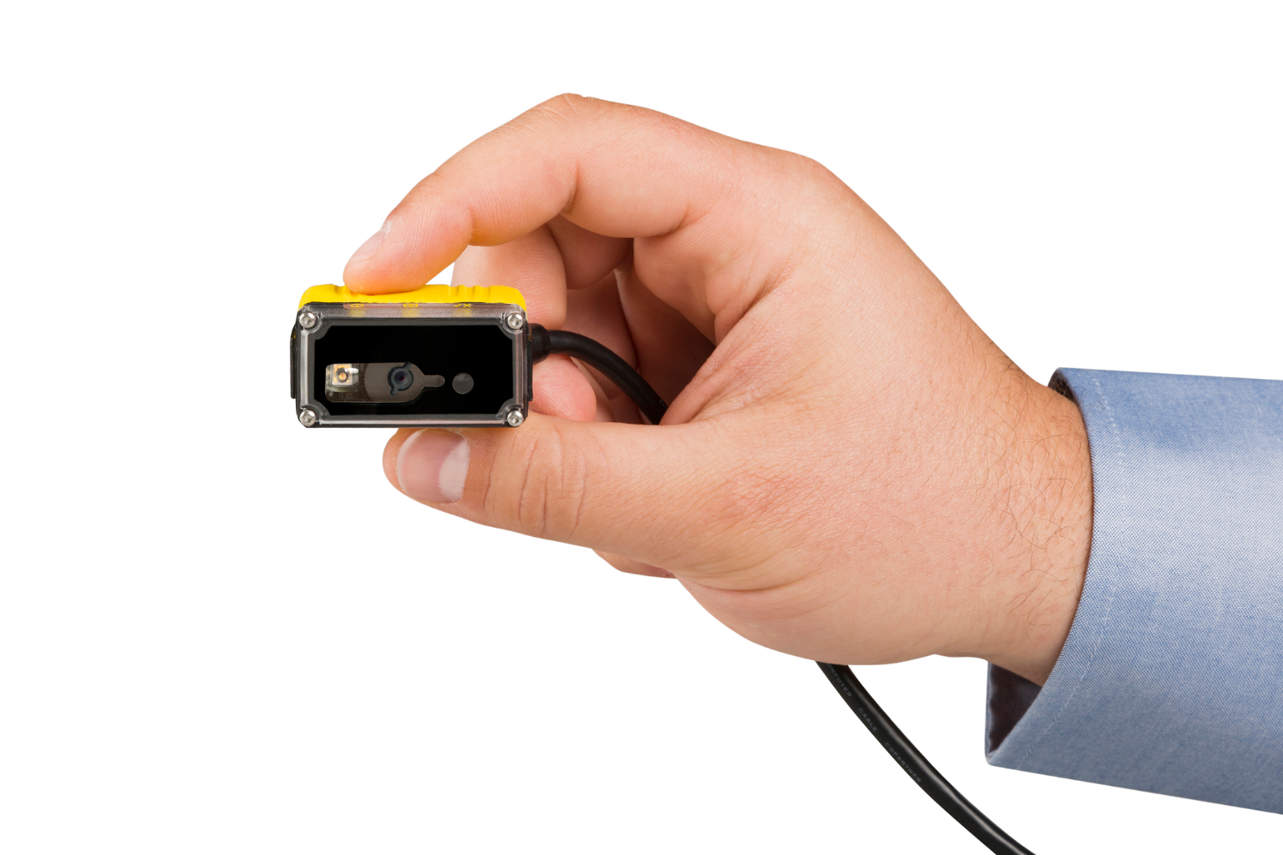
Marketing and Commerce combined
URL and GS1 GTIN in a Graphical QR
Notes:
Highly Graphical QR Code (QR+)
ISO / IEC 18004 compliance
Custom URL domain name
Optimised Codification

Slide 24
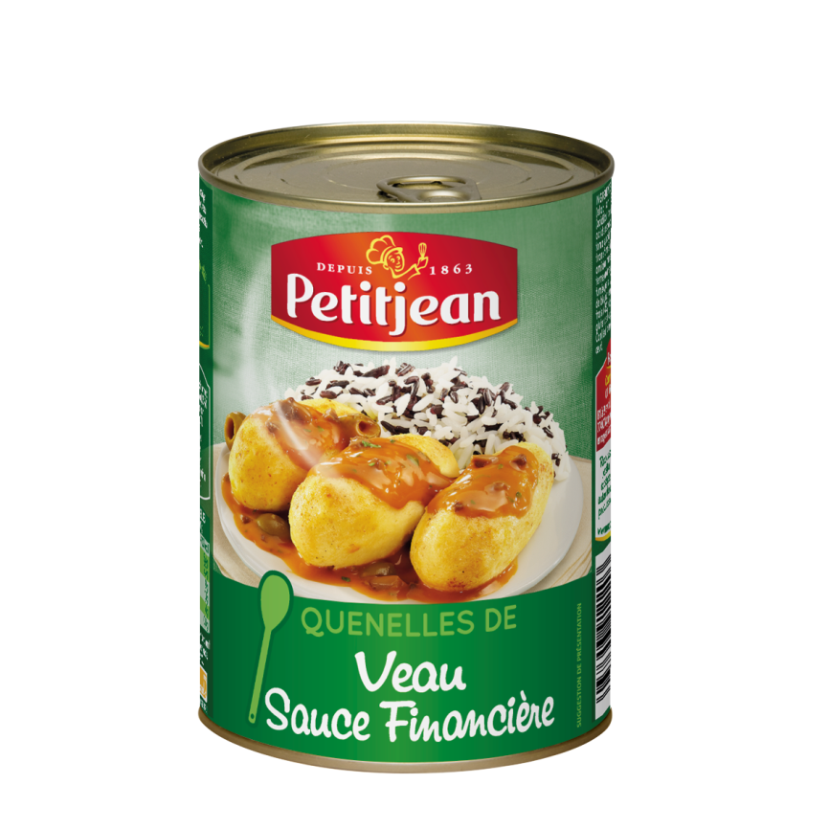
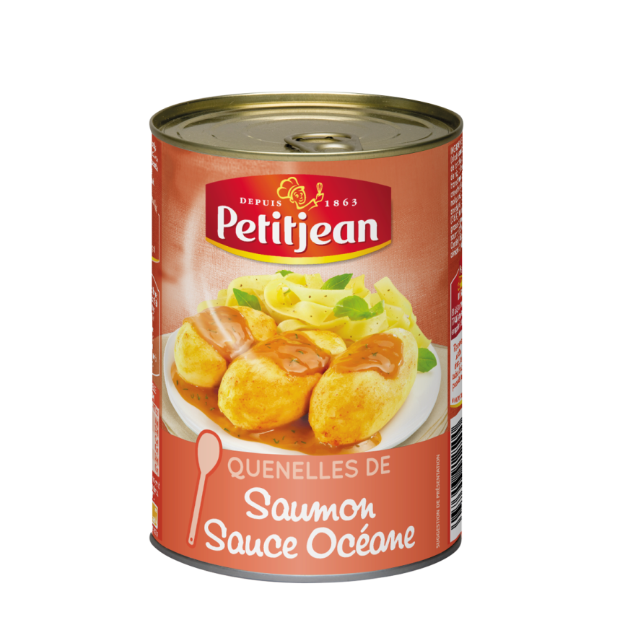
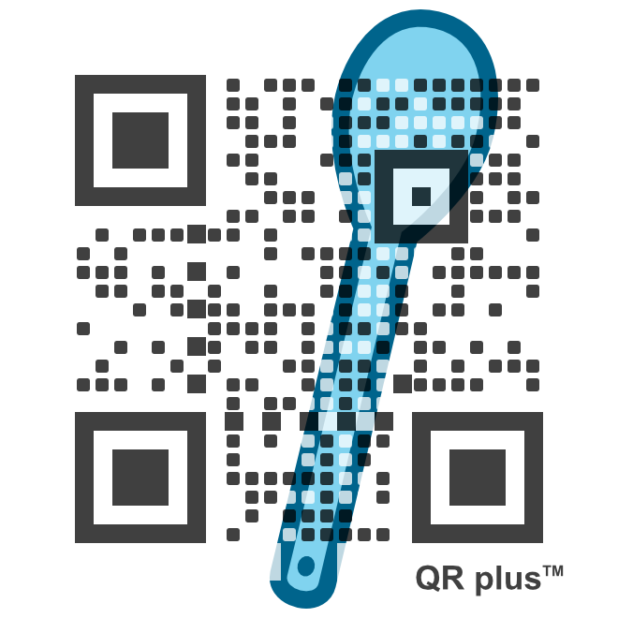
Marketing and Commerce combined
URL and GS1 GTIN in a Graphical QR
Notes:
ISO, W3C

Slide 25
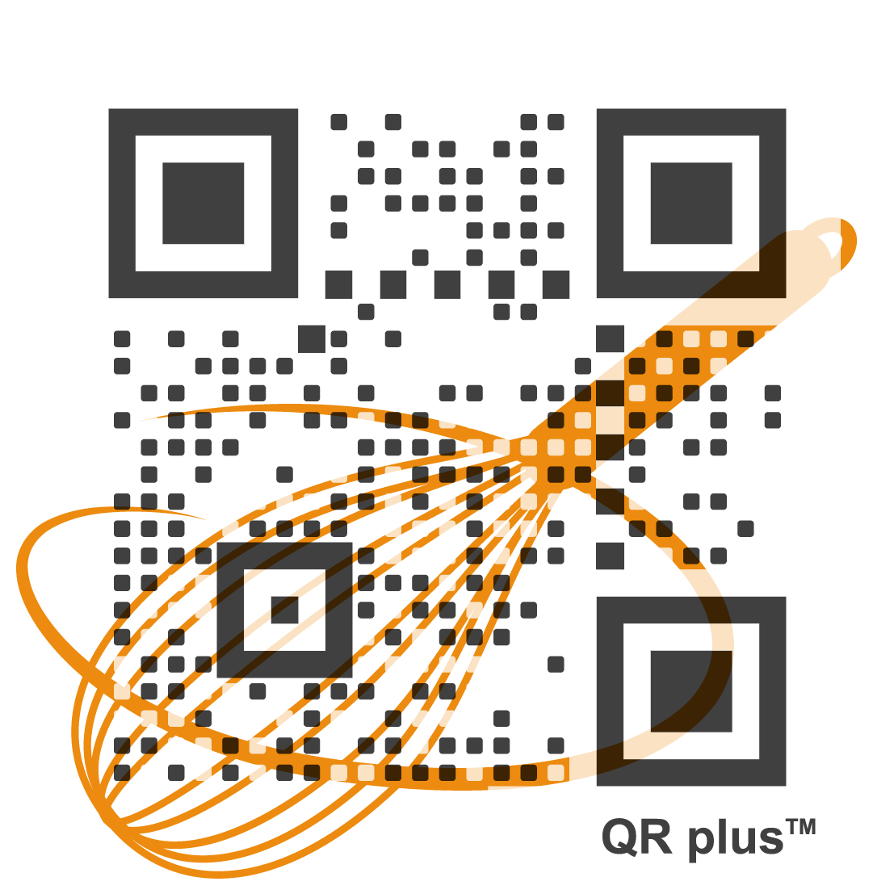
Marketing and Commerce combined
URL and GS1 GTIN in a Graphical QR
Notes:
ISO, W3C

Slide 26

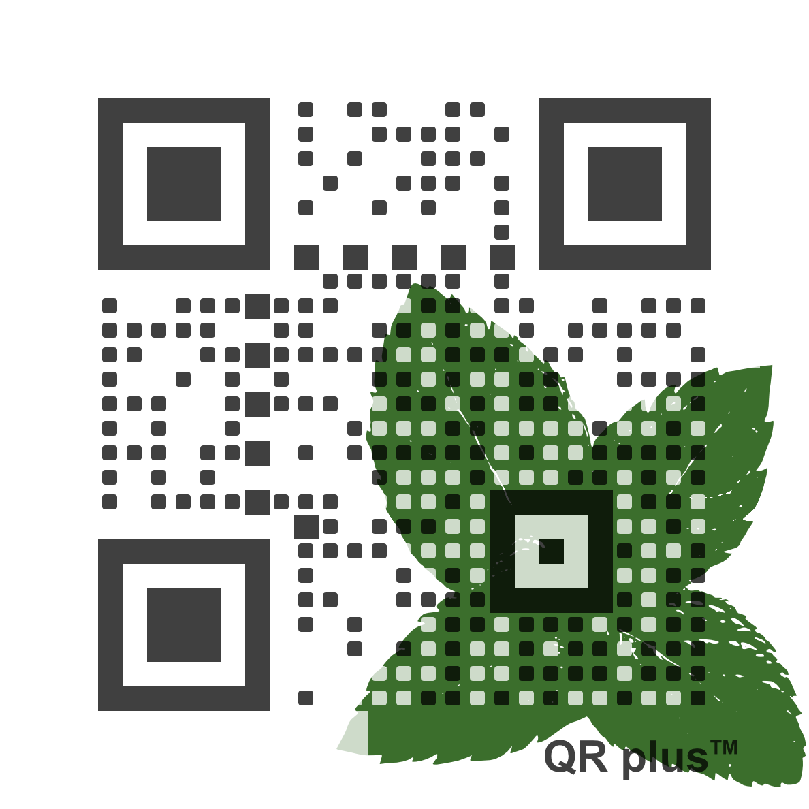

Marketing and Commerce combined
URL and GS1 GTIN in a Graphical QR
Notes:
ISO, W3C
http://wst.ag/5LeI8AM
http://www.garbit.fr/#3038353421309
1 modèle graphique optimisé : (QR plus) moins intrusif + image
Permettant création de séries de codes tous différents adoptant le même visuel

Slide 27
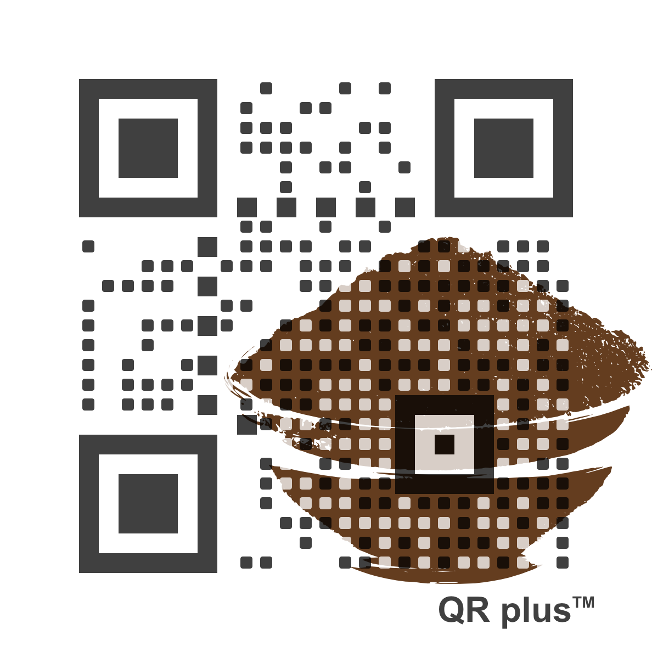
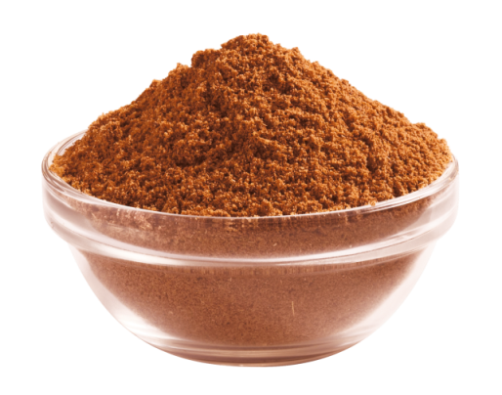
Marketing and Commerce combined
Graphical QR, URL and GS1 GTIN
Notes:
ISO, W3C

Slide 28
Driven by Innovation, a unique and original approach
Where…
Geocoding
Region
What…
Label Signature
Product Signature
URL based
Unique ID
When…
Timestamp
Period of Time
What…
ERP Identifier
With…
Visual Identifier
What…
GTIN Identifier
Coded
Cyphered

Slide 29
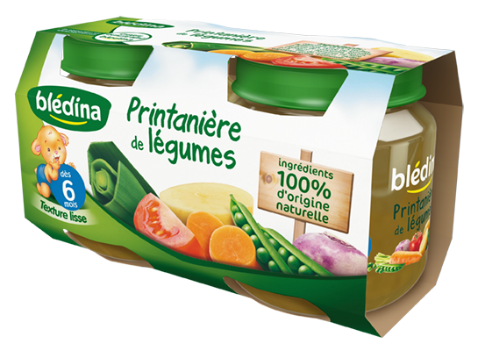
Marketing, Logistics, Commerce combined
URL and GS1 GTIN in a QR
Notes:
ISO, W3C

Slide 30
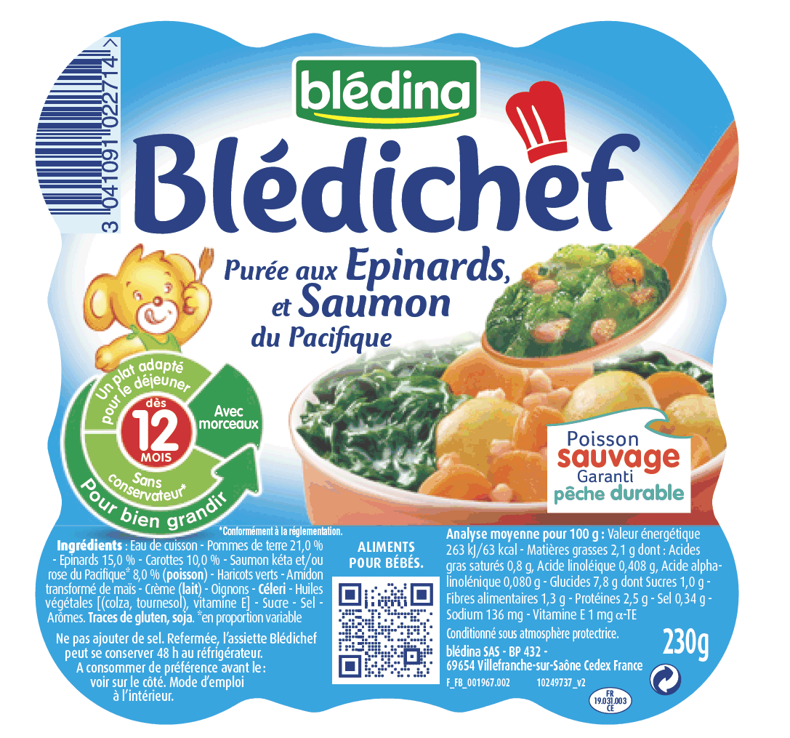
Marketing, Logistics, Commerce combined
URL, ERP ID, Exp. and GTIN in a QR
Notes:
ISO, W3C

Slide 31
Unitary Tagging and Variable Digital Printing
Each object, each pack, each label is made Unique
MOBILEAD works with HP an DOMINO Digital Printing
But not limited to…
Notes:
Team: details on who you are, experience and qualifications
Our DNA: Large companies, Software
Technical expertise IoT, WoT, WoO
Market expertise
Marketing expertise

Slide 32
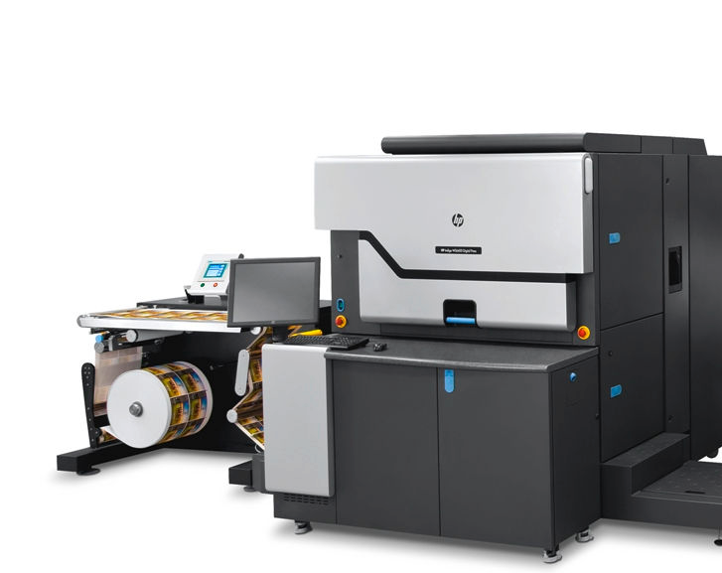
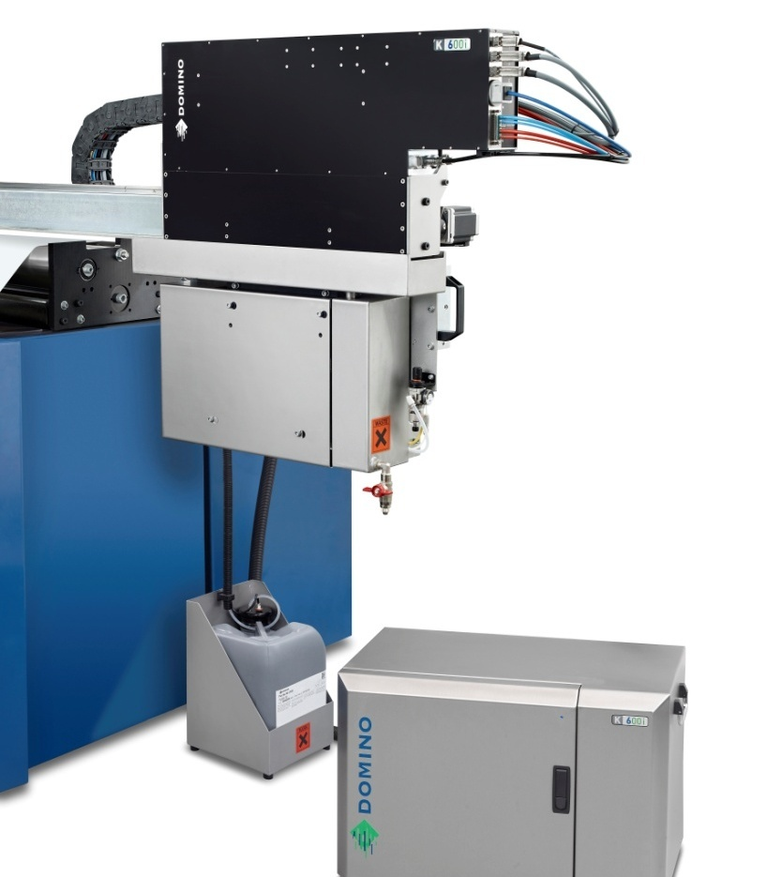
Unitary Tagging and Variable Digital Printing
Drop on Demand
Notes:
Unitary marking

Slide 33
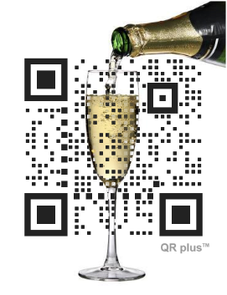

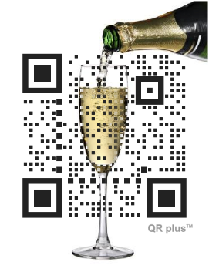

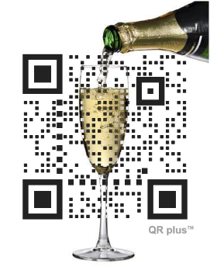

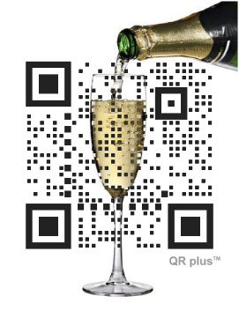

Unitary Tagging and
Variable Digital Printing

Slide 34
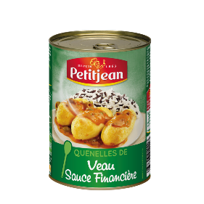
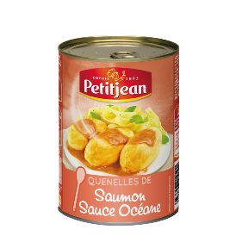

Unitary Tagging and Variable Digital Printing
Scalable Solutions (patent #2)
Brand level
SKU level
Unitary level
Patent #2
Notes:
Personnel
MultiMedia
Connecté

Slide 35
Unitary Tagging and Variable Digital Printing
Scalable Solutions (patent #2)
Batch #1
Batch #2
Unitary level
Patent #2
Notes:
Personnel
MultiMedia
Connecté

Slide 36
Driven by Innovation, a unique and original approach
Where…
Geocoding
Region
What…
Label Signature
Product Signature
URL based
Unique ID
When…
Timestamp
Period of Time
What…
ERP Identifier
With…
Visual Identifier
What…
GTIN Identifier
Coded
Cyphered

Slide 37
Driven by Innovation, a unique and original approach
Where…
Geocoding
Region
What…
Label Signature
Product Signature
URL based
Unique ID
When…
Timestamp
Period of Time
What…
ERP Identifier
With…
Visual Identifier
What…
GTIN Identifier
Coded
Cyphered

Slide 38
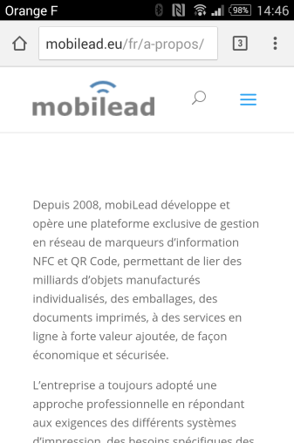
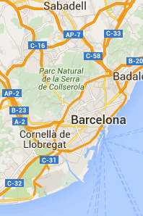
From one Tag to several usages
Marketing & Semantic Anticounterfeiting
Anti Count. Grey Market
Marketing
Public
Online
Web App
Private
Online/Offline
Map
Application

Slide 39
Driven by Innovation, a unique and original approach
Where…
Geocoding
Region
What…
Label Signature
Product Signature
URL based
Unique ID
When…
Timestamp
Period of Time
What…
ERP Identifier
With…
Visual Identifier
What…
GTIN Identifier
Coded
Cyphered

Slide 40
From one Tag to several usages
Marketing & Semantic Anticounterfeiting
Anti
counterfeiting
Marketing
Public
Remote
Web App
Private
Local Control
Application

Slide 41
Driven by Innovation, a unique and original approach
Where…
Geocoding
Region
What…
Label Signature
Product Signature
URL based
Unique ID
When…
Timestamp
Period of Time
What…
ERP Identifier
With…
Visual Identifier
What…
GTIN Identifier
Coded
Cyphered

Slide 42
From one Tag to several usages
Marketing & Visual Anticounterfeiting
Anti
counterfeiting
Marketing
Public
Remote
Web App
Private
Local Draw
Application

Slide 43
Driven by Innovation, a unique and original approach
Where…
Geocoding
Region
What…
Label Signature
Product Signature
URL based
Unique ID
When…
Timestamp
Period of Time
What…
ERP Identifier
With…
Visual Identifier
What…
GTIN Identifier
Coded
Cyphered

Slide 44
Driven by Innovation, a unique and original approach
Not only…
… But also
We are able to create hundreds, thousands, millions, billions of uniques URL Links.
We are able to provide Unique IDs, Unique URLs, Unique Tags (QR Code, NFC)
We are able to manage each link on the serveur side, on premise, or locally.
We are able to provide integrated solutions, software licences, algorithms, patent IP licences thru FRANCE BREVET
Notes:
Team: details on who you are, experience and qualifications
Our DNA: Large companies, Software
Technical expertise IoT, WoT, WoO
Market expertise
Marketing expertise
Existing Problem
Silos
Online offline
No network
Performances
QR Code and NFC are good candidates
• Unique Product/Company
R&D is good to be done from France
IP is protected in France
• Market Opportunity
Each consumer package good, each printed document,
each electonic printed document
• Competition/ co petition
Evrythng
Adent
with FRANCE BREVET
• Business model
IP Licencing
• Traction with users and customers
• Investment received, investment seeking, and what the money is for
Private money 94K€ (to be 150K€ by the end if June)
We want to turn this IP company, into a software company
Please confirm receipt of email and that you have selected a time,
and let me know if you have any questions. We look forward to meeting you!

Slide 45
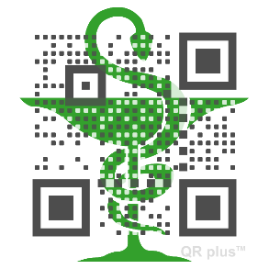
Driven by Innovation, a unique and original approach
Not only…
… But also
We do believe in Research and Development, Intellectual Properties
We are willing to share our IP with others, to be part of Norms, Standards and Best Practices – including Open Innovation.
Notes:
Team: details on who you are, experience and qualifications
Our DNA: Large companies, Software
Technical expertise IoT, WoT, WoO
Market expertise
Marketing expertise
Existing Problem
Silos
Online offline
No network
Performances
QR Code and NFC are good candidates
• Unique Product/Company
R&D is good to be done from France
IP is protected in France
• Market Opportunity
Each consumer package good, each printed document,
each electonic printed document
• Competition/ co petition
Evrythng
Adent
with FRANCE BREVET
• Business model
IP Licencing
• Traction with users and customers
• Investment received, investment seeking, and what the money is for
Private money 94K€ (to be 150K€ by the end if June)
We want to turn this IP company, into a software company
Please confirm receipt of email and that you have selected a time,
and let me know if you have any questions. We look forward to meeting you!

Slide 46
Driven by Innovation, a unique and original approach
Not only…
… But also
We are able to create Unique URL links, either QR Code or NFC tag, to personalized and tailored content.
We are able to provide remotely on a distant machine such a MDM product information server
We are able to create Unique IDentifiers that contains coded and cyphered information.
We are able to provide local information, or premises, without network required.
Notes:
Team: details on who you are, experience and qualifications
Our DNA: Large companies, Software
Technical expertise IoT, WoT, WoO
Market expertise
Marketing expertise
Existing Problem
Silos
Online offline
No network
Performances
QR Code and NFC are good candidates
• Unique Product/Company
R&D is good to be done from France
IP is protected in France
• Market Opportunity
Each consumer package good, each printed document,
each electonic printed document
• Competition/ co petition
Evrythng
Adent
with FRANCE BREVET
• Business model
IP Licencing
• Traction with users and customers
• Investment received, investment seeking, and what the money is for
Private money 94K€ (to be 150K€ by the end if June)
We want to turn this IP company, into a software company
Please confirm receipt of email and that you have selected a time,
and let me know if you have any questions. We look forward to meeting you!

Slide 47
INTERNET of THINGS enabler
from unique identification
to related content and services
Notes:
Team: details on who you are, experience and qualifications
Our DNA: Large companies, Software
Technical expertise IoT, WoT, WoO
Market expertise
Marketing expertise
Existing Problem
Silos
Online offline
No network
Performances
QR Code and NFC are good candidates
• Unique Product/Company
R&D is good to be done from France
IP is protected in France
• Market Opportunity
Each consumer package good, each printed document,
each electonic printed document
• Competition/ co petition
Evrythng
Adent
with FRANCE BREVET
• Business model
IP Licencing
• Traction with users and customers
• Investment received, investment seeking, and what the money is for
Private money 94K€ (to be 150K€ by the end if June)
We want to turn this IP company, into a software company
Please confirm receipt of email and that you have selected a time,
and let me know if you have any questions. We look forward to meeting you!

