Slide 1


Smart Packaging and IoT Platform
from unique identification
to related content and services
Notes:
Team: details on who you are, experience and qualifications
Our DNA: Large companies, Software
Technical expertise IoT, WoT, WoO
Market expertise
Marketing expertise
Existing Problem
Silos
Online offline
No network
Performances
QR Code and NFC are good candidates
• Unique Product/Company
R&D is good to be done from France
IP is protected in France
• Market Opportunity
Each consumer package good, each printed document,
each electonic printed document
• Competition/ co petition
Evrythng
Adent
with FRANCE BREVET
• Business model
IP Licencing
• Traction with users and customers
• Investment received, investment seeking, and what the money is for
Private money 94K€ (to be 150K€ by the end if June)
We want to turn this IP company, into a software company
Please confirm receipt of email and that you have selected a time,
and let me know if you have any questions. We look forward to meeting you!

Slide 2
from MDM data to PRINT and MOBILE Content
Product Information
PRINT
URL
NFC Tag
QR Code
Content

Slide 3
from Convergence to Point of Views
Anti
counterfeiting
Marketing
3779000000576
Commerce
Identification
Ticketing
Logistics
Personalization
Unitary Tracking
One to One Marketing

Slide 4

Driven by Innovation, a unique and original approach
Brand
Product
Batch
Item
SKU / GTIN
Ingredients
Allergens
sGTIN
UUID
Exp.
Every
Each
Cold data
Warm data
Variable Printing
Unitary
Tagging

Slide 5
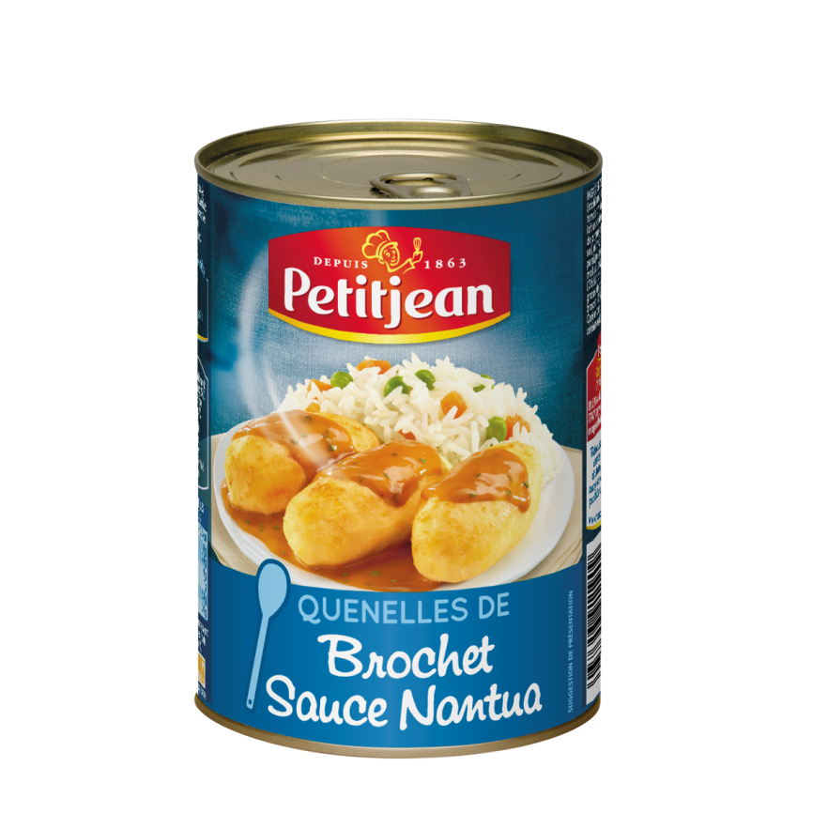
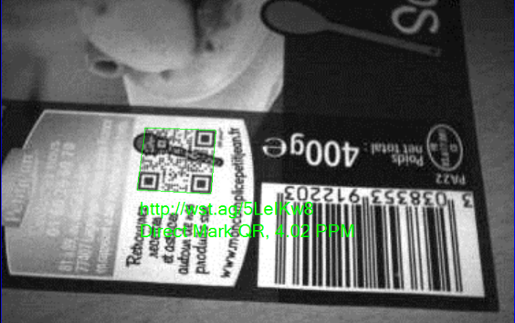
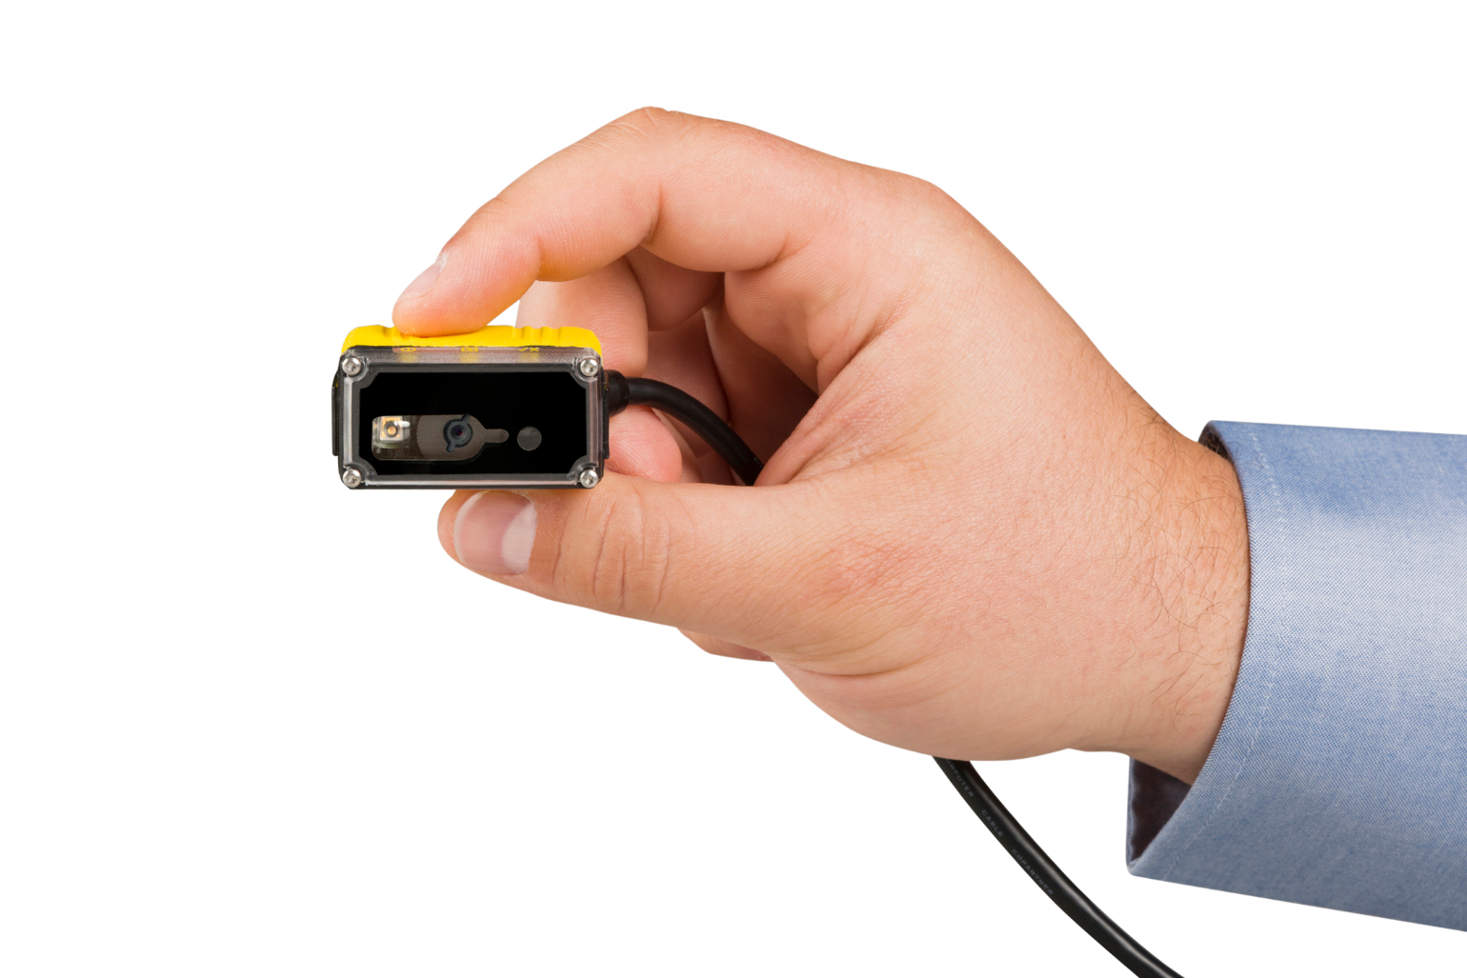
Marketing and Commerce combined
URL and GS1 GTIN in a Graphical QR
Notes:
Highly Graphical QR Code (QR+)
ISO / IEC 18004 compliance
Custom URL domain name
Optimised Codification

Slide 6
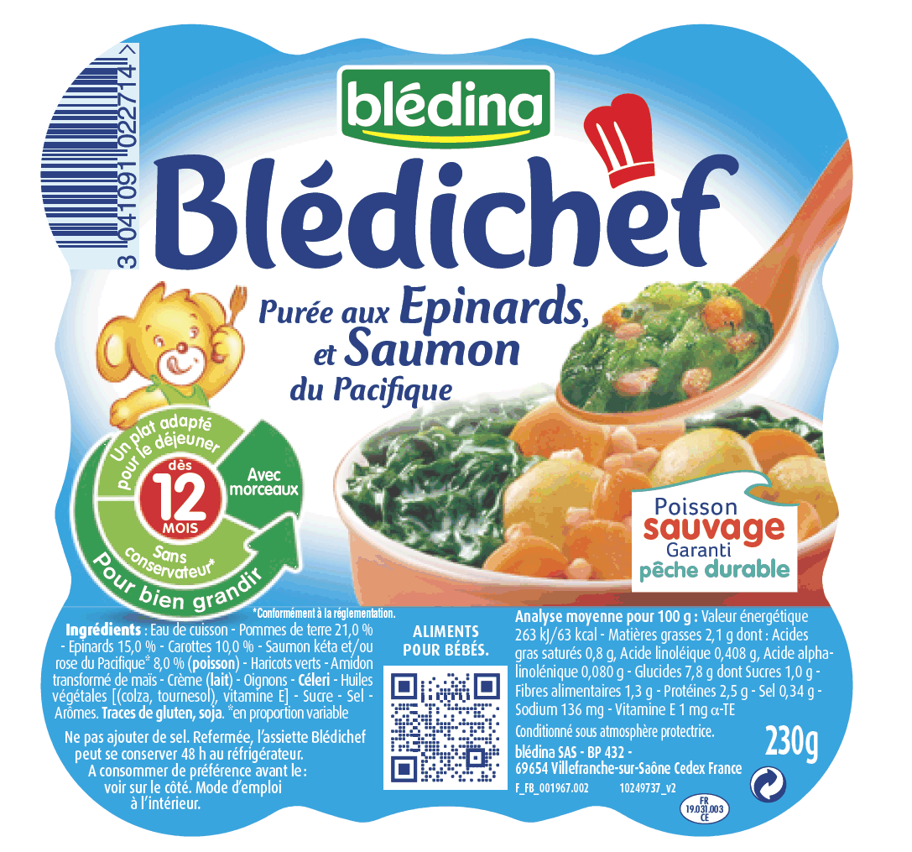
Marketing, Logistics, Commerce combined
URL, Logistics ID and GS1 GTIN in a QR
Notes:
ISO, W3C

Slide 7

Driven by Innovation, a unique and original approach
Where…
Geocoding
Region
What…
Label Signature
Product Signature
URL based
Unique ID
When…
Timestamp
Period of Time
What…
ERP Identifier
With…
Visual Identifier
What…
GTIN Identifier
Coded
Cyphered

