Slide 1
INTERNET of THINGS enabler
from unique identification
(product, packaging, label)
to related content and services
Laurent TONNELIER
March 2016
Paris, France
mobiLead, CEO
lt@mobilead.fr
Notes:
Team: details on who you are, experience and qualifications
Our DNA: Large companies, Software
Technical expertise IoT, WoT, WoO
Market expertise
Marketing expertise
Existing Problem
Silos
Online offline
No network
Performances
QR Code and NFC are good candidates
• Unique Product/Company
R&D is good to be done from France
IP is protected in France
• Market Opportunity
Each consumer package good, each printed document,
each electonic printed document
• Competition/ co petition
Evrythng
Adent
with FRANCE BREVET
• Business model
IP Licencing
• Traction with users and customers
• Investment received, investment seeking, and what the money is for
Private money 94K€ (to be 150K€ by the end if June)
We want to turn this IP company, into a software company
Please confirm receipt of email and that you have selected a time,
and let me know if you have any questions. We look forward to meeting you!

Slide 2
From MDM data to PRINT and MOBILE Content
Product Information
PRINT
URL
NFC Tag
QR Code
Content

Slide 3

Sensors
” 26 Billion Units by 2020 ” Gartner
Devices
M2M
INTERNET OF THINGS
Unique IDs
URL based
NFC Tags
QR Codes
Audio Tags
Documents
Cards
Labels
Consumer Packaged Goods
Notes:
INTERNET DES OBJETS (IoT)

Slide 4
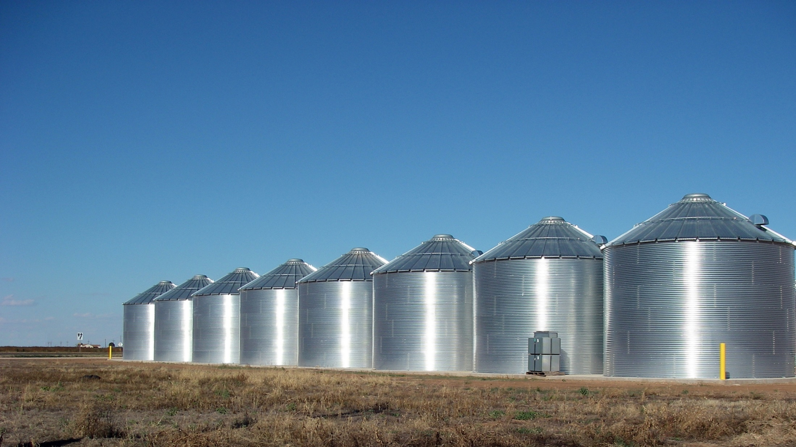
SeveraL USAGES
Marketing, Commerce, Logistic…
Ralls, Texas – Grain silos
Notes:
Existing Problem
Silos
Online offline
No network
Performances

Slide 5
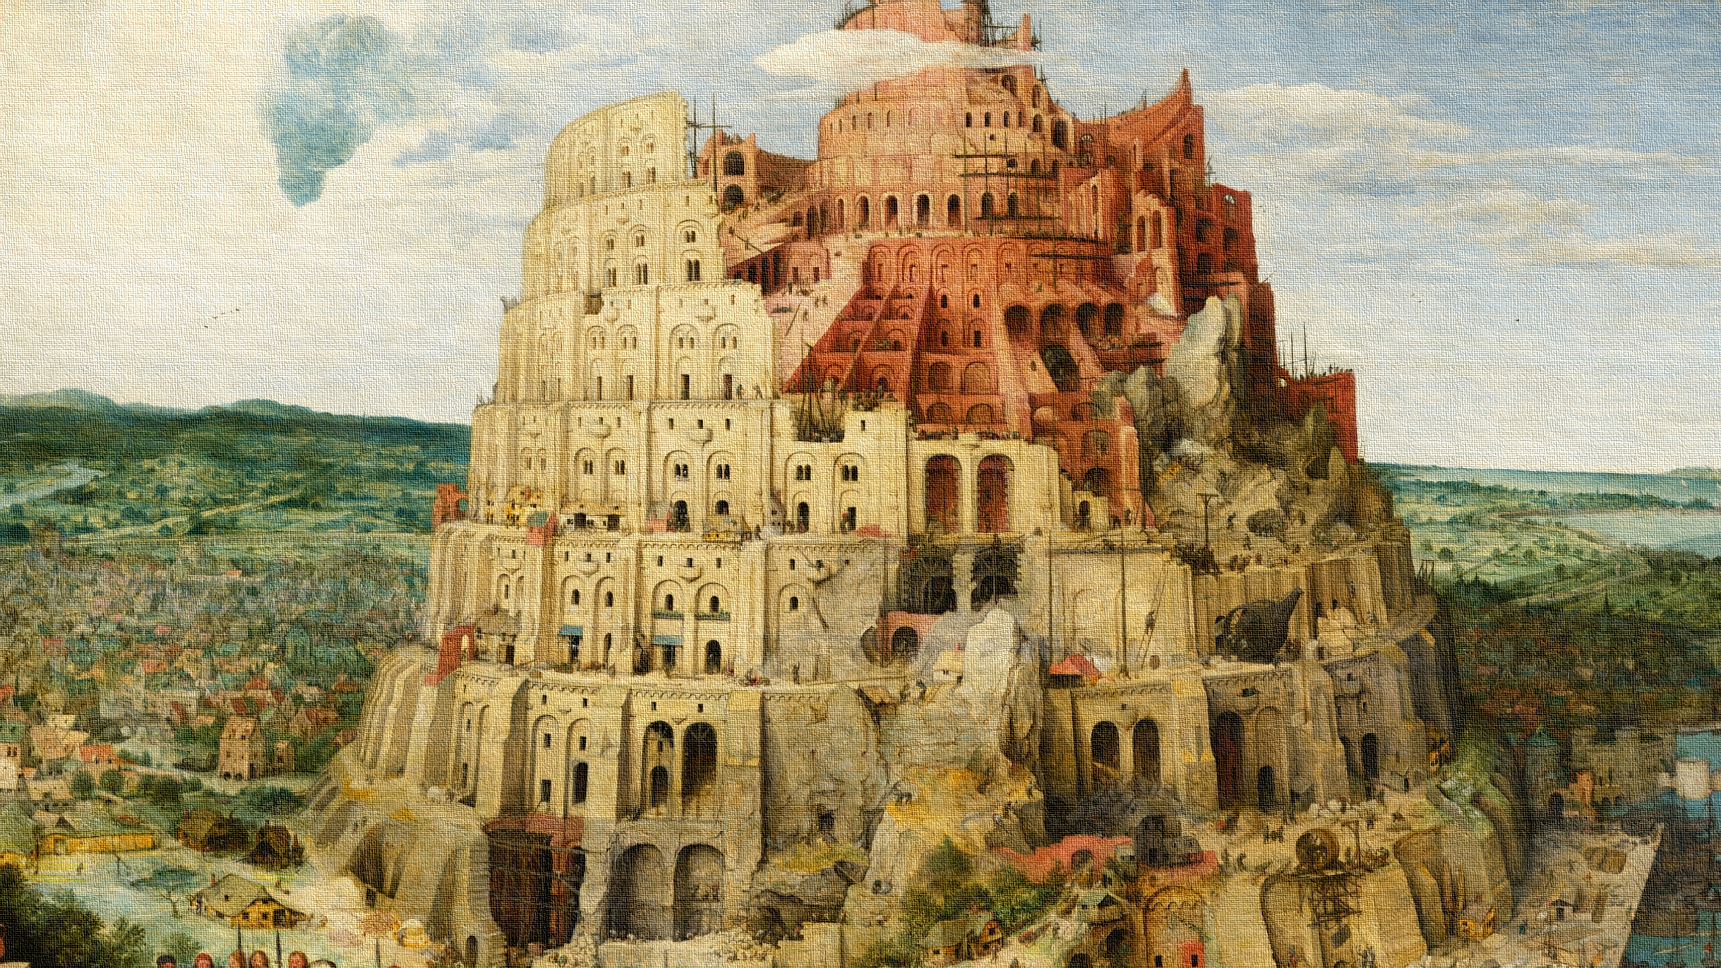
SEVERAL TECHNOLOGIES
QR, DM, UPC, NFC…
Babel Tour, Pieter Bruegel
Notes:
La Tour de Babel (1 563) de Pieter Bruegel
Existing problems
Online offline
No network
Performances

Slide 6
Convergence of Technologies
Anti
counterfeiting
Marketing
3779000000576
Commerce
Identification
Ticketing
Logistics

Slide 7
different Point of Views
Anti
counterfeiting
Marketing
Personalization
Unitary Tracking
One to One Marketing
Commerce
Identification
Ticketing
Logistics

Slide 8


MOBILEAD, committed to Norms and Standards
Best Practices
SYSTEMATIC
CNRFID
AIPIA
Norms
AFNOR
ISO
Standards
GS1
W3C
Notes:
http://www.centrenational-rfid.com/mobilead-offreurs-fiche-494-fr-ruid-1.html?searchtype=Fulltext&searchstring=A

Slide 9
Driven by Innovation, a unique and original approach
Brand
Product
Variant
Batch
Item
SKU / GTIN
Ingredients
Allergens
sGTIN
UUID
Exp.
Every
Each
Cold data
Warm data
Variable Printing
Unitary
Tagging

Slide 10
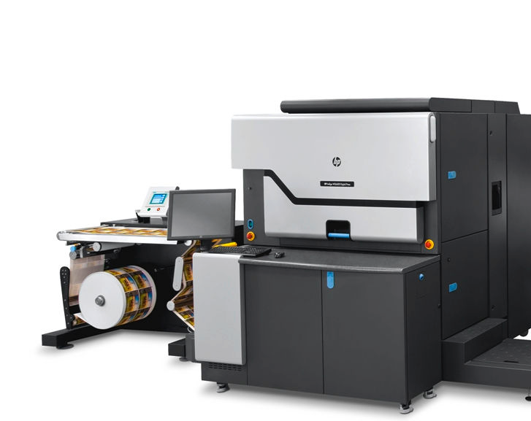
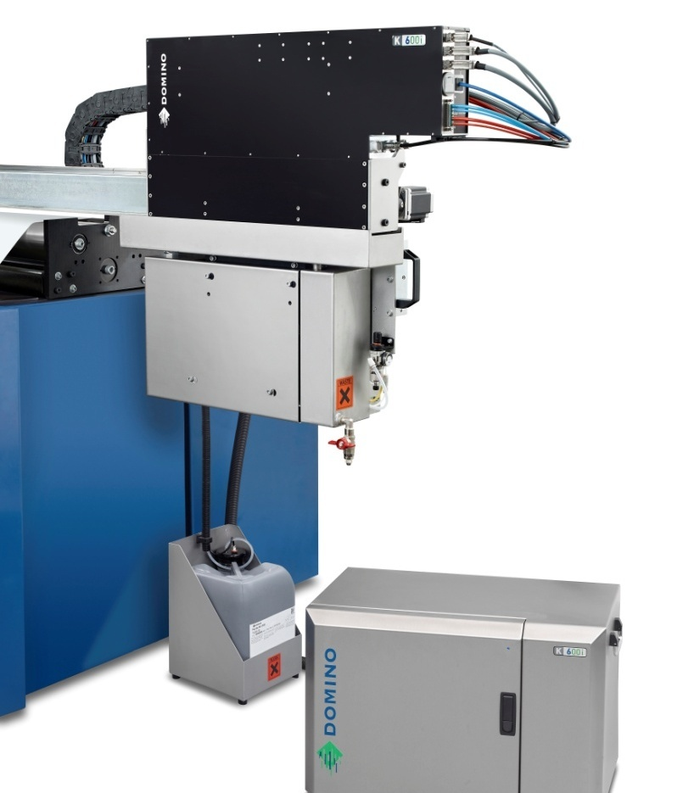
Unitary Tagging and Variable Digital Printing
Drop on Demand
Notes:
Unitary marking

Slide 11

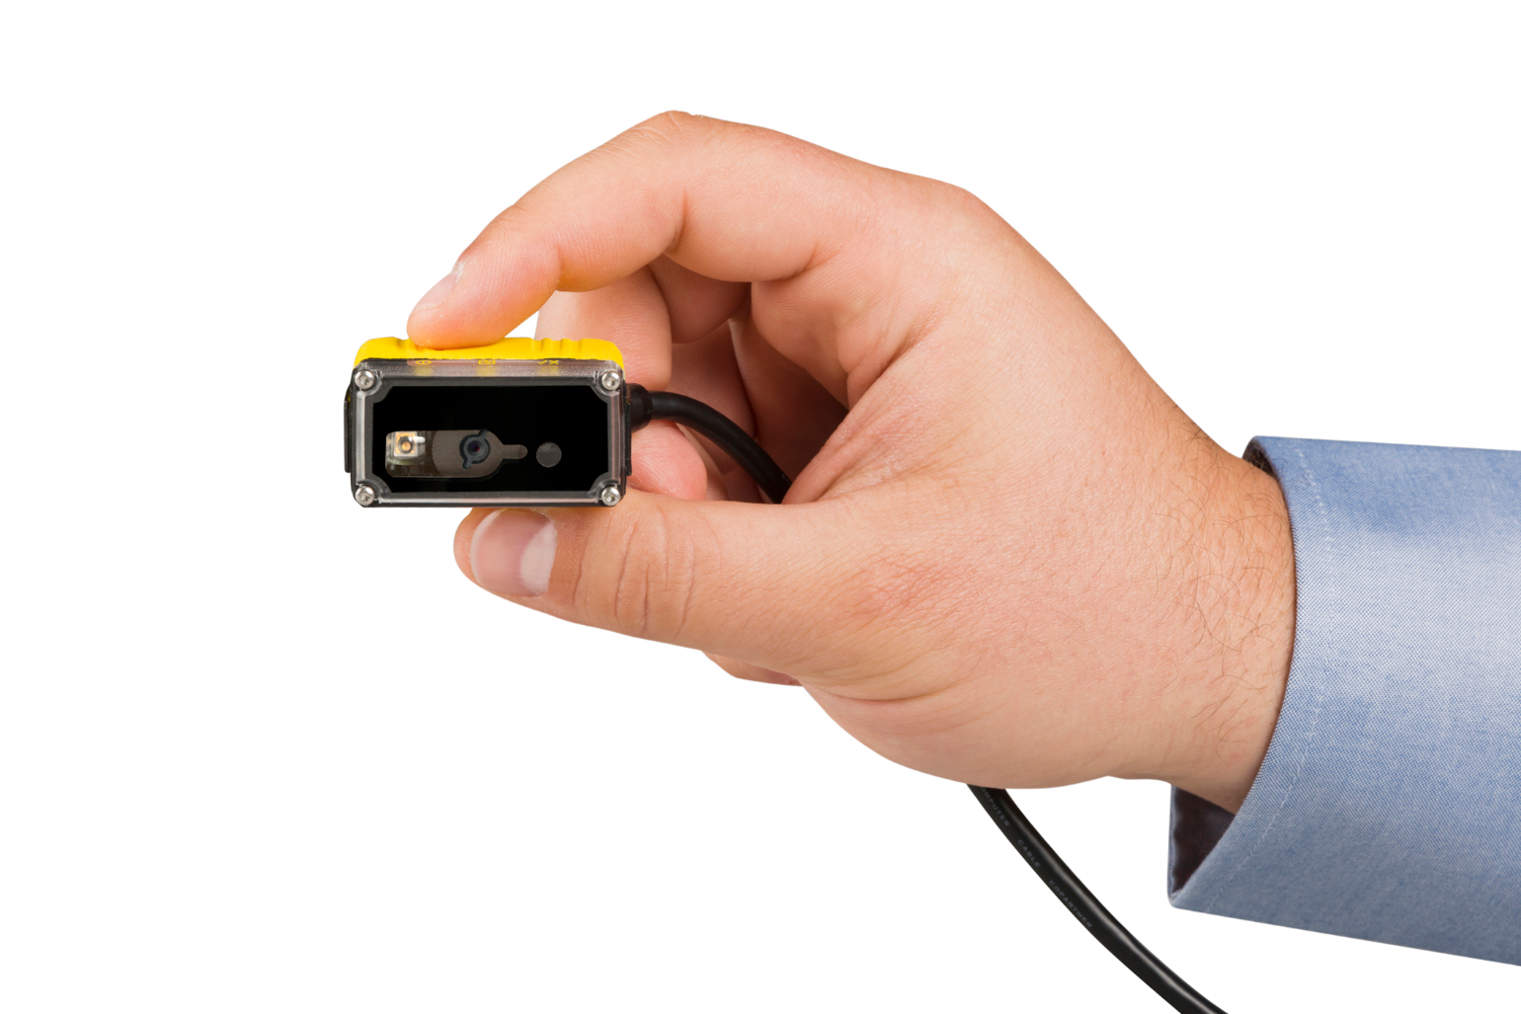
Marketing, Logistics, Commerce combined
URL, GTIN, ERP ID and Exp. in a QR Code
Notes:
ISO, W3C

Slide 12

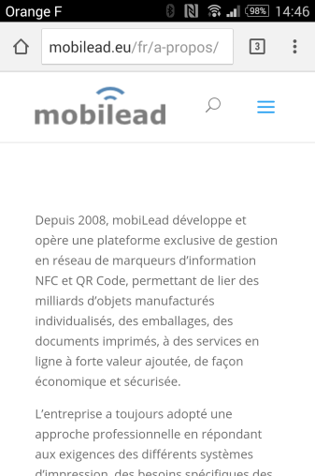
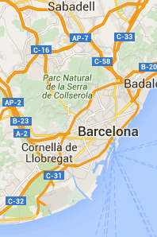
From one Tag to several usages
Marketing & Semantic Anticounterfeiting
Anti Count. Grey Market
Marketing
Public
Online
Web App
Private
Online/Offline
Map
Application

Slide 13
From one Tag to several usages
Marketing & Visual Anticounterfeiting
Anti
counterfeiting
Marketing
Public
Remote
Web App
Private
Local Draw
Application

Slide 14
Driven by Innovation, a unique and original approach
Where…
Geocoding
Region
What…
Label Signature
Product Signature
URL based
Unique ID
When…
Timestamp
Period of Time
What…
ERP Identifier
With…
Visual Identifier
What…
GTIN Identifier
Coded
Cyphered

Slide 15
INTERNET of THINGS enabler
from unique identification
(product, packaging, label)
to related content and services
Laurent TONNELIER
March 2016
Paris, France
mobiLead, CEO
lt@mobilead.fr
Notes:
Team: details on who you are, experience and qualifications
Our DNA: Large companies, Software
Technical expertise IoT, WoT, WoO
Market expertise
Marketing expertise
Existing Problem
Silos
Online offline
No network
Performances
QR Code and NFC are good candidates
• Unique Product/Company
R&D is good to be done from France
IP is protected in France
• Market Opportunity
Each consumer package good, each printed document,
each electonic printed document
• Competition/ co petition
Evrythng
Adent
with FRANCE BREVET
• Business model
IP Licencing
• Traction with users and customers
• Investment received, investment seeking, and what the money is for
Private money 94K€ (to be 150K€ by the end if June)
We want to turn this IP company, into a software company
Please confirm receipt of email and that you have selected a time,
and let me know if you have any questions. We look forward to meeting you!

