Slide 1
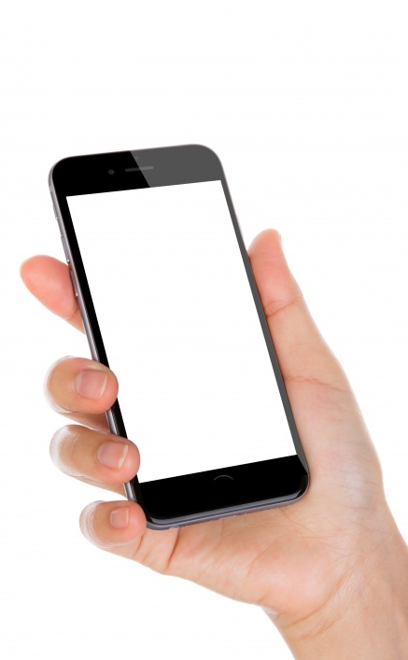
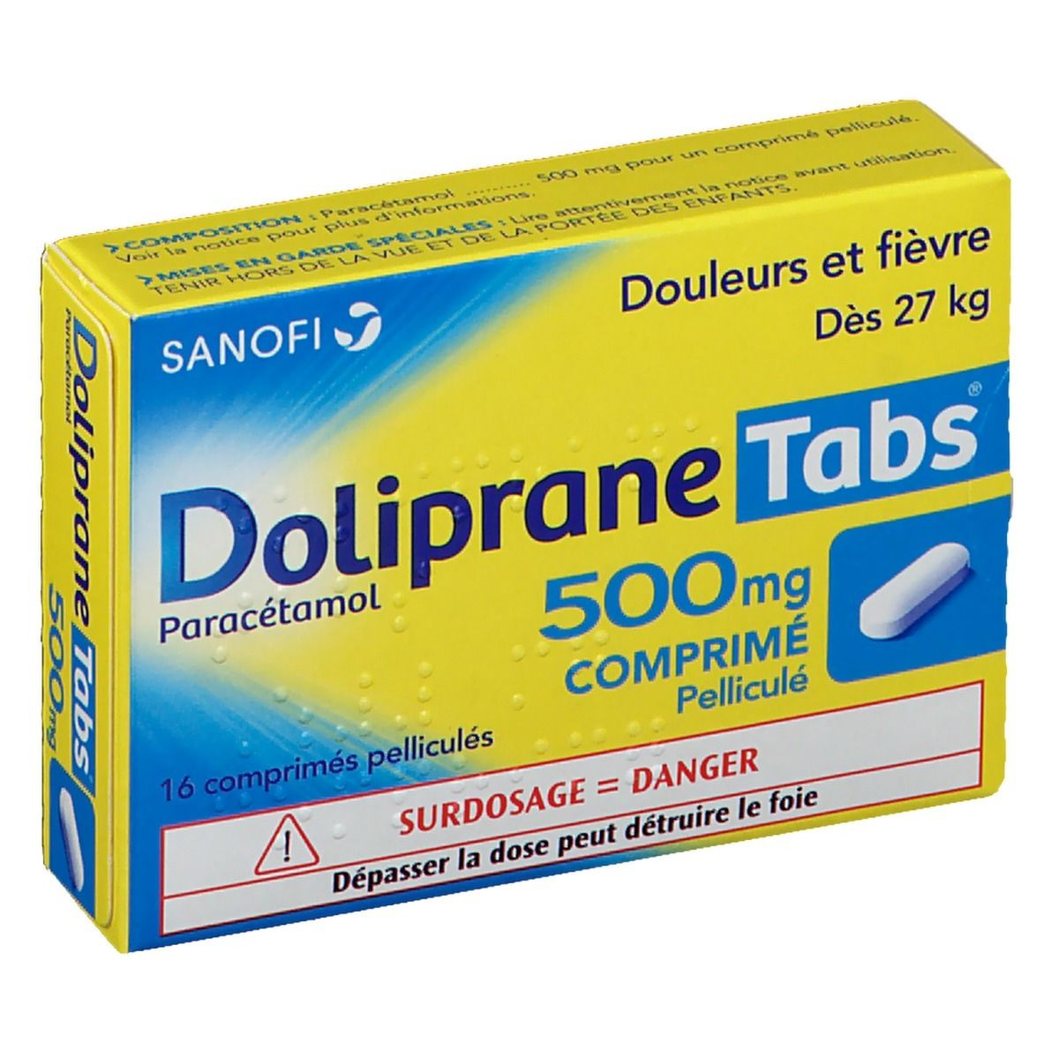
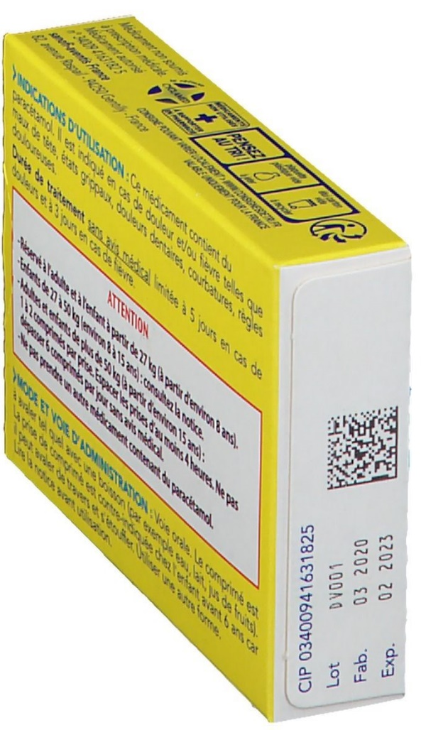
electronic Product Information (ePI)
Medicine Labelling for the Visually Impaired
2021/09/05
Lise Wagner
Accessibility Specialist and User Expert
OKEENEA
Laurent Tonnelier
AIDC expert and CEO,
MOBILEAD
october 2021
(c) 2021 - All rights reserved
Notes:
In the following minutes, I will present the XTAG project, an innovative approach to Medicine Labelling for the Visually Impaired
Our lecture will illustrate how the existing Datamatrix on packaging could be leveraged, today, by everyone, including visually impaired users, to access a tailored and relevant information.
electronic Product Information for human Medecines / accessibility made possible
Product Information for human Medicines, a case study on Medicine Labelling for visually impaired
Pharmapack Europe 2021 - 5th of October 2021
Innovation in Connectivity Roundtable -20 minutes presentations followed by a group discussion 14:00 - 15:00
Electronic Product Information (ePI) on Medicine Labelling for the Visually Impaired
Introduction from Pharmapack (5)
Patient Journey Driven Considerations for Integrating Digital Health for Combination Products. Mark Tunkel (20)
Electronic Product Information: A Case Study on Medicine Labelling for the Visually Impaired. Laurent Tonnelier & Lise Wagner (20)
Traceability of medicines: from finished product to unit dose delivery. Nathalie Wardé (20)
Comfort break for audience/ buffer in case any presentations run over time. (10)
Live panel discussion led by Lionel Jeannin (45)

Slide 2
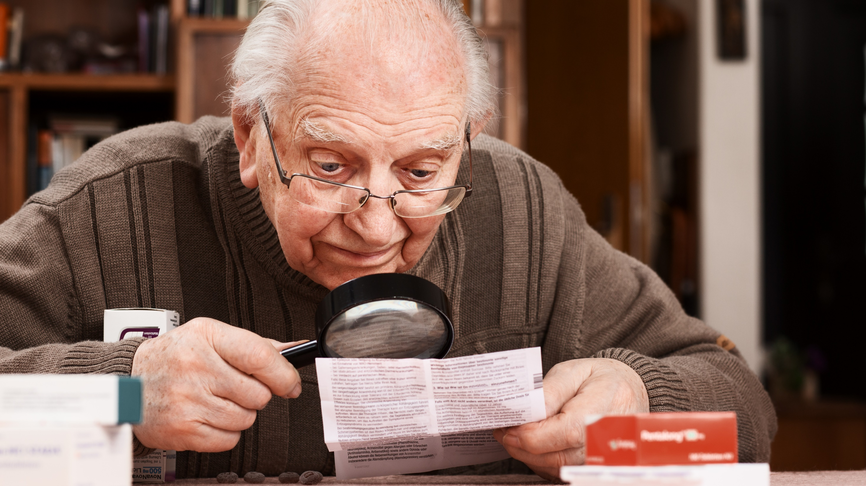
42% of seniors complain about the
poor readability of the packaging
Source : Etudee YouGov for ALL4PACK Paris event – COMEXPOSIUM Group
.
Notes:
42% of seniors complain about the poor readability of the packaging
Readability means many things
Readability means
the size of characters, too tiny sometimes
the color of text
too much information to read
to many languages printed on one single paper document
It also means the confusion in the understanding of the content itself
too technical
too legal
too many acronyms
complex symbologies

Slide 3
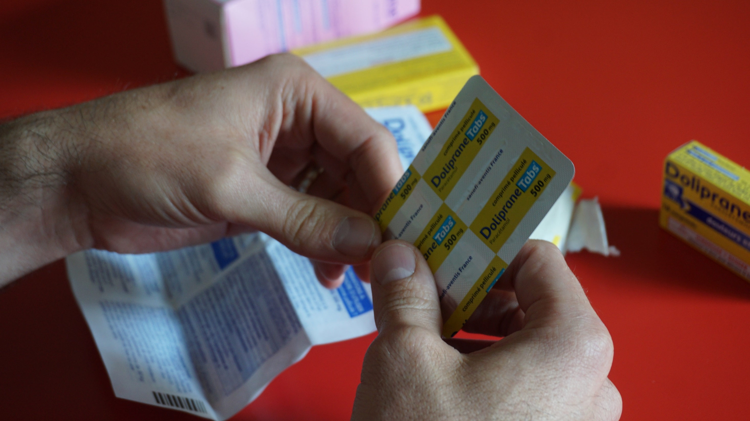
Notes:
It is complex, sometimes too complex, to access the relevant information on the medicine
But for some of us, it is impossible.

Slide 4
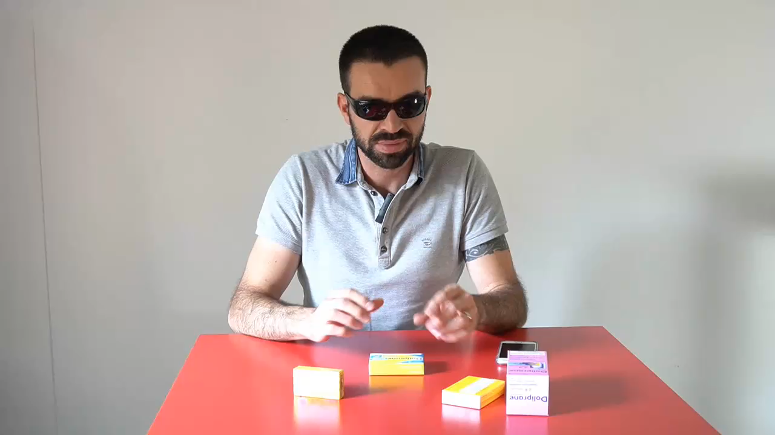
Lecture du braille
Pierre-Marie MICHELI
Accessibility Specialist
Notes:
Let me present Pierre-Marie MICHELI, an accessibility specialist.
As anybody Pierre-Marie needs medicine.
Pierre-Marie is blind.
Pierre-Marie would love to get some relevant and tailored information about its medicine.

Slide 5
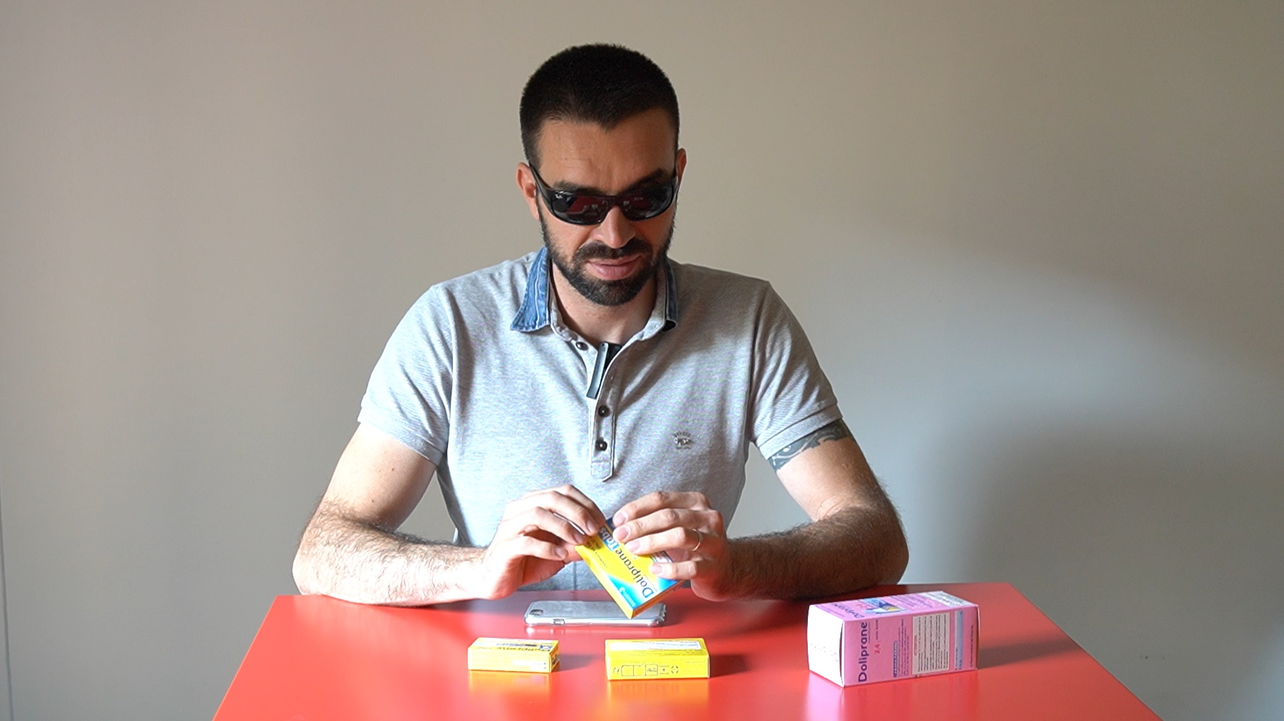
Pierre-Marie MICHELI
Accessibility Specialist
Notes:
Let me present Pierre-Marie MICHELI, an accessibility specialist.
As anybody Pierre-Marie needs medicine.
Pierre-Marie is blind.
Pierre-Marie would love to get some relevant and tailored information about its medicine.

Slide 6
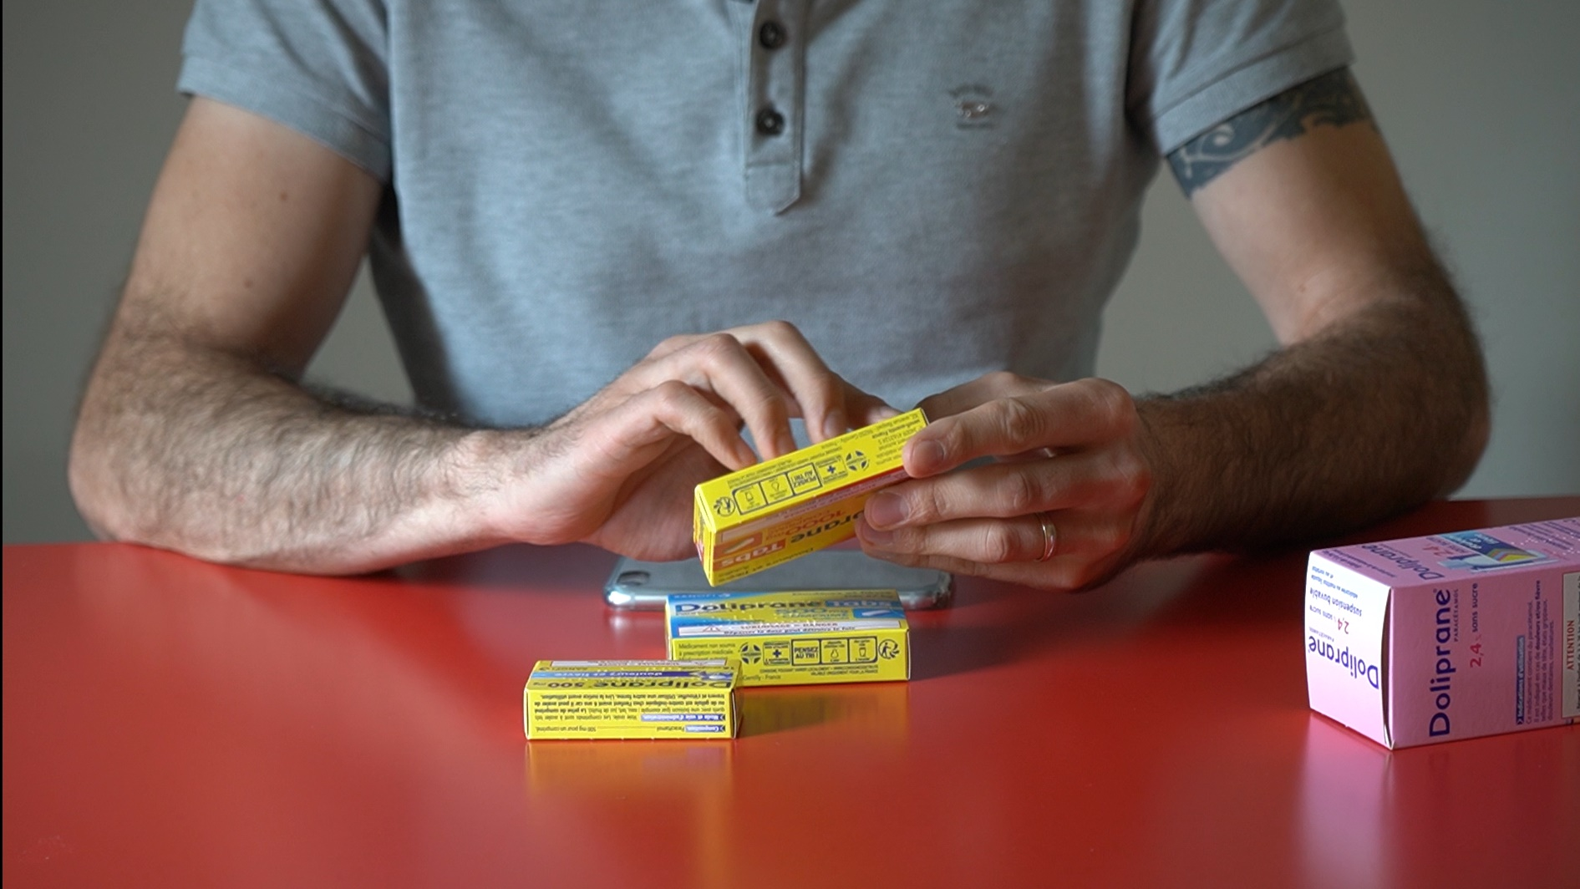
Pierre-Marie MICHELI
Accessibility Specialist
Notes:
Pierre-Marie is able to « read », I should say «decipher » the braille alphabet…
But, from the packaging, Pierre-Marie only has Access to some very limited information.
https://www.interpack.com/en/TIGHTLY_PACKED/SECTORS/PHARMACEUTICS_PACKAGING/News/Braille_on_packaging

Slide 7
electronic product information (ePI)
GS1 Digital Link
Only 10% to 15% of blind people read the Braille alphabet
  doliprane
  tabs
  500 mg
  Comprimé
  doliprane
  tabs
  500 mg
  Comprimé
A very limited access to drug information
  no readable expiration date
  no access to security warnings
  …
89% of blind people and visually impaired are using a Smartphone
october 2021
Source: Access 42 et la Fédération des Aveugles de France
(c) 2021 - All rights reserved
Notes:
Unfortunately, only very few of the blind people read the Braille alphabet
It leaves the majority of blind people without any information
A very limited access to drug information
On the packaging, Pierre-Marie was able to dicypher in braille : Doliprane Tabs 500 « m » « g » (j) « Comprimé »
Very few information as you can witness:
- no expiration date
- no security warnings
- nothing more than a short label
Braille is a very useful but a very limited technology, only usable by 10% to 15% of blind people
> But 89% of blind people and visually impaired are using a Smartphone
https://www.interpack.com/en/TIGHTLY_PACKED/SECTORS/PHARMACEUTICS_PACKAGING/News/Braille_on_packaging

Slide 8

Notes:
This is why we created xTag
xTag was awarded “best business plan 2020” by the prestigious business school H E C
A medicine Labelling for the Visually Impaired based on norms, standards and best practices.
A technology to be used :
not only, by blind people and visually impaired people,
but also, by any patient willing to a gain a convenient and relevant access to content.
We may remember the remote control designed for people unable to reach the television set…
Now used by every body… just as a very convenient tool.

Slide 9
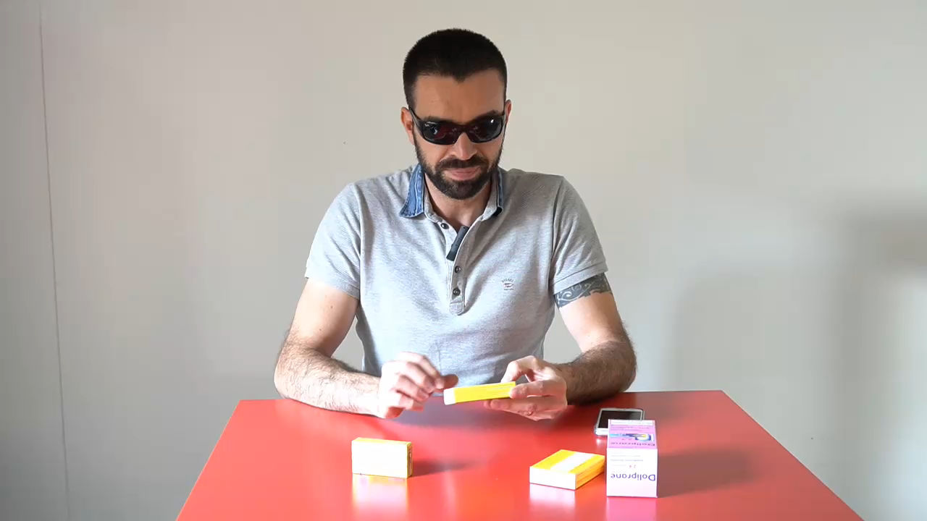
Lecture du braille
Pierre-Marie MICHELI
Accessibility Specialist
october 2021
(c) 2021 - All rights reserved
Notes:
A smartphone, a legacy barcode already printed of each pack (Datamatrix), a relevant and qualified Database

Slide 10
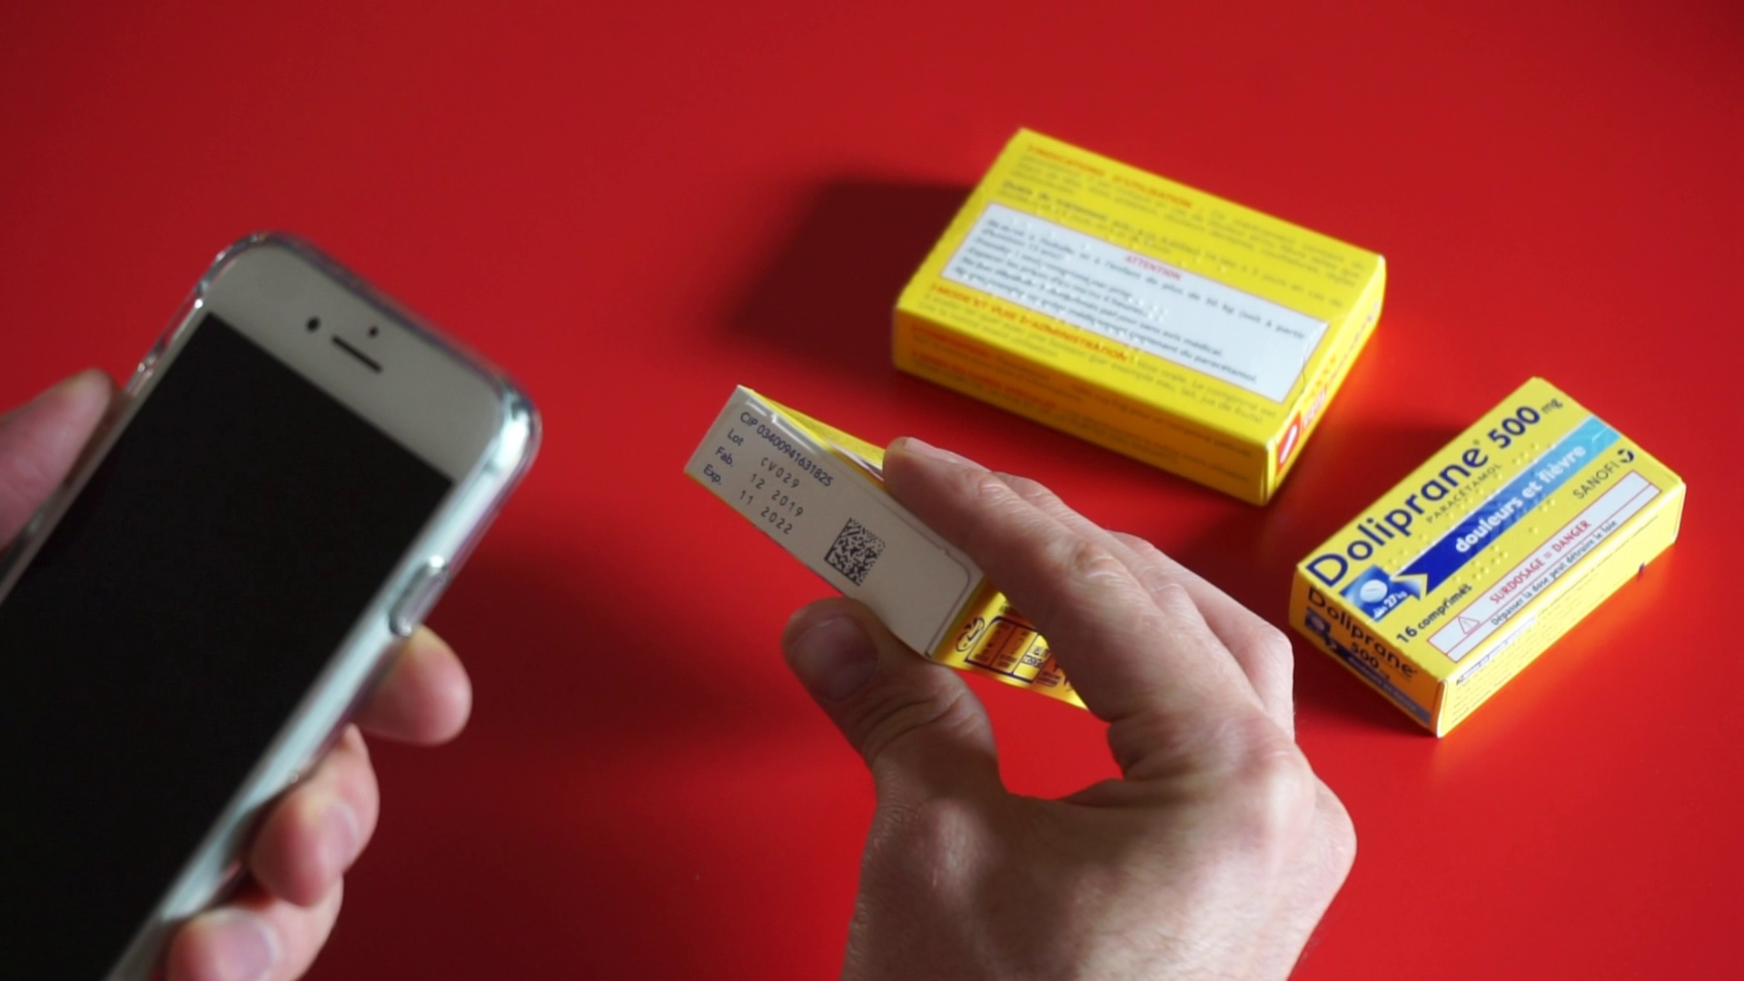
electronic product information (ePI)
GS1 Digital Link
DOLIPRANE 500 mg , film-coated tablet. Product valid for 1 year, 6 months and 6 days, until Wednesday November the 30th, 2022. Medication containing paracetamol, beware of the risk to the liver in case of overdose.
Notes:
A smartphone, a legacy barcode already printed of each pack (Datamatrix), a relevant and qualified Database
xTag is able to leverage an existing marking on packaging, enhance it, and turn it into a relevant, tailored and audible information to the end user.

Slide 11
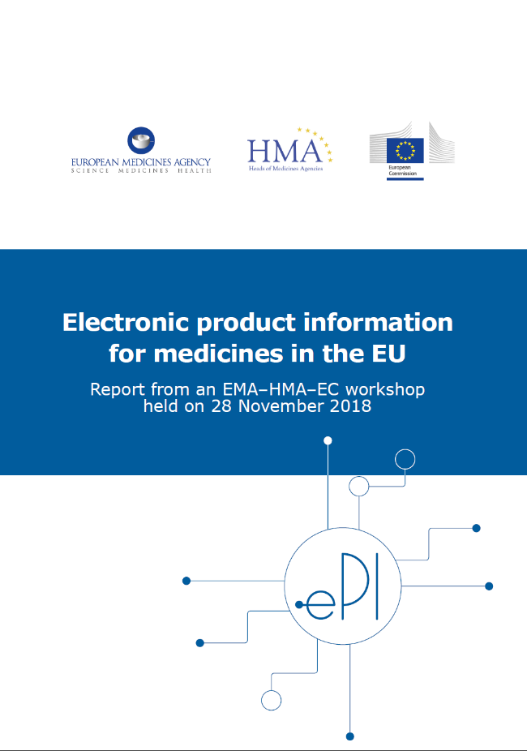
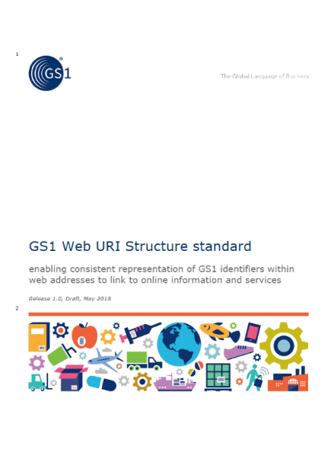
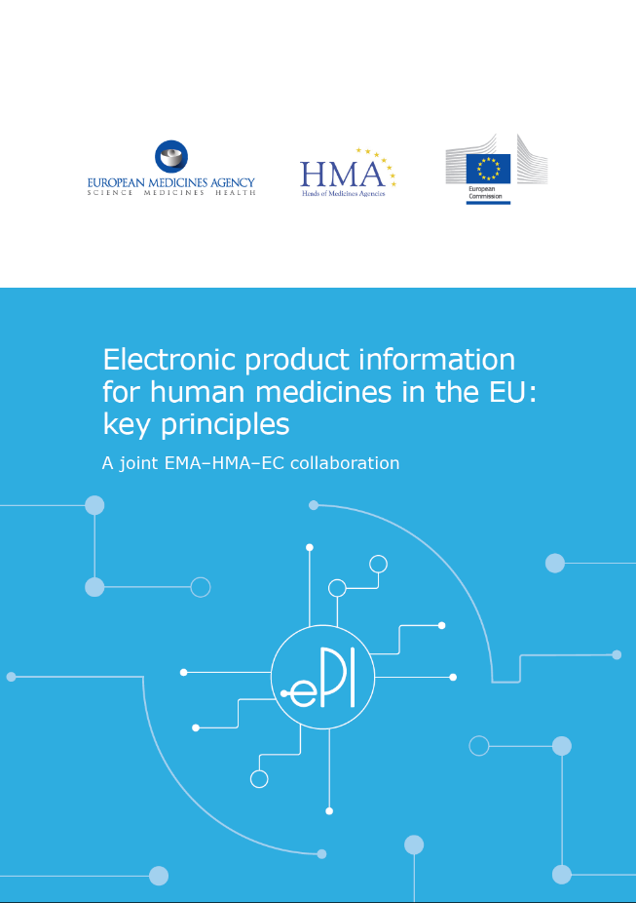
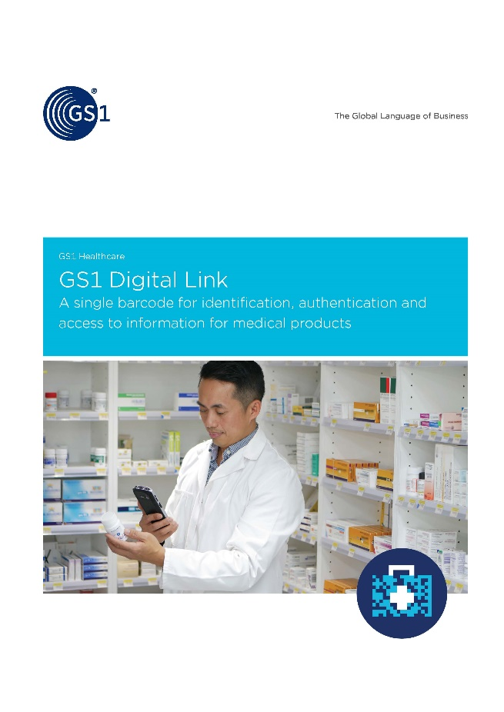
electronic product information (ePI)
GS1 Digital Link
ePI - electronic Product Information
GS1 Digital Link
Patient experience
Healthcare experience
Supply chain
Traceability
Laurent TONNELIER, AIDC expert at AFNOR, member of ISO,
GS1 Digital Link co-chair and technical expert at GS1
Notes:
xTag, a medicine Labelling for the Visually Impaired based on norms, standards and best practices.
On the one hand, The European ePI initiative
The electronic Product Information initiative for Medicines (ePI) aim to ease the accessibility on product information to everyone, including visually impaired patients.
On the other hand, the GS1 Digital Link initiative
The GS1 Digital Link initiative aim to provide a single barcode for identification, brand protection, and access to product information for patients.

Slide 12
GS1 Digital Link key principles
GS1 Digital Link
A single barcode for identification, authentication and access to information for medical products
Patient experience
Healthcare experience
Supply chain
Traceability
Laurent TONNELIER, AIDC expert at AFNOR, member of ISO,
GS1 Digital Link co-chair and technical expert at GS1
Notes:
the GS1 Digital Link initiative
a single barcode for identification, authentication and access to information for medical products
A better Patient experience
A better Healthcare experience
A smooth integration to the Supply chain
A better Traceability
GS1 is in charge of the structure of the inside of the DataMatrix we saw previously
GS1 is also known for the numbering system used on consumer good packages : EAN or UPC barcode.
In December 2017 GS1 global was looking for expert all over the globe.
Not only I was selected to be part of this working group but was also pleased to lead this working group as co-chair

Slide 13
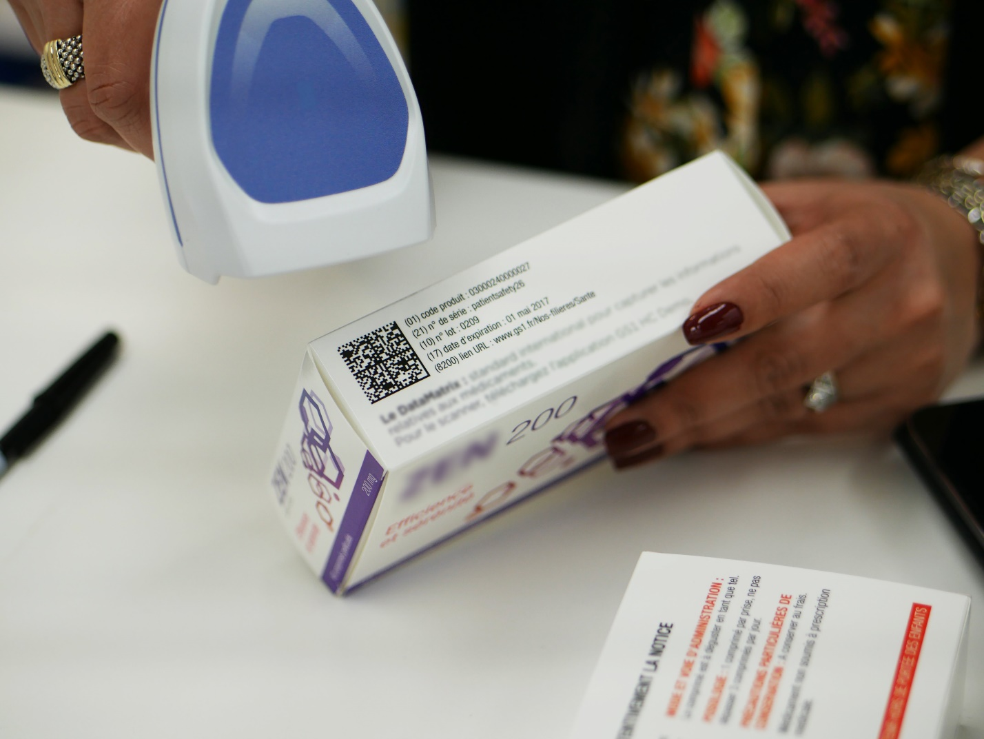
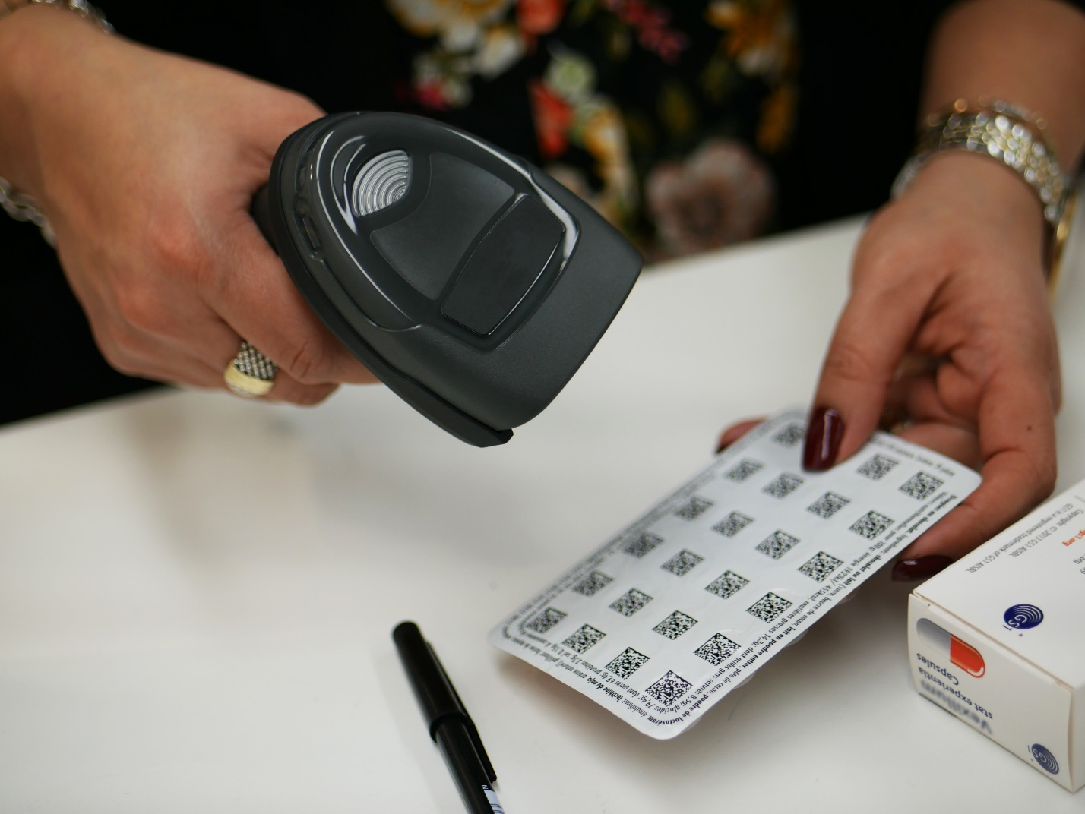
GS1 Digital Link key principles
Notes:
a single barcode for identification, authentication and access to information for medical products

Slide 14

electronic product information (ePI) key principles
october 2021
(c) 2021 - All rights reserved
Notes:
The European ePI initiative - electronic Product Information
Aim to expand the access to information on medicines
Aim to ease the Access to users with diverse abilities
Multilingual by design, to provide the information in the language you selected
Go beyond the paper package leaflet
https://eur-lex.europa.eu/eli/dir/2016/2102/oj
The following key principles have been agreed by EMA, HMA, EC and representatives of patients, consumers, HCPs and the pharmaceutical industry. Users (and thereby also stakeholders) of ePI include patients, consumers, HCPs, pharmaceutical companies and regulatory agencies (EMA and national competent authorities [NCAs]).
Future work on ePI will progress in alignment with these principles.

Slide 15
electronic product information (ePI) key principles
Complementing paper
leaflet
Compliance to Article 58 of Directive 2001/83/EC1
Complementing paper package leaflet
Up-to-date content
Notes:
Complementing paper package leaflet
The goal is not to remove or substitute the currently available paper format.
Not legally mandatory, the use of ePI will be a recommended digital source of information
The paper Leaflet should include a statement directing to the electronic Leaflet as the most up-to-date version of the paper Leaflet.
Statement
ePI will not supersede or negate the requirement of the pharmaceutical legislation (Article 58 of Directive 2001/83/EC1) to include a PL in the packaging of all medicines or directly convey all information required (by Articles 59 and 62 of the Directive) on the outer or immediate packaging.
Since the current legislation does not require the use of an electronic version of PI, the use of ePI will not constitute a new legal obligation.
Rationale
The ePI is intended to expand the formats in which PL is available and not to remove or substitute the currently available paper format. PLs are a valuable tool presented directly in the medicines package and therefore provided to all patients / consumers when they open their medicine. The paper PL is particularly important for patients / consumers with low digital literacy (low ability to use digital devices effectively) or limited internet access.
Implication
Generation of ePI does not involve any change to the content of the PI. ePI generation will be performed in addition to the current inclusion of the PL in the medicine package. Though not legally mandatory, the use of ePI will be a recommended digital source of information and EMA, HMA and NCAs shall commit to implementation.
The paper PL should include a statement directing to the ePI as the most up-to-date version of the PL. This statement (based on updated QRD [Working Group on Quality Review of Documents] product information templates

Slide 16



electronic product information (ePI) key principles
Multilingual ePI
Multilingual ePI
preferred language
Notes:
Multilingual ePI
EU citizens will be able to read ePI in their preferred language, when available
Statement
ePI shall support all official EU languages and Icelandic and Norwegian so that EU citizens will be able to read ePI in their preferred language when authorized ePI in that language is available.
Rationale
The PI for a centrally authorized medicine is available in all official EU languages (plus Norwegian and Icelandic) and the PI for a nationally authorized medicine is available in one or more official language(s) of the Member State where the medicine is placed on the market.
NCAs decide in which official language(s) PI will be provided in their countries for nationally authorized products. The ePI initiative does not imply any additional translations other than those that are already carried out for PI in the EU.
ePI should also be possible in these languages, as applicable. Availability of ePI in patients’ / consumers’ and HCPs’ own language, where available, facilitates full understanding. However, this principle does not imply interchangeability of all language versions of a product that is authorized in individual Member States, as these may not necessarily be harmonized and differences may exist in the PIs in different countries.
PI may be needed in non-EU languages in some Member States, however additional non-EU languages are not currently in the scope of the ePI initiative.
Implication
ePI design and implementation must, from the start, ensure capability to provide PI in all official EU languages as well as Icelandic and Norwegian.

Slide 17
electronic product information (ePI) key principles
Accessibility to users with diverse abilities
Accessible to everyone
Accessible by design
Directive (EU) 2016/2102 compliance
Notes:
Accessibility to users with diverse abilities
ePI will facilitate creation of Product Information that is accessible to everyone.
ePI allows the use of large fonts or high screen contrast for partially sighted users and audible formats for blind users.
ePI will be accessible to screen readers, web and mobile applications, convertible to large font and amenable to other accessible formats
‘accessible by design.’
This means that accessibility to users with diverse abilities will be considered from the beginning in the ePI initiative.
ePI will comply with Directive (EU) 2016/2102 on the accessibility of the websites and mobile applications of public sector bodies.
Statement
ePI will facilitate creation of PI that is accessible to everyone, including users with print impairments, including physical impairments or learning difficulties, or for whom printed PI is difficult to access for other reasons. ePI allows the use of large fonts or high screen contrast for partially sighted users and audible formats for blind users and those with low literacy levels. ePI on the web will be accessible to screen readers, web and mobile applications, convertible to large font and amenable to other accessible formats. Accessible formats will provide the full and balanced product information to users in formats suitable for their needs.
Rationale
Current PDF and print copy formats of PI do not well serve all citizens equally, given the wide range of abilities throughout society.
In contrast with PDF and print copy formats of the PI, the availability of ePI will allow third-parties, such as companies, not-for-profit organizations or patient / consumer groups, to convert the PI into accessible formats. ePI will make it easier to add authorized or supportive video or audio content or other interactive materials (in line with the appropriate guidance) to the PI. Accessible formats refer to format only and will include the entire PI without any change to the content.
Implication
ePI will be ‘accessible by design.’ This means that accessibility to users with diverse abilities will be taken into account from the beginning and throughout the ePI initiative.

Slide 18
electronic product information (ePI)
GS1 Digital Link
ePI - electronic Product Information
GS1 Digital Link
Patient experience
Healthcare experience
Supply chain
Traceability
Laurent TONNELIER, AIDC expert at AFNOR, member of ISO,
GS1 Digital Link co-chair and technical expert at GS1
Notes:
Thanks to GS1 Digital Link
a single barcode for identification, authentication and access to information for medical products
For a bettrer Patient experience
Thanks to the European initiative on ePI
Expanding access to information on medicines
Accessible to users with diverse abilities
Multilingual
Complementing paper package leaflet

Slide 19
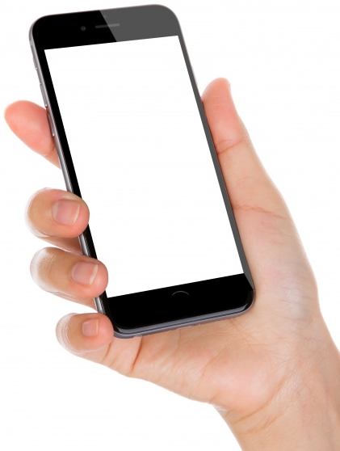

Multilingual
DOLIPRANETABS 500 mg , film-coated tablet. Product valid for 2 years, 3 months and 25 days, until Tuesday February 28, 2023. Medication containing paracetamol, beware of the risk to the liver in case of overdose.
Notes:
Ici en anglais sur le Doliprane 500mg
En utilisation le DataMatrix existant ou un marqueur radio NFC
http://x1d.com/cis_bdpm/index.php?p=%1D0103400941631825172302281120031710DV001

Slide 20
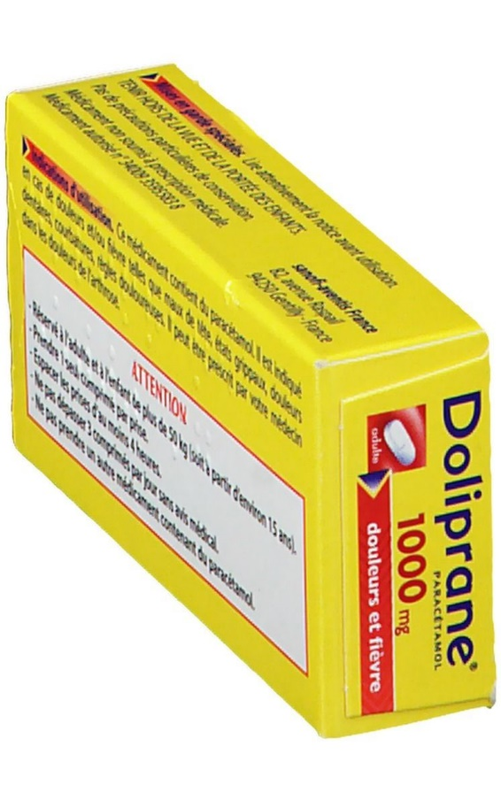
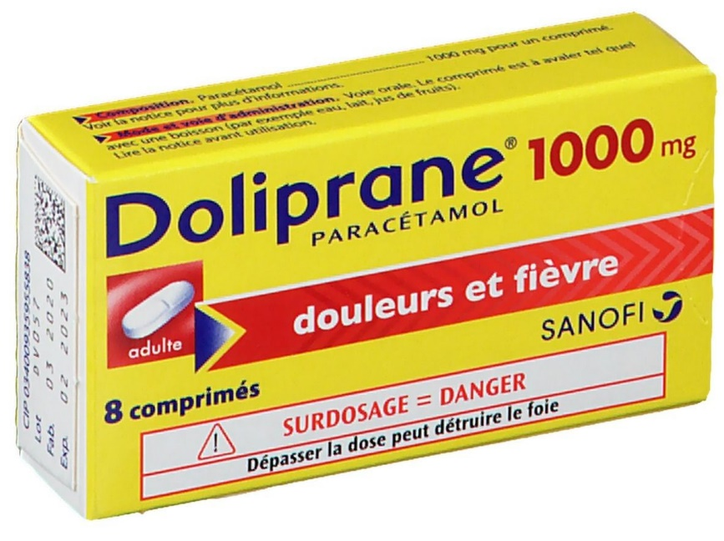
Multilingual
DOLIPRANE 1000 mg, en comprimé. Produit périmé depuis 2 ans, 2 mois et 6 jours, soit depuis le vendredi 31 août 2018. Médicament contenant du paracétamol, attention au risque pour le foie en cas de surdosage
Notes:
Nous avons créé un prototype à même de vocaliser, aujourd’hui 15 200 médicaments
Sans aucun changement sur l’emballage existant
Une information personnalisé, dans la langue de l’utilisateur.
Ici en francais sur le Doliprane 1000
http://x1d.com/cis_bdpm/index.php?p=%1D01034009359558381115090017180800105GK4A

Slide 21
Multilingual
DOLIPRANETABS 500 mg, en comprimé pelliculé. Produit valable pendant 2 ans, 3 mois et 25 jours, jusqu'au mardi 28 février 2023. Médicament contenant du paracétamol, attention au risque pour le foie en cas de surdosage.
Notes:
http://x1d.com/cis_bdpm/index.php?p=%1D0103400941631825172302281120031710DV001

Slide 22
Multilingual
DOLIPRANETABS 500 mg compresse rivestite con film.
Il prodotto è valido per 2 anni, 3 mesi e 25 giorni, fino a martedì 28 febbraio 2023. Medicinali contenenti paracetamolo, attenzione ai sovradosaggi che potrebbero mettere in pericolo il fegato.
Notes:
http://x1d.com/cis_bdpm/index.php?p=%1D0103400941631825172302281120031710DV001

Slide 23
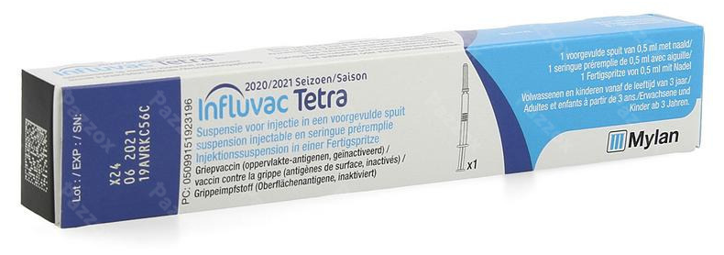
INFLUVAC TETRA, suspension injectable en seringue préremplie, vaccin grippal inactivé à antigènes de surface.
Produit valable pendant 7 mois et 26 jours, jusqu'au mercredi 30 juin 2021.
17 décembre 2020
(c) XTAG 2020 - Droits reservés
Notes:
http://x1d.com/cis_bdpm/index.php?p=%1D01034009301177121721063010X08

Slide 24
INFLUVAC TETRA, suspension for injection in pre-filled syringe, inactivated influenza vaccine with surface antigens. Product valid for 7 months and 26 days, until Wednesday, June 30, 2021.
(c) XTAG 2020 - Droits reservés
Notes:
http://x1d.com/cis_bdpm/index.php?p=%1D01034009301177121721063010X08

Slide 25
Un même code, une même infrastructure, différents services à valeur ajoutée
End users benefits
Laboratory customers benefits
Make information about the drug readable, tailored, personalized and accessible
At the service of the blind, the visually impaired, patients, pharmacists, doctors
65 000 blind people in France
1 200 000 profound and medium visually impaired
560 000 mild visually impaired
the comfort of all
Save on the cost of the paper Leaflet
Capitalize on the existing (Datamatrix code)
Meet the regulatory requirements of Laboratories - Directive (EU) 2016/2102 (accessibility, ePI)
Address new tools (mobile, voice assistants, GS1 Digital Link) and new uses (information requirement)
Notes:
The is some benefits for the end user,
The is some benefits for the pharmceutical industry
A convenient acces to content
A cost saving
A better usage of the already printed Dtamatrix on pack
The huge list of new features made possible by the Européen ePI initiative combined with the GS1 Digiltal link initiative
Nos utilisateurs,
Nos clients, les laboratoires
Accessibilité du contenu pour l’ensemble des déficients visuels (d’une déficience faible à totale)
Au 1er janvier 2018, la France compte 67,187 millions d'habitants. Le vieillissement de la population française se poursuit.
Les personnes âgées d'au moins 65 ans représentent 19,6 % de la population, contre 19,2 % un an auparavant et 18,8 % deux ans auparavant.
(13 168 652 séniors)
https://eur-lex.europa.eu/eli/dir/2016/2102/oj

Slide 26
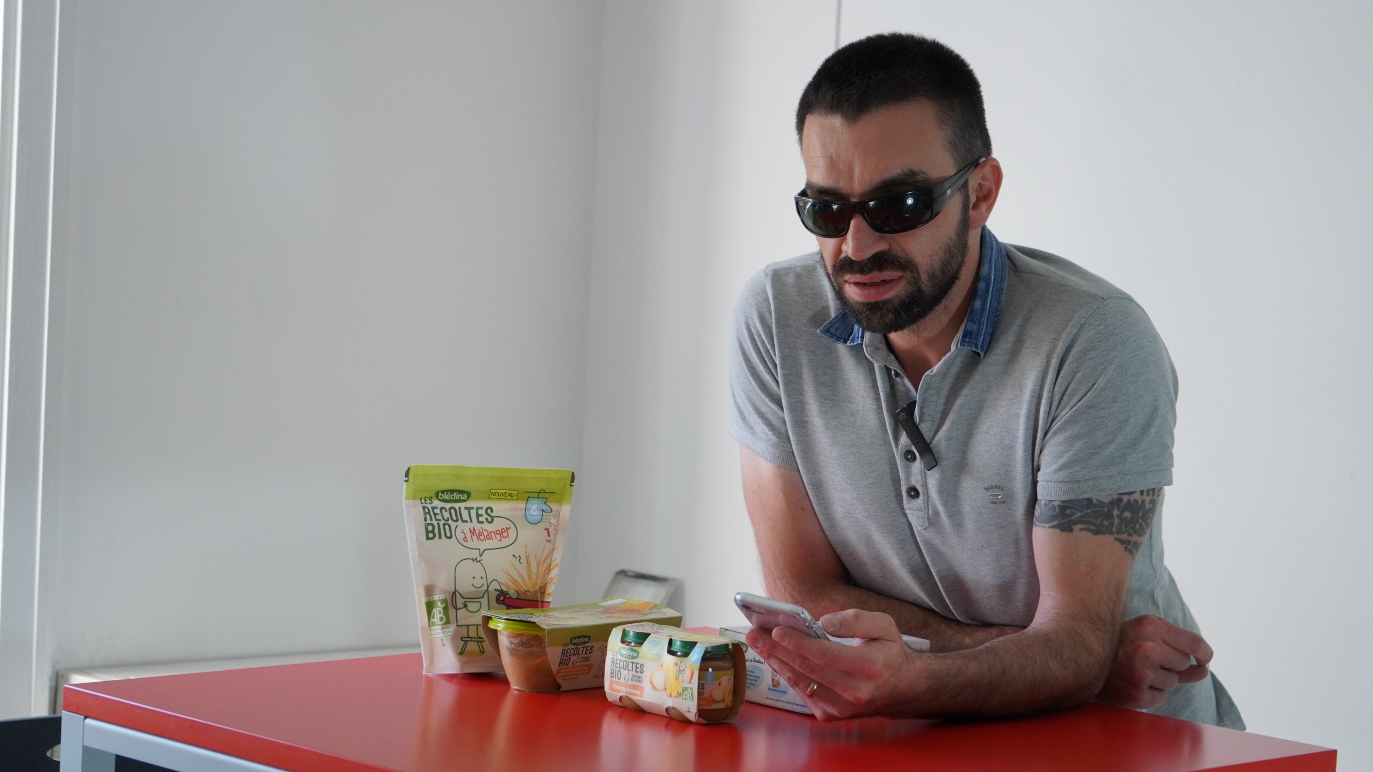
Pierre-Marie MICHELI
Accessibility Specialist
october 2021
(c) 2021 - All rights reserved
Notes:
Beyond the medecine only,
The very same technologu could bu used on any product, inculding food products
Après le médicament, nous travaillons sur l’ensemble des produits de grande consommation

Slide 27
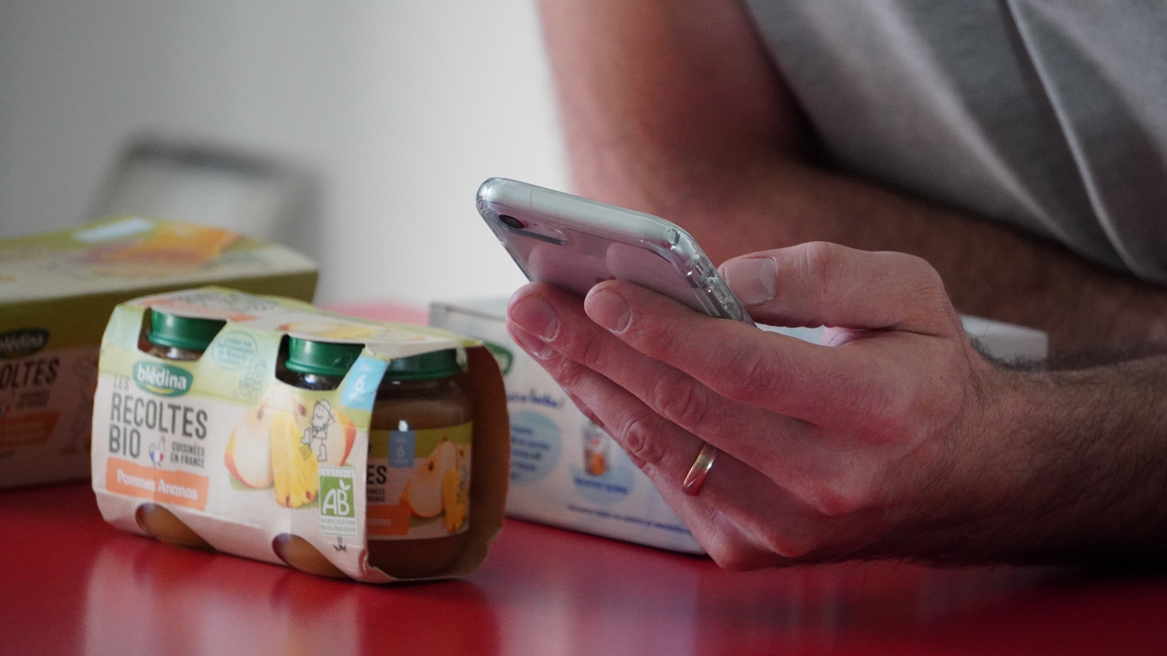
82% of global retailers and 92% of global brands could deploy the GS1 Digital Link
in the next 5 years
Source : VDC Research
Pierre-Marie MICHELI
Accessibility Specialist
october 2021
(c) 2021 - All rights reserved
Notes:
82% of global retailers and 92% of global brands could deploy the GS1 Digital Link in the next 5 years
What we have designed for the pharmaceutical industry and for the visually impaired
will be directly applicable to any product, and to everyone.

Slide 28
electronic Product Information (ePI)
Medicine Labelling for the Visually Impaired
2021/09/05
Lise Wagner
Accessibility Specialist and User Expert
OKEENEA
Laurent Tonnelier
AIDC expert and CEO,
MOBILEAD
october 2021
(c) 2021 - All rights reserved
Notes:
Thank you for your attention
Introduction from Pharmapack (5)
Patient Journey Driven Considerations for Integrating Digital Health for Combination Products. Mark Tunkel (20)
Electronic Product Information: A Case Study on Medicine Labelling for the Visually Impaired. Laurent Tonnelier & Lise Wagner (20)
Traceability of medicines: from finished product to unit dose delivery. Nathalie Wardé (20)
Comfort break for audience/ buffer in case any presentations run over time. (10)
Live panel discussion led by Lionel Jeannin (45)

