Slide 1
INTERACTIVE PACKAGING
Smart identifiers for the packaging in food industries, evolving in order to deliver a convenient, personalized, reliable and trusted information to consumers
fTag
2017, September 20th
Notes:
Harnessing active and intelligent technologies to add value to flexible and rigid packaging
How to create positive experiences to bring healthier life to people through food ?
Smart identifiers for the packaging in food industries is evolving in order to deliver a convenient, personalised,
reliable and trusted information to consumers
Mr. Laurent Tonnelier, CEO,
MOBILEAD - FTAG, France

Slide 2
Food allergy and intolerance a serious medical issue
Food allergy is a serious medical issue
15 million people in the US
17 million people in Europe
3.5 million are younger than 25 years
Number of people who have a food allergy is growing
Rates among children +50% between 1997 and 2011

Slide 3
Food allergy and intolerance management
INCO – European Union (EU)'s 1169/2011 regulation
The European Union (EU)'s 1169/2011 regulation, commonly referred to as INCO (Information to Consumers), makes mandatory for brands to provide consumers with clearer information about the food products.
fTag is the optimal solution
to help brand owners to be compliant with the regulation
to provide convenience to users, consumers and patients
Information on products with an allergenic or intolerance effect should be given to enable consumers, to make informed choices which are tailored and safe for them.

Slide 4
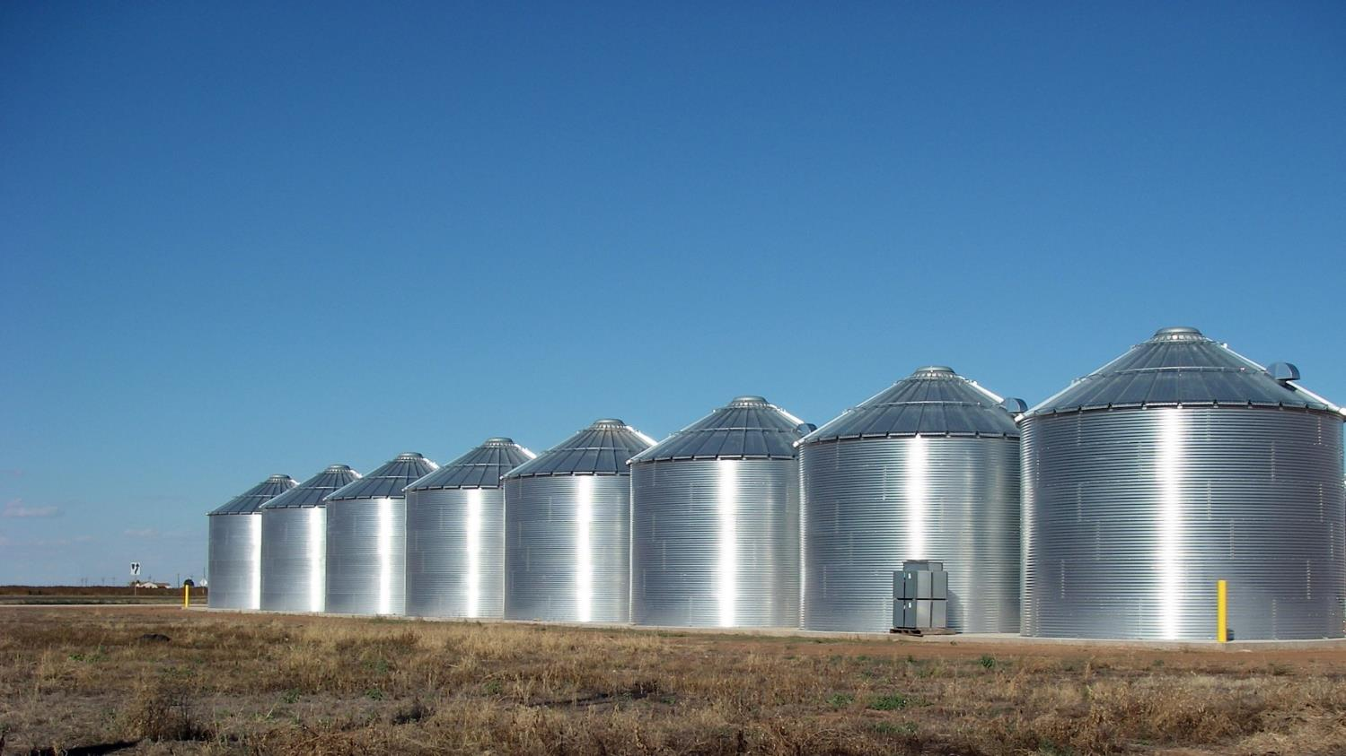
SeveraL USAGES
Marketing, Commerce, Logistic…
Ralls, Texas – Grain silos
Notes:
Existing Problem
Silos

Slide 5

SEVERAL TECHNOLOGIES
QR, DM, UPC, NFC…
Babel Tour, Pieter Bruegel
Notes:
La Tour de Babel (1 563) de Pieter Bruegel
Existing problems
Online offline
No network
Performances

Slide 6
About mobiLead
Smart and Unique Identifiers
Where…
Geocoding
Region
What…
Label Signature
Product Signature
URL based
Unique ID
When…
Timestamp
Period of Time
What…
ERP Identifier,
GTIN Identifier
With…
Visual Identifier
Exist…
Blockchain
public ledger
xTag Coded
Cyphered

Slide 7
from mobiLead’s Smart and Unique Identifiers to fTag as a solution
Patents, Brands, Know-how
Prototypes, Proof of Concept
zTag
security
mTag
tracking
fTag
food allergens
8Tag
blockchain
jTag
anticounterfeiting

Slide 8
8Tag trusted information
Local and Remote Control
8Tag
NFC or QR Code
8Tag
Mobile Application
8 Tag
Blockchain Network
Local
Remote
8Tag
blockchain
Notes:
Limited space on pack
Few languages
Generic
Hard to read
Complex
Legal
Unlimited space on mobile
Unlimited languages
Tailored
Easy to read
Trivial
Legal with fTag

Slide 9
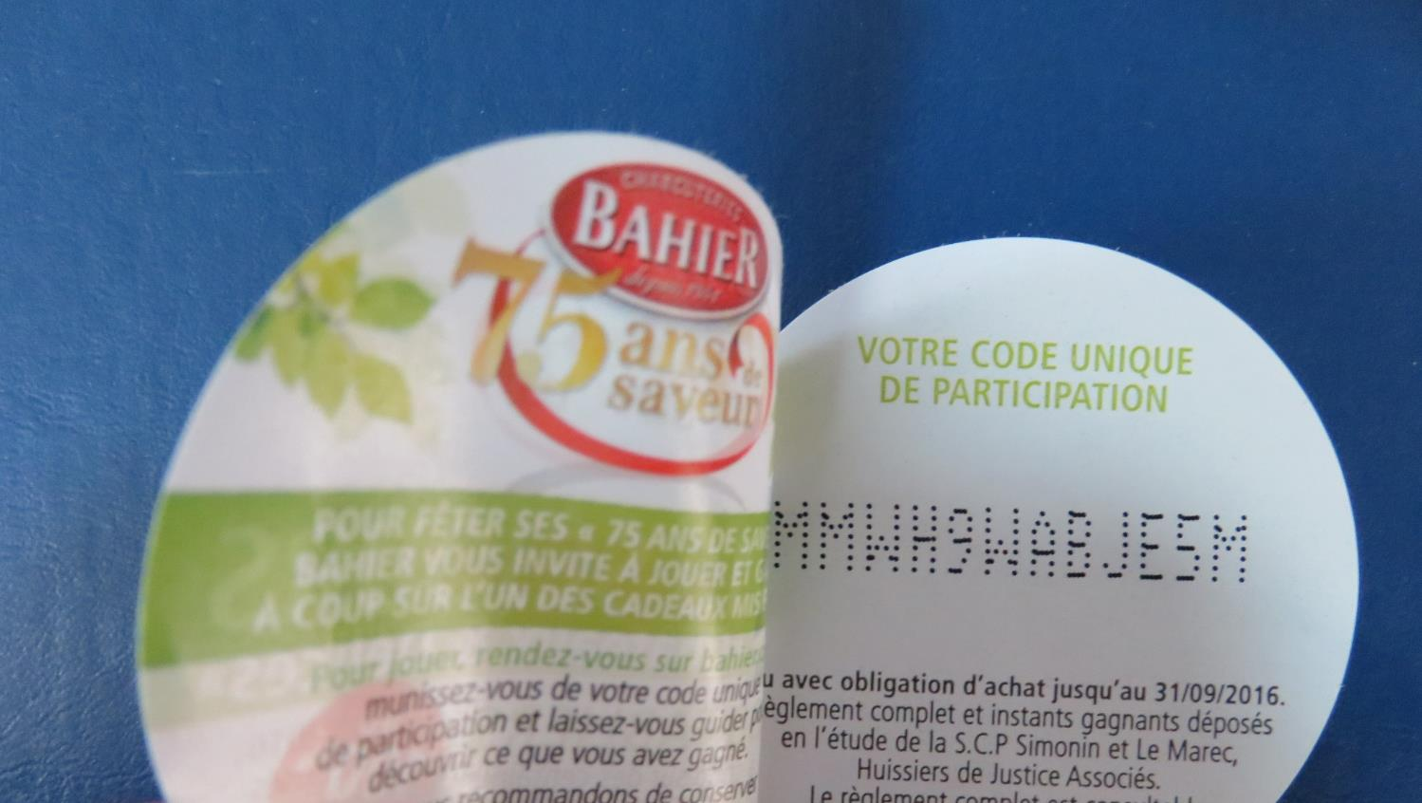
28 000 000 Unique identifiers
QR, DM, UPC, NFC…
Babel Tour, Pieter Bruegel
Notes:
4B Single Code c'est la 4B Twin avec code aléatoire unique! Cette étiquette multi-couches qui répond déjà à tous vos besoins se perfectionne. Vous pouvez désormais sur un même format d'étiquette, imprimer sur plusieurs volets détachables ou repositionnables...Ce qui augmente déjà considérablement votre surface de communication. 4B Single Code vous permet aujourd'hui d'imprimer un code aléatoire unique. Une véritable solution "clé en main"!
Compagnie Industrielle d'Etiquettes
BAHIER
AOSTE
Justin Bridou
C'est ma tournée
12 480 000 =
10 000 000
2 400 000
60 000
20 000
12 050 000

Slide 10

Marketing QR URL Links on each pack
Babel Tour, Pieter Bruegel
Notes:
4B Single Code c'est la 4B Twin avec code aléatoire unique! Cette étiquette multi-couches qui répond déjà à tous vos besoins se perfectionne. Vous pouvez désormais sur un même format d'étiquette, imprimer sur plusieurs volets détachables ou repositionnables...Ce qui augmente déjà considérablement votre surface de communication. 4B Single Code vous permet aujourd'hui d'imprimer un code aléatoire unique. Une véritable solution "clé en main"!
Compagnie Industrielle d'Etiquettes
BAHIER
AOSTE
Justin Bridou
C'est ma tournée
12 480 000 =
10 000 000
2 400 000
60 000
20 000
12 050 000

Slide 11

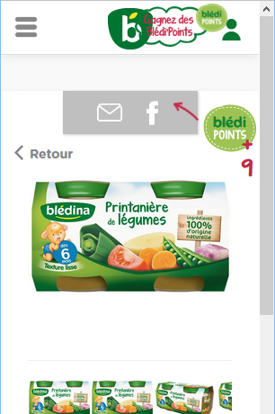


Marketing QR URL Links on each pack
GTIN
GTIN
3041091022851
http://d4n.fr/015Lwongj0
3041091022851
Notes:
http://d4n.fr/015Lwongj0
https://www.bledina.com/produits-bebe/bledina-pots-2x130g-printaniere-de-legumes-des-6-mois

Slide 12
xTag in the packaging ecosystem
Brand
Product
Batch
Unit
SKU / GTIN
Ingredients
Allergens
sGTIN
UUID
Exp.
Every
Each
Cold Data
Warm Data
Variable Printing
Unitary
Tagging

Slide 13
from Product Information to Print and Mobile Content
Product Information
Printed
Label
URL
NFC Tag
QR Code
Mobile
Content
Notes:
de l’identification unitaire
(produit, emballage, étiquette)
au contenu et services associés

Slide 14
Printed information vs Digital mobile comparaison
Limited space on pack
Few languages
Generic
Hard to read
Complex
Legal
Unlimited space on mobile
Unlimited languages
Tailored
Easy to read
Trivial
Legal with fTag
(data are also local)
Packaging or Label
Mobile content
fTag

Slide 15

Emballage:
Protéger, informer
Packaging
Protect the product
Information on Pack or Label
Inform the consumer
Protect the consumer
Consumer
Mobile User
Patient
Individual
0FRCEB02
DCR21/04

Slide 16
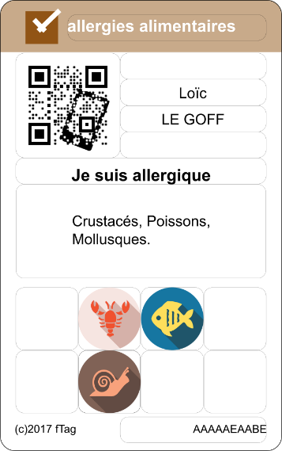
Tailored Content on Mobile
« Sur mesure »
Profile
Lots of printed Information
Tailored Content on Mobile
« Sur mesure »
fTag
Notes:
Limited space on pack
Few languages
Generic
Hard to read
Complex
Legal
Unlimited space on mobile
Unlimited languages
Tailored
Easy to read
Trivial
Legal with fTag

Slide 17
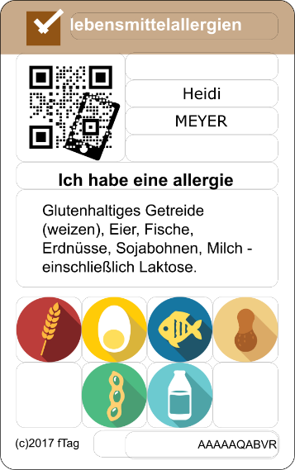
Tailored Content on Mobile
« Sur mesure »
Individual
Preferences
Pathology
Product
Personalization
Individualization
Tailored content
Profile
Lots of printed Information
Tailored Content on Mobile
« Sur mesure »
fTag
Notes:
Limited space on pack
Few languages
Generic
Hard to read
Complex
Legal
Unlimited space on mobile
Unlimited languages
Tailored
Easy to read
Trivial
Legal with fTag

Slide 18
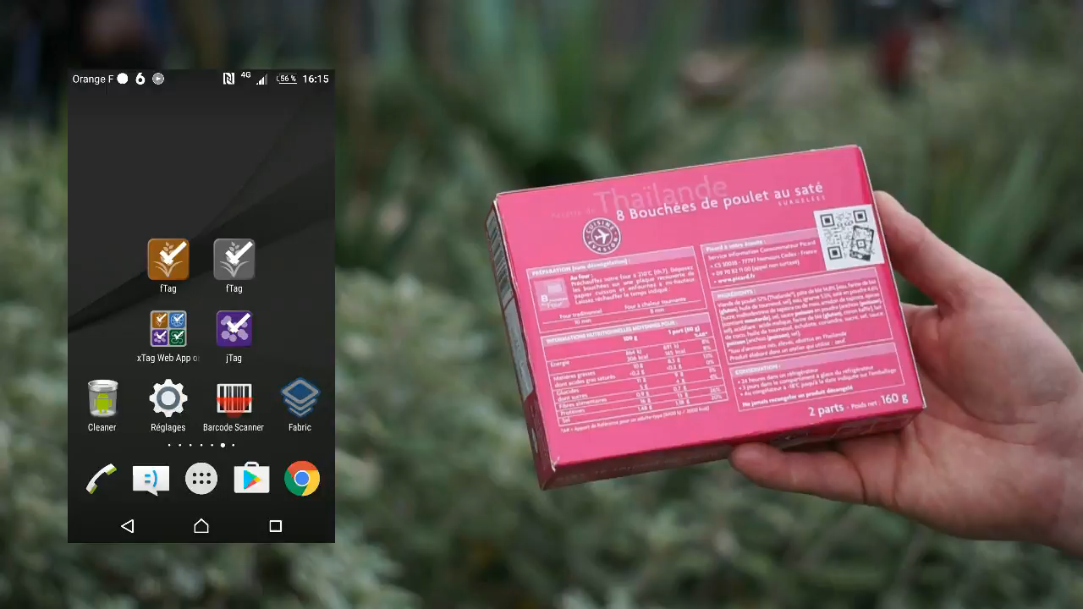
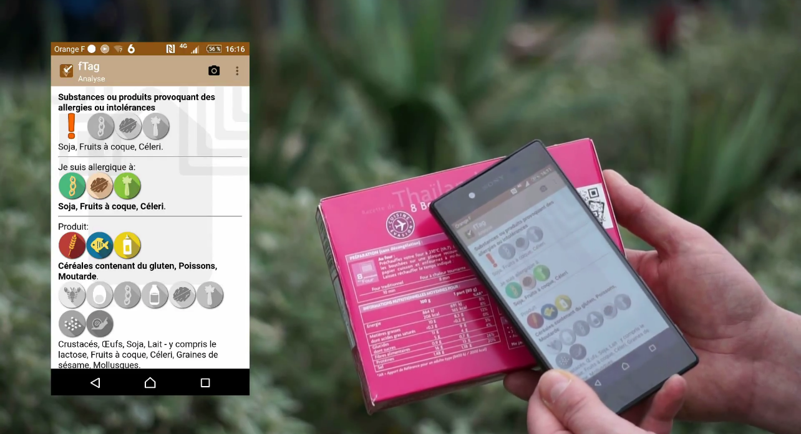
Food allergy and intolerance usage fTag in 30 secondes
MPEG video
Notes:
https://youtu.be/dtxu1AOhVlI

Slide 19
key features fTag Data
DATA | fTag | competition
Medical data source
INCO main 14 Allergens +Traces
INCO detailled 28 Allergens +Traces
Multilingual DE, EN, ES, FR, IT, NL
beyond Regulation 230 Allergens +Traces | EN, FR
xTag compliance 8tag, jTag, mTag, zTag
  The only solution based on a reliable medical data source
Notes:
Observance therapeutique = posologie (Adherence)
Diets = Regime

Slide 20
key features fTag Tags and Labels
TAGS | fTag | competition
EAN
QR Code
NFC
Local data
Advanced codification
Remote data
W3C URL based
  The only solution as legally valid as a printed information on pack
  (data are local)
Notes:
Observance therapeutique = posologie (Adherence)
Diets = Regime

Slide 21
key features fTag Mobile A pplications
MOBILE ACCESS | fTag | competition
Medical certified
Remote access
Local access
Privacy by Design
Mobile Web App
Native App Androïd
Multilingual DE, EN, ES, FR, IT, NL
QR Code reader
NFC device
  The only solution designed to support privacy as a core feature
Notes:
Observance therapeutique = posologie (Adherence)
Diets = Regime

Slide 22
fTag usages
New features / New markets
Diets
Ingredients
Allergens
Allergens
Allergens
Industries
Food
Cosmetics
Pharmaceuticals
Icons ©Wissawa Khamsriwath
Notes:
Observance therapeutique = posologie (Adherence)
Diets = Regime
Icons ©Wissawa Khamsriwath
http://www.flaticon.com/authors/wissawa-khamsriwath

Slide 23
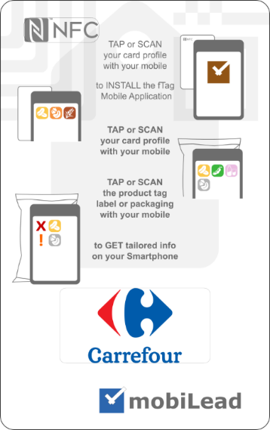
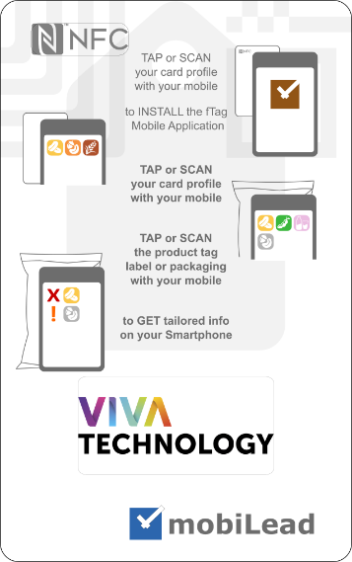
Food allergy and intolerance usage fTag with INPI @ Vivatech
Notes:
ISO, W3C

Slide 24
INTERACTIVE PACKAGING
Smart identifiers for the packaging in food industries, evolving in order to deliver a convenient, personalized, reliable and trusted information to consumers
fTag
2017, September 20th
Notes:
Harnessing active and intelligent technologies to add value to flexible and rigid packaging
How to create positive experiences to bring healthier life to people through food ?
Smart identifiers for the packaging in food industries is evolving in order to deliver a convenient, personalised,
reliable and trusted information to consumers
Mr. Laurent Tonnelier, CEO,
MOBILEAD - FTAG, France

