Slide 1
Bar Code Realities
Peter Langlois
Product Management and Strategy
http://langlois.tel

Slide 2
North American Numbering Plan Registry and other countries
Number Portability
Common Short Codes Registry
Domain registries: .biz .us .cn .tn .tel
GSMA’s Pathfinder: Converting phone numbers to IP addresses and SIPIX for business
Web Site analytics, management, and optimization
Mobile Messaging infrastructure
NeuStar makes Networks SmarterSM
Mission:
To be the world’s leading provider of managed IP services that enable communication across networks, applications, and enterprises

Slide 3
Today’s topics
Bar Codes: A Global Advertising Phenomenon
Mobile Operators Have a Large Impact
Make Your Organization’s Needs Well Understood

Slide 4
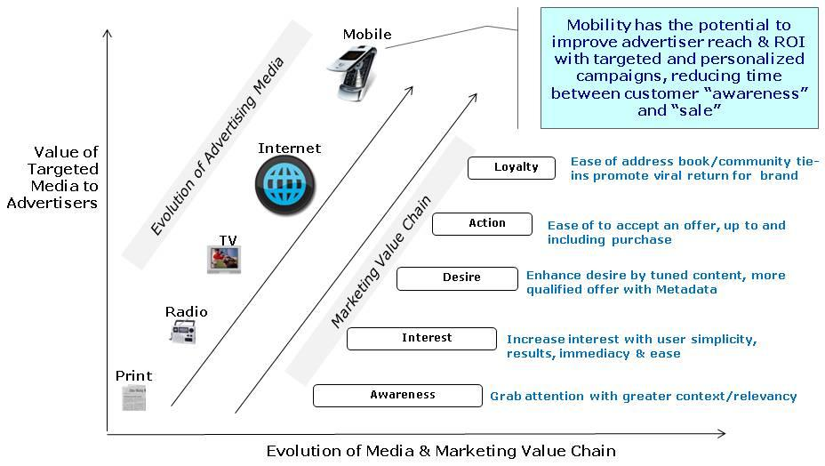
Bar Codes: A Global Advertising Phenomenon
Bar Codes are a Mobile Marketing method of access and discovery
Like banner ads, short codes and dial codes
Objective is customer acquisition and engagement
Target of one marketing
Compare uses and costs to other Direct Response media to determine rate of use and adoption
Consumer PULL
Measurable engagement
Quality experience
Already deployed in France, Japan, Poland, Italy, Australia
And looking to be deployed in Spain, USA, and elsewhere
Mobile Marketing taking a growing share of total marketing spend of over $6B (growing to $12B by 2012) worldwide.
Informa, Carat Interactive, Kelsey Group

Slide 5
Top Issues
What is a scan worth: Analogues
A Google Ad word
A CPA
How can a Brand control its codes
Maintain Authority: control the registered reference – who will be asked to resolve the code
By investing only in systems that provide direct control over the authority specified in the code
By being able to change the authority on demand
How Operators can best recognize Brands
Brands take the rightful position as the funding mechanism for the technology, systems, and content delivered through mobile operators

Slide 6
Mobile Operator Views Differ
North America: MOs in the starting gate
Wanting to take a strong position as an advertising entity
Needing the market to prove itself
Europe: MOs taking a leading role, where they are becoming/leveraging media companies
Content delivery: Television, portals, advertising
Vertically packaged solutions: Buy from the MO or in the MO channel.
Smaller MOs do not have the size and scale for these very large ambitions: Looking for a way to participate.
MOs (like others) have as a goal to extract maximum value for their investments.

Slide 7
Where Interests Converge
A unified marketplace is better
Operators play a key role in promoting and distributing reader
Getting brands engaged adds value
Scale decreases costs and improves outcomes
Single point of control
A common service mark for readers and codes ensures appropriate behavior and instills confidence

Slide 8
What you should make known
Code control
Bottom line authority is with the Brand.
Vendor Diversity (Scale and interoperability)
Buy like you buy today
Same partners, channels, and mechanisms
Your intention to move with mobile operators
Synch up reduces risk all around
Sets realistic expectations

Slide 9
Questions?
Peter Langlois
Pete.langlois@neustar.biz
+1 703 930 9613
Vcard at: http://langlois.tel

