Slide 1
MOBILE CODES
Attilio G Zani : Director of Business Development, GSMA

Slide 2
What is the GSMA?
Founded in 1987 by 15 operators committed to the joint development of a cross border digital system for mobile communications
In 22 years GSMA membership has grown to 750 of the world’s mobile operators and 200 companies in the broader mobile ecosystem, from 219 countries
Innovating, incubating and creating new opportunities for its membership, to drive the growth of the global mobile communications industry
REPRESENTING MORE THAN 3.5 BILLION MOBILE CONNECTIONS

Slide 3
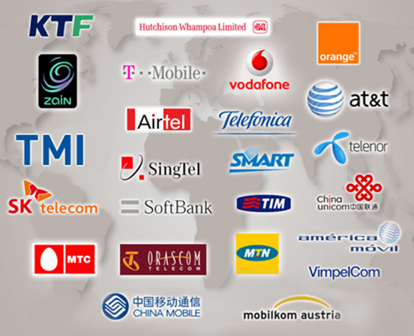
GSMA Board
Formed in 2003, the Board provides the Association’s membership with a strong voice, clear direction, and fast decision-making
The Board is 26 strong and comprises:
25 senior operator representatives
(including the Chairman)
CEO and GSMA Member of the Board

Slide 4
GSMA and 2D Past...
GSMA Whitepaper – What is inside?
Two different service scenarios (direct and indirect mode)
Business model analysis describing the actors
Defining relationships between the actors
Providing a solution to enable national and international interoperability
Providing a solution to enable a secure and trustworthy service environment
Service recommendations
http://www.gsmworld.com/documents/2D_barcodes_B01_0_2.pdf
SUPPORTING MARKET MAKING ACTIVITY

Slide 5
The Mobile Media Metrics example...
Data that will enable media agencies to better target mobile advertising.
Project supported by FT-Orange, Telefónica O2, T-Mobile, 3 and Vodafone
Measurement process respects the privacy of mobile users
Top Sites: The model will clearly identify the top sites visited by mobile users
User Behaviour: The model will deliver aggregate volumes of users, pages viewed, the time at which they are viewed, and the number and duration of visits etc
Demographics: The real value comes in the combination of site popularity and user behaviour data with aggregated demographic information
UK feasibility study completed
Proceeding to commercial launch in 2H2009
SUPPORTING A NEW FEATURE-RICH MEDIA CHANNEL

Slide 6
GSMA 2D Activity: Now and in the Future
Refine high level business requirements
Work with formal standards organisations, such as GS1 & OMA to arrive at the high level business requirements of the ecosystem
Provide the 2D ecosystem with elements of essential service
Raise the bar...
SUPPORTING A NEW ECOSYSTEM

Slide 7
THANK YOU!
azani@gsm.org

