Slide 1

fTag
EMBALLAGE INTERACTIF
Emballage et Information Santé
Croiser les données nutritionnelles et le profil santé
du consommateur pour traquer les allergènes
15-17 juin, 2017
November 14-17, 2016
Notes:
#frenchtech #startup mobiLead xTag speaker at @VIVATECH event
#brevet #innovation
#patent #IoT #NFC #QR
#VivaTech
@VIVATECH
@INPIFrance
@mobiLead
@FranceBrevets
@Bpifrance

Slide 2
CONFERENCE INPI
CONCESSION DE LICENCES
Un business model dans l’IOT
fTag
Notes:
#frenchtech #startup mobiLead xTag speaker at @VIVATECH event
#brevet #innovation
#patent #IoT #NFC #QR
#VivaTech
@VIVATECH
@INPIFrance
@mobiLead
@FranceBrevets
@Bpifrance

Slide 3
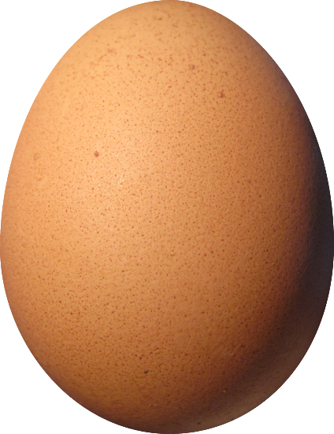
Emballage:
Protéger, informer
Emballage
Protéger le Produit
Information Emballage
Informer le consommateur
Protéger le consommateur
Consommateur
Utilisateur mobile
Patient
Individu
0FRCEB02
DCR21/04

Slide 4
Individualisation
Personnalisation, sur mesure
Individu
Préférences
Carnation
Pathologie
Produit
Personnalisation
Individualisation
Sur mesure
Profil
Personnalisation
Ensemble des informations
Contenu adapté
« Sur mesure »
Notes:
Itc Avant Garde Gothic Lt Bold NUTELLA

Slide 5
from Product Information to Print and Mobile Content
Product Information
Print
URL
NFC Tag
QR Code
Mobile
Content
Notes:
de l’identification unitaire
(produit, emballage, étiquette)
au contenu et services associés

Slide 6
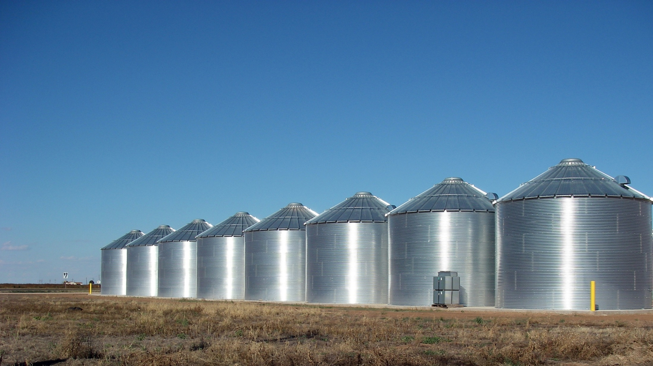
Silos
Marketing, Commerce, Logistic…
Ralls, Texas – Grain silos
Notes:
Existing Problem
Silos

Slide 7

SEVERAL TECHNOLOGIES
QR, DM, UPC, NFC…
Babel Tour, Pieter Bruegel
Notes:
La Tour de Babel (1 563) de Pieter Bruegel
Existing problems
Online offline
No network
Performances

Slide 8
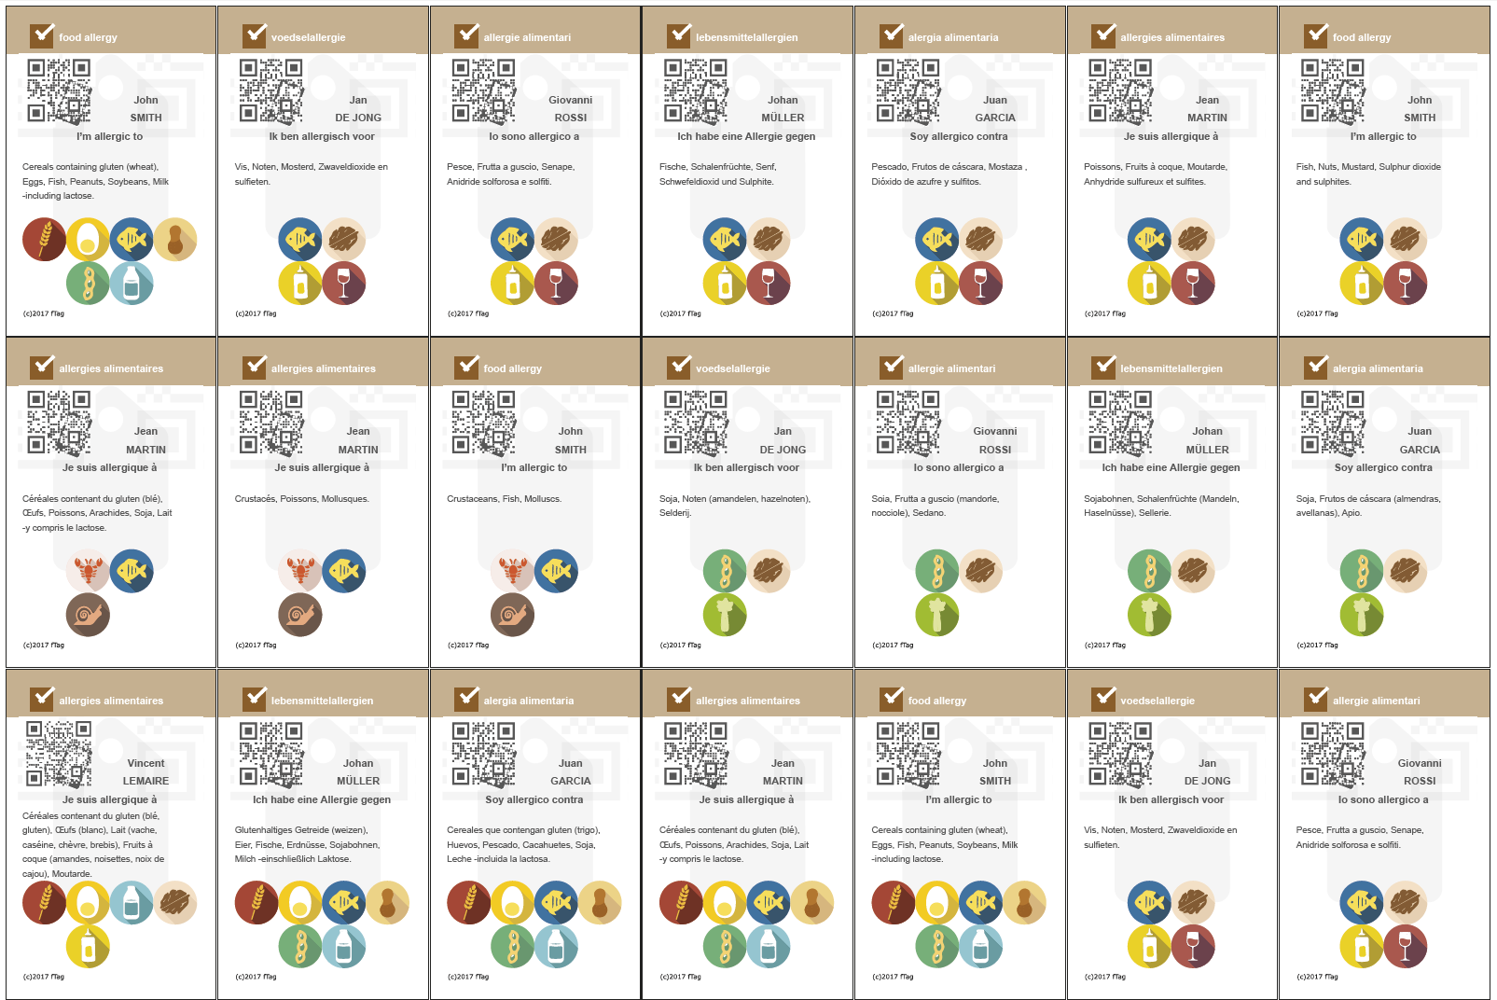
SEVERAL TECHNOLOGIES
QR, DM, UPC, NFC…
Babel Tour, Pieter Bruegel
Notes:
La Tour de Babel (1 563) de Pieter Bruegel
Existing problems
Online offline
No network
Performances

Slide 9
Source: Etude Inquiétude OCHA – CERTOP – CREDOC 2016 c

Slide 10
Why fTAG

Slide 11
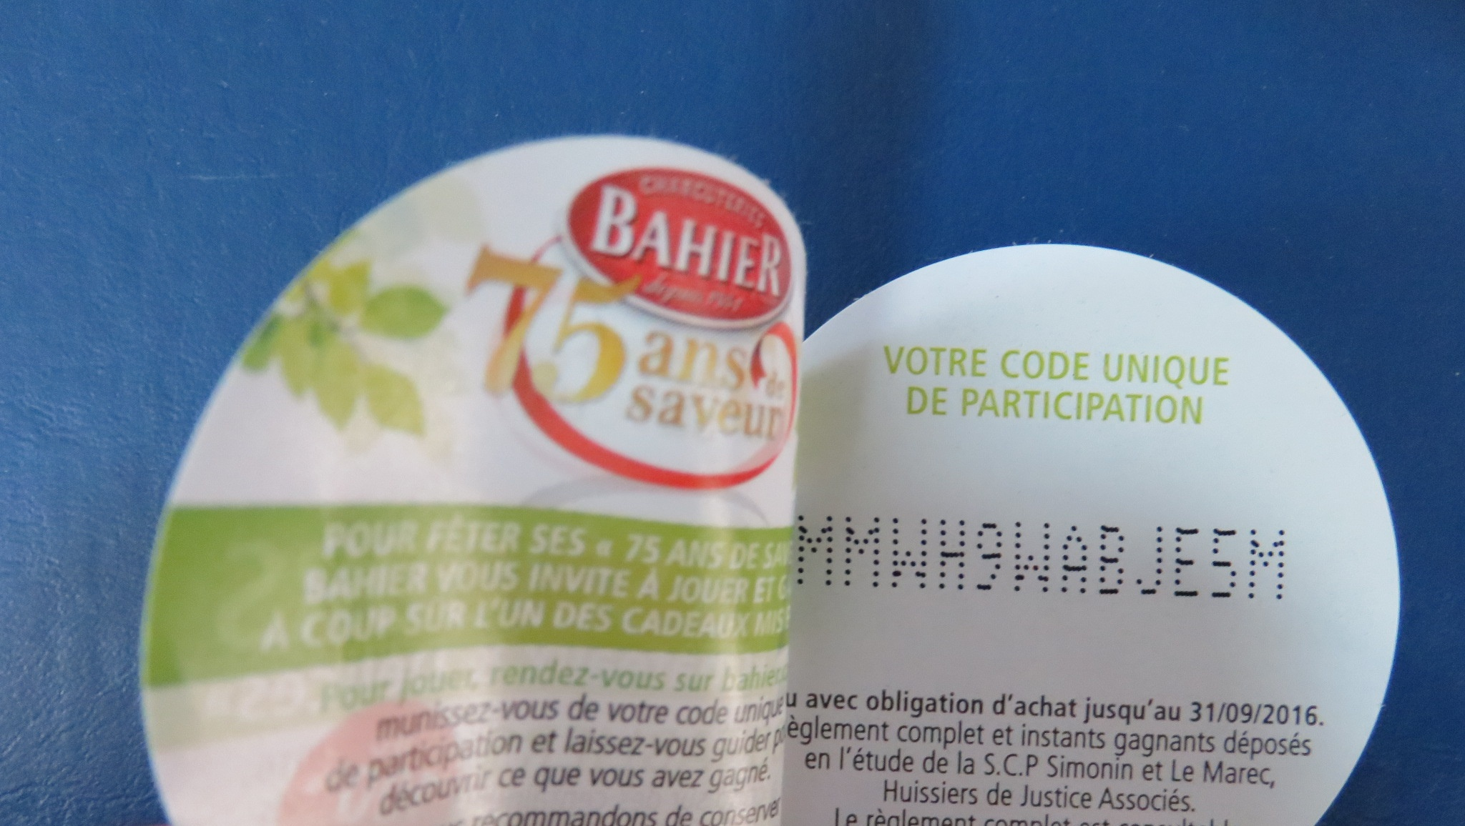
28 000 00 identifiants uniques
Jeu concours
QR, DM, UPC, NFC…
Babel Tour, Pieter Bruegel
Notes:
4B Single Code c'est la 4B Twin avec code aléatoire unique! Cette étiquette multi-couches qui répond déjà à tous vos besoins se perfectionne. Vous pouvez désormais sur un même format d'étiquette, imprimer sur plusieurs volets détachables ou repositionnables...Ce qui augmente déjà considérablement votre surface de communication. 4B Single Code vous permet aujourd'hui d'imprimer un code aléatoire unique. Une véritable solution "clé en main"!
Compagnie Industrielle d'Etiquettes
BAHIER
AOSTE
Justin Bridou
C'est ma tournée
12 480 000 =
10 000 000
2 400 000
60 000
20 000
12 050 000

Slide 12

Identifiants sur l’ensemble des produits
Information produits
Babel Tour, Pieter Bruegel
Notes:
4B Single Code c'est la 4B Twin avec code aléatoire unique! Cette étiquette multi-couches qui répond déjà à tous vos besoins se perfectionne. Vous pouvez désormais sur un même format d'étiquette, imprimer sur plusieurs volets détachables ou repositionnables...Ce qui augmente déjà considérablement votre surface de communication. 4B Single Code vous permet aujourd'hui d'imprimer un code aléatoire unique. Une véritable solution "clé en main"!
Compagnie Industrielle d'Etiquettes
BAHIER
AOSTE
Justin Bridou
C'est ma tournée
12 480 000 =
10 000 000
2 400 000
60 000
20 000
12 050 000

Slide 13

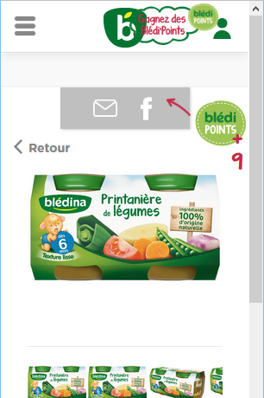


Identifiants sur l’ensemble des produits
Information produits
GTIN
GTIN
3041091022851
http://d4n.fr/015Lwongj0
3041091022851
Notes:
http://d4n.fr/015Lwongj0
https://www.bledina.com/produits-bebe/bledina-pots-2x130g-printaniere-de-legumes-des-6-mois

Slide 14

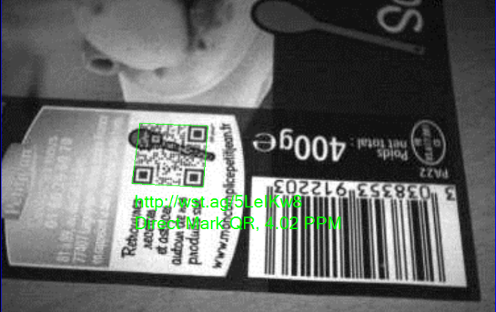
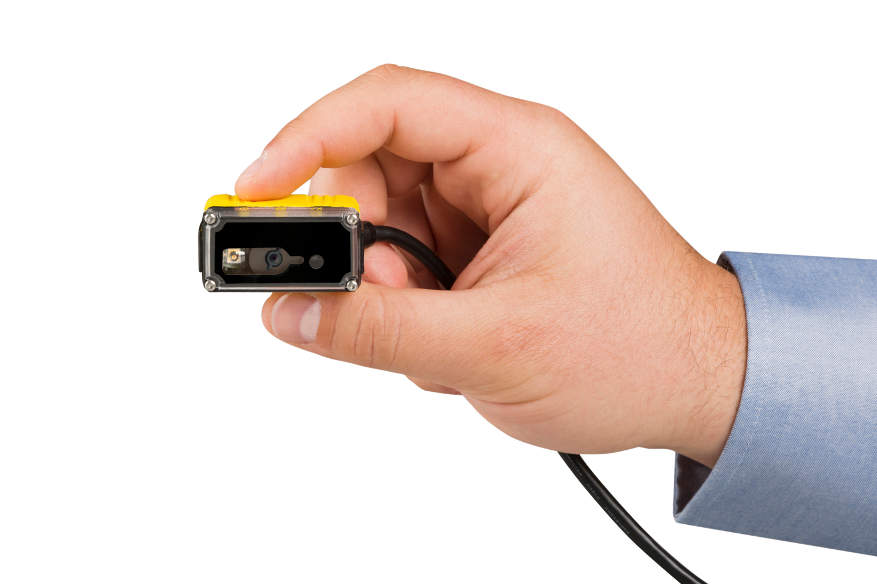
Approche industrielle
Technique et Graphique
Notes:
Highly Graphical QR Code (QR+)
ISO / IEC 18004 compliance
Custom URL domain name
Optimised Codification

Slide 15

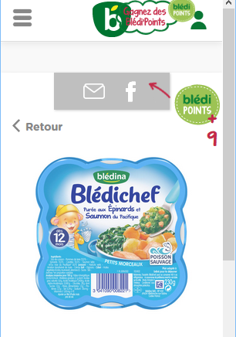
Approche industrielle
Concept Pack
Notes:
ISO, W3C

Slide 16

12 050 000
QR, DM, UPC, NFC…
Babel Tour, Pieter Bruegel
Notes:
4B Single Code c'est la 4B Twin avec code aléatoire unique! Cette étiquette multi-couches qui répond déjà à tous vos besoins se perfectionne. Vous pouvez désormais sur un même format d'étiquette, imprimer sur plusieurs volets détachables ou repositionnables...Ce qui augmente déjà considérablement votre surface de communication. 4B Single Code vous permet aujourd'hui d'imprimer un code aléatoire unique. Une véritable solution "clé en main"!
Compagnie Industrielle d'Etiquettes
BAHIER
AOSTE
Justin Bridou
C'est ma tournée
12 480 000 =
10 000 000
2 400 000
60 000
20 000
12 050 000

Slide 17
from mobiLead’s Smart and Unique Identifiers to fTag as a solution
Patents, Brands, Know-how
Prototypes, Proof of Concept
8Tag
blockchain
mTag
tracking
fTag
food allergens
zTag
security
jTag
anticounterfeiting

Slide 18
xTag in the packaging ecosystem
Brand
Product
Batch
Unit
SKU / GTIN
Ingredients
Allergens
sGTIN
UUID
Exp.
Every
Each
Cold Data
Warm Data
Variable Printing
Unitary
Tagging

Slide 19
from silos to convergence
Smart and Unique Identifiers
Where…
Geocoding
Region
What…
Label Signature
Product Signature
URL based
Unique ID
When…
Timestamp
Period of Time
What…
ERP Identifier,
GTIN Identifier
With…
Visual Identifier
Exist…
Blockchain
public ledger
xTag Coded
Cyphered

Slide 20
Food allergy and intolerance a serious medical issue
Food allergy is a serious medical issue
15 million people in the US
17 million people in Europe
3.5 million are younger than 25 years
Number of people who have a food allergy is growing
Notes:
Problème
Context legal

Slide 21
Food allergy and intolerance management
INCO – European Union (EU)'s 1169/2011 regulation
The European Union (EU)'s 1169/2011 regulation, commonly referred to as INCO (Information to Consumers), makes mandatory for brands to provide consumers with clearer information about the food products.
fTag is the optimal solution
to help brand owners to be compliant with the regulation
to provide convenience to users, consumers and patients
Notes:
Contexte légal
Voice of the brand

Slide 22
Food allergy and intolerance management
INCO – European Union (EU)'s 1169/2011 regulation
Information on products with an allergenic or intolerance effect should be given to enable consumers, to make informed choices which are tailored and safe for them.
Profil
Ensemble des informations
Contenu adapté
« Sur mesure »

Slide 23
Printed information vs Digital mobile comparaison
Limited space on pack
Few languages
Generic
Hard to read
Complex
Legal
Unlimited space on mobile
Unlimited languages
Tailored
Easy to read
Trivial
Legal with fTag
Packaging or Label
Mobile content

Slide 24
from Brand owner to End user bridging the Gap on Consumer Good Package
Brand owner
End user
Print
  Package
  Label
Digital
  Mobile
Legal
Consumer
Patient
Mobile User
Ensemble des infos
Contenu adapté
« Sur mesure »
Notes:
Problème
Context legal

Slide 25
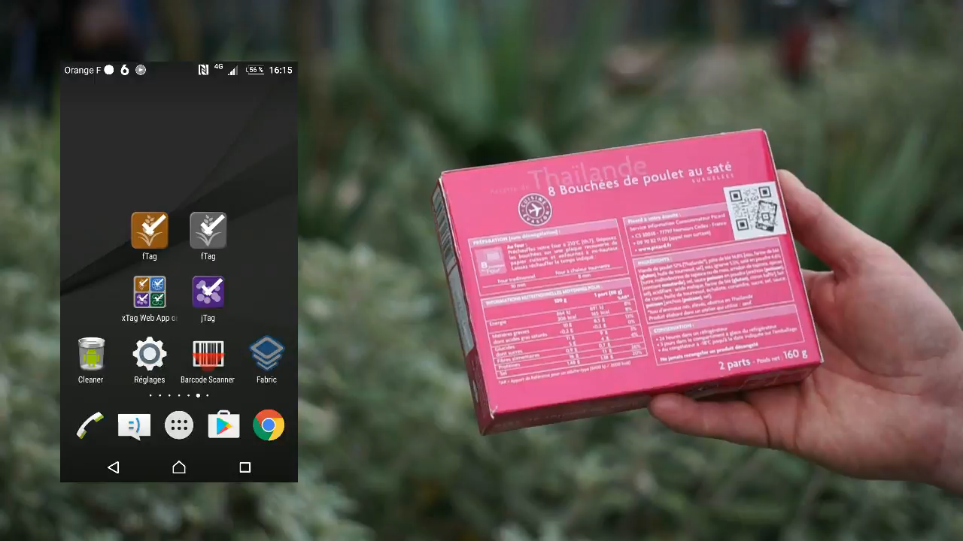
MPEG video
Read the article from
See a short video on
fTag
Notes:
ISO, W3C

Slide 26
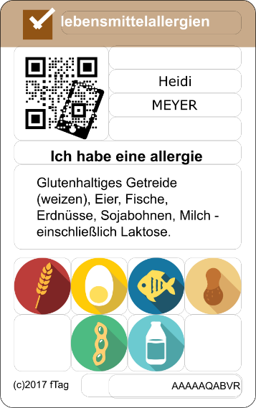
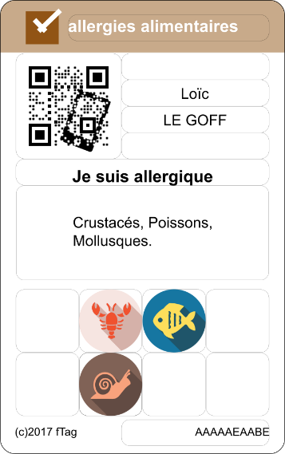
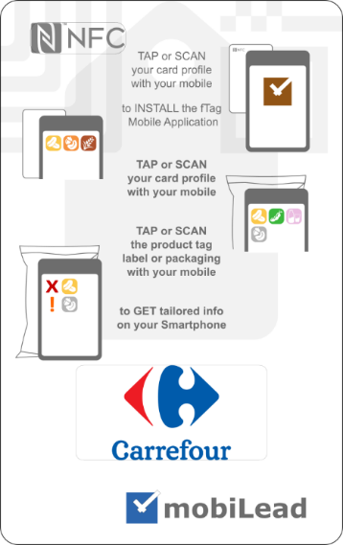
Food allergy and intolerance usage fTag with Carrefour @ Vivatech
Notes:
ISO, W3C

Slide 27
from Product Information to Tailored Content with the fTag solution in few steps
« Voice of the Brand »
product information
End user
card profile
1/ print
on pack or label
2/ read
raw content
(3/ read
user
Profile)
4/ read
tailored content
Printed on Packaging
or Label
Tailored
Mobile
content
URL
NFC Tag
QR Code

Slide 28
Food allergy and intolerance management fTag – as easy as ABC
Scan or Tap a Product Pack
or Label
Scan or Tap your Profile card
the Product info
is displayed
no network required
your Profile
is displayed
2017 Innovation
Notes:
ISO, W3C

Slide 29
Food allergy and intolerance management fTag – as easy as ABC
Your profile
is known for
few hours…
after
few hours…
Scan or Tap a Product Pack
or Label
Scan or Tap a Product Pack
or Label
the Tailored info
is displayed
no network required
your Profile
is gone
2017 Innovation
Notes:
ISO, W3C

Slide 30
fTag team, from Oracle to data driven business
Laurent TONNELIER 47, CEO
mobiLead, Microsoft, Oracle US, CNES, Essilor
DEA BdD and MIAGe
Bruno LAI, 50, COO
Oracle, MicroStrategy, Business Objects, SG
DESS CTCI
Catherine DIEMER, 57, Business dev
APEC, Oracle
ESIEA and MBA IAE
Anaëlle LEBAS, 47, CTO
HP, B&D, Fatwire, OpenMarket, Oracle
DEA BdD
Xavier PAQUET, 33, CMO
Bolton, William Saurin, Pierre Martinet
Agri-Food ISARA and EM Lyon
fTag
Notes:
Datadriven bus

Slide 31
B2C / user ecosystem tailored card
Restaurant
Brands
Patient
Online plateforme
500 € /year
Sponsors
1€ to 5€ /card
NFC Card
5€ /card

Slide 32
B2B / CPG Brand owner ecosystem
3 Targets, 3 Phases
Brand owner
Packaging and label
Printing company
Professional
printing machines
API and OEM
3.5¢ ‰ tag
Services
Tools and SAAS
Phase I
Phase II
Phase III

Slide 33
Printed information vs Digital mobile
comparaison
Notes:
24/03 Journée Utilisateurs #ORACLE #WeLoveStartup #JU2016 #AUFO #JDEdwards #PeopleSoft http://clubutilisateursoracle.org/ju/journee-utilisateurs-2016/

Slide 34

Ils nous font déjà confiance/notre écosystème

Slide 35
key features fTag Tags and Labels
TAGS | fTag | competition
EAN
QR Code
NFC
Local data
Advanced codification
Remote data
W3C URL based
  The only solution as legally valid as a printed information on pack
  (data are local)
Notes:
Observance therapeutique = posologie (Adherence)
Diets = Regime

Slide 36
key features fTag Mobile A pplications
MOBILE ACCESS | fTag | competition
Medical certified
Remote access
Local access
Privacy by Design
Mobile Web App
Native App Androïd
Multilingual DE, EN, ES, FR, IT, NL
QR Code reader
NFC device
  The only solution designed to support privacy as a core feature
Notes:
Observance therapeutique = posologie (Adherence)
Diets = Regime

Slide 37
key features fTag Data
DATA | fTag | competition
Medical data source
INCO main 14 Allergens +Traces
INCO detailled 28 Allergens +Traces
Multilingual DE, EN, ES, FR, IT, NL
beyond Regulation 230 Allergens +Traces | EN, FR
xTag compliance 8tag, jTag, mTag, zTag
  The only solution based on a reliable medical data source
Notes:
Observance therapeutique = posologie (Adherence)
Diets = Regime

Slide 38
What are you looking for at the accelerator
Explorer new businesses
Diets
Ingredients
Allergens
Allergens
Allergens
Industries
Food
Cosmetics
Pharmaceuticals
Icons ©Wissawa Khamsriwath
Notes:
Observance therapeutique = posologie (Adherence)
Diets = Regime
Icons ©Wissawa Khamsriwath
http://www.flaticon.com/authors/wissawa-khamsriwath

Slide 39

About mobiLead
Committed to standards / Industy focused
8Tag
blockchain
mTag
tracking
fTag
food allergens

Slide 40
About mobiLead
Smart and Unique Identifiers
Where…
Geocoding
Region
What…
Label Signature
Product Signature
URL based
Unique ID
When…
Timestamp
Period of Time
What…
ERP Identifier
With…
Visual Identifier
What…
GTIN Identifier
Coded
Cyphered

Slide 41
What are you looking for at the accelerator
The more you know the more you dare
After several years of Research & Development, Prototypes, and Proof of Concept, our unique vision is now coming to fruition into a specific food Allergies software solution: fTag.
Joining the accelerator is a rare opportunity for some technical innovations to find their market through challenged business opportunities; a unique opportunity to achieve in few months, the goals that would have been reached in years.
It is key for any company, especially those based on technical innovations, to be as creative on the business side as on the technical side. A Minimum Viable Product (MVP) is nothing if not related to a Minimum Viable Business (MVB).
MVP
MVB
Notes:
After several years of Research & Development, Prototypes, and Proof of Concept, our unique vision is now coming to fruition into a specific food Allergies software solution: fTag.
Joining the HEC accelerator is a rare opportunity for some technical innovations to find their market through challenged business opportunities; a unique opportunity to achieve in few months, the goals that would have been reached in years.
It is key for any company, especially those based on technical innovations, to be as creative on the business side as on the technical side. A Minimum Viable Product (MVP) is nothing if not related to a Minimum Viable Business (MVB).
Accélérer le temps!!!
Faire en 3 ans ce que nous ferions en un an !!
Affiner notre value proposition, valeur perçue par le client (Couple produits/marché business model)
Nous accompagner dans le développement commercial / le déploiement de la mise en œuvre (POC payant)
Grâce aux ressources et compétences de l’incubateur, nous permettre de réaliser en un an ce que nous mettrions 3 ans à faire

Slide 42
About mobiLead
Committed to standards / Industy focused
8Tag
blockchain
mTag
tracking
fTag
food allergens

Slide 43

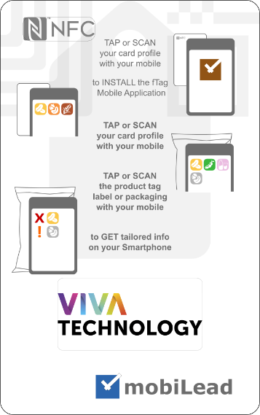
Food allergy and intolerance usage fTag with INPI @ Vivatech
Croiser les données nutritionnelles et le profil santé du consommateur pour traquer les allergènes
Notes:
ISO, W3C

Slide 44
Smart Identifiers
Smart uages
Involved in norms at ISO / AFNOR, including TC307 Blockchain.
> able to share technical expertise of norms and standards
INPI and FRANCE BREVETS selected partner, investment fund dedicated to IP.
> able to share our knowledge of patent and patent licensing in software
ORACLE Corporation Product Manager based in Redwood Shores.
> able to share my experience in the software industry based in USA
Notes:
Because of our commitment to promoting standards and best practices, our technical expertise, we are actively involved in norms at ISO / AFNOR (the French standards agency), including the newly created TC307 Blockchain / Distributed Ledger Technology;
As a France Brevets selected partner, an investment fund dedicated to international patent licensing, we hold several patents that may directly be used by fTag solution; We may be able to share our deep knowledge of patent and patent licensing in the software industry;
As a former ORACLE Corporation Product Manager based in Redwood Shores, USA; I may be able to share my experience in the software industry while based in the San Francisco bay area.
le dépôt de brevets/ patents (8 familles de brevets déposés à ce jour depuis 7 ans)
Comment, en tant que startup, intégrer la propriété intellectuelle dans son développement, travailler avec l’INPI, les avocats, la réglementation de la propriété intellectuelle en USA, Asie…
La connaissance fine des Normes et standards ISO, AFNOR, W3C… ( un associé membre du W3C)
Le réseau du G20YEA, évènement organisé par Citizen entrepreneurs (organisateur des G20 des jeunes entrepreneurs (un des associés à Berlin en juin 2017).
Expérience de « Product manager » chez Oracle Corp , San Francisco (CEO)
Expérience d’approche gestion grand compte/big data par un des associés

Slide 45
fTag
2017, June 15-17th with INPI at Vivatech, Paris
fTag
food allergens
2017, September 19th Smart Packaging, Cologne
Notes:
#frenchtech #startup mobiLead xTag speaker at @VIVATECH event
#brevet #innovation
#patent #IoT #NFC #QR
#VivaTech
@VIVATECH
@INPIFrance
@mobiLead
@FranceBrevets
@Bpifrance

