Slide 1

INTERACTIVE PACKAGING
Food & Wellbeing
How to create positive experiences to bring healthier life to people through food ?
fTag
2017, June 17th
Notes:
https://challenges.vivatechnology.com/en/challenges/carrefour-5/

Slide 2
Food allergy and intolerance a serious medical issue
Food allergy is a serious medical issue
15 million people in the US
17 million people in Europe
3.5 million are younger than 25 years
Number of people who have a food allergy is growing
Rates among children +50% between 1997 and 2011

Slide 3
Food allergy and intolerance management
INCO – European Union (EU)'s 1169/2011 regulation
The European Union (EU)'s 1169/2011 regulation, commonly referred to as INCO (Information to Consumers), makes mandatory for brands to provide consumers with clearer information about the food products.
fTag is the optimal solution
to help brand owners to be compliant with the regulation
to provide convenience to users, consumers and patients
Information on products with an allergenic or intolerance effect should be given to enable consumers, to make informed choices which are tailored and safe for them.

Slide 4
from mobiLead’s Smart and Unique Identifiers to fTag as a solution
Patents, Brands, Know-how
Prototypes, Proof of Concept
8Tag
blockchain
mTag
tracking
fTag
food allergens
zTag
security
jTag
anticounterfeiting

Slide 5
from Product Information to Print and Mobile Content
Product Information
Printed
Label
URL
NFC Tag
QR Code
Mobile
Content
Notes:
de l’identification unitaire
(produit, emballage, étiquette)
au contenu et services associés

Slide 6

Emballage:
Protéger, informer
Packaging
Protect the product
Information on Pack or Label
Inform the consumer
Protect the consumer
Consumer
Mobile User
Patient
Individual
0FRCEB02
DCR21/04

Slide 7
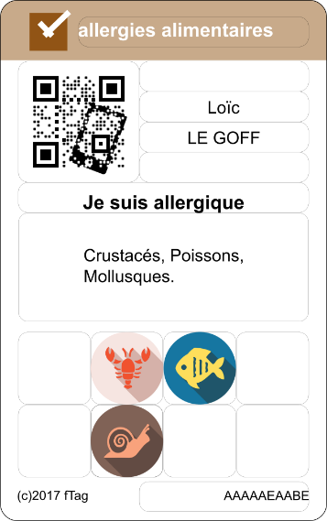
Tailored Content on Mobile
« Sur mesure »
Profile
Lots of printed Information
Tailored Content on Mobile
« Sur mesure »
Notes:
Limited space on pack
Few languages
Generic
Hard to read
Complex
Legal
Unlimited space on mobile
Unlimited languages
Tailored
Easy to read
Trivial
Legal with fTag

Slide 8
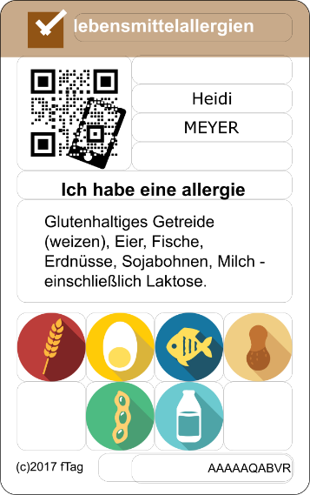
Tailored Content on Mobile
« Sur mesure »
Individual
Preferences
Pathology
Product
Personalization
Individualization
Tailored content
Profile
Lots of printed Information
Tailored Content on Mobile
« Sur mesure »
Notes:
Limited space on pack
Few languages
Generic
Hard to read
Complex
Legal
Unlimited space on mobile
Unlimited languages
Tailored
Easy to read
Trivial
Legal with fTag

Slide 9
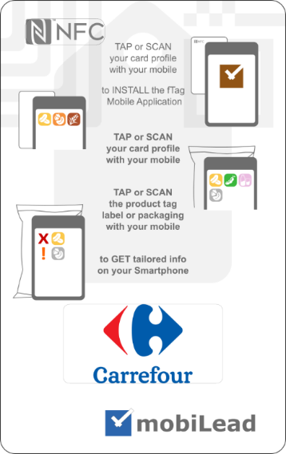
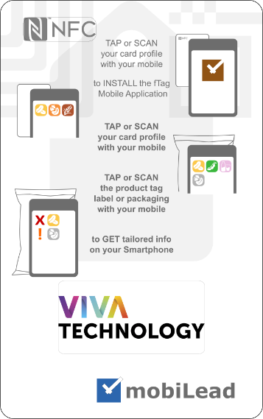
Food allergy and intolerance usage fTag with INPI @ Vivatech
Notes:
ISO, W3C

Slide 10
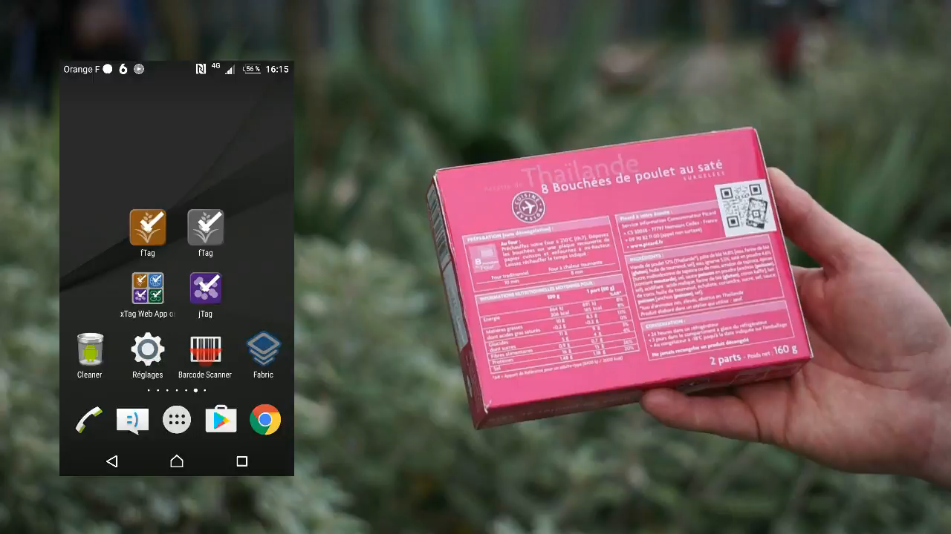
MPEG video
Read the article from
See a short video on
fTag
Notes:
ISO, W3C

Slide 11
INTERACTIVE PACKAGING
Food & Wellbeing
fTag
2017, September 19th Smart Packaging, Cologne
Notes:
https://challenges.vivatechnology.com/en/challenges/carrefour-5/

