Slide 1

CONFERENCE INPI
CONCESSION DE LICENCES
Un business model dans l’IOT
fTag
15h30 15 juin 2017
Paris
Speaker at
Notes:
#VivaTech #INPI #OMPI @VIVATECH
#frenchtech #startup #innovation #techno
@INPIFrance #brevet #patent
@FranceBrevets @Bpifrance
#IoT #NFC #FranceBrevets

Slide 2
CONFERENCE ANNUELLE
EMBALLAGE INTERACTIF
Information Santé
Croiser les données nutritionnelles et le profil santé du consommateur
fTag
30 mai 2017
Paris
Speaker at

Slide 3
COLLOQUE
DE L’ETIQUETTE NUMERIQUE
EMBALLAGE INTERACTIF
Sécurité et Valeur ajoutée
fTag
23 mars 2017
Paris
Speaker at

Slide 4
fTag
8 décembre 2016
La Rochelle
Speaker at
CONGRÈS ATF-FLEXO
EMBALLAGE INTERACTIF
Les données nutritionnelles

Slide 5
Food allergy and intolerance management fTag – as easy as ABC
Your profile
is known for
few hours…
after
few hours…
Scan or Tap a Product Pack
or Label
Scan or Tap a Product Pack
or Label
the Tailored info
is displayed
no network required
your Profile
is gone
2017 Innovation
fTag
Notes:
ISO, W3C

Slide 6
Colloque de l’Etiquette Numérique
Sécurité et Valeur ajoutée
fTag
2017, March 23rd

Slide 7
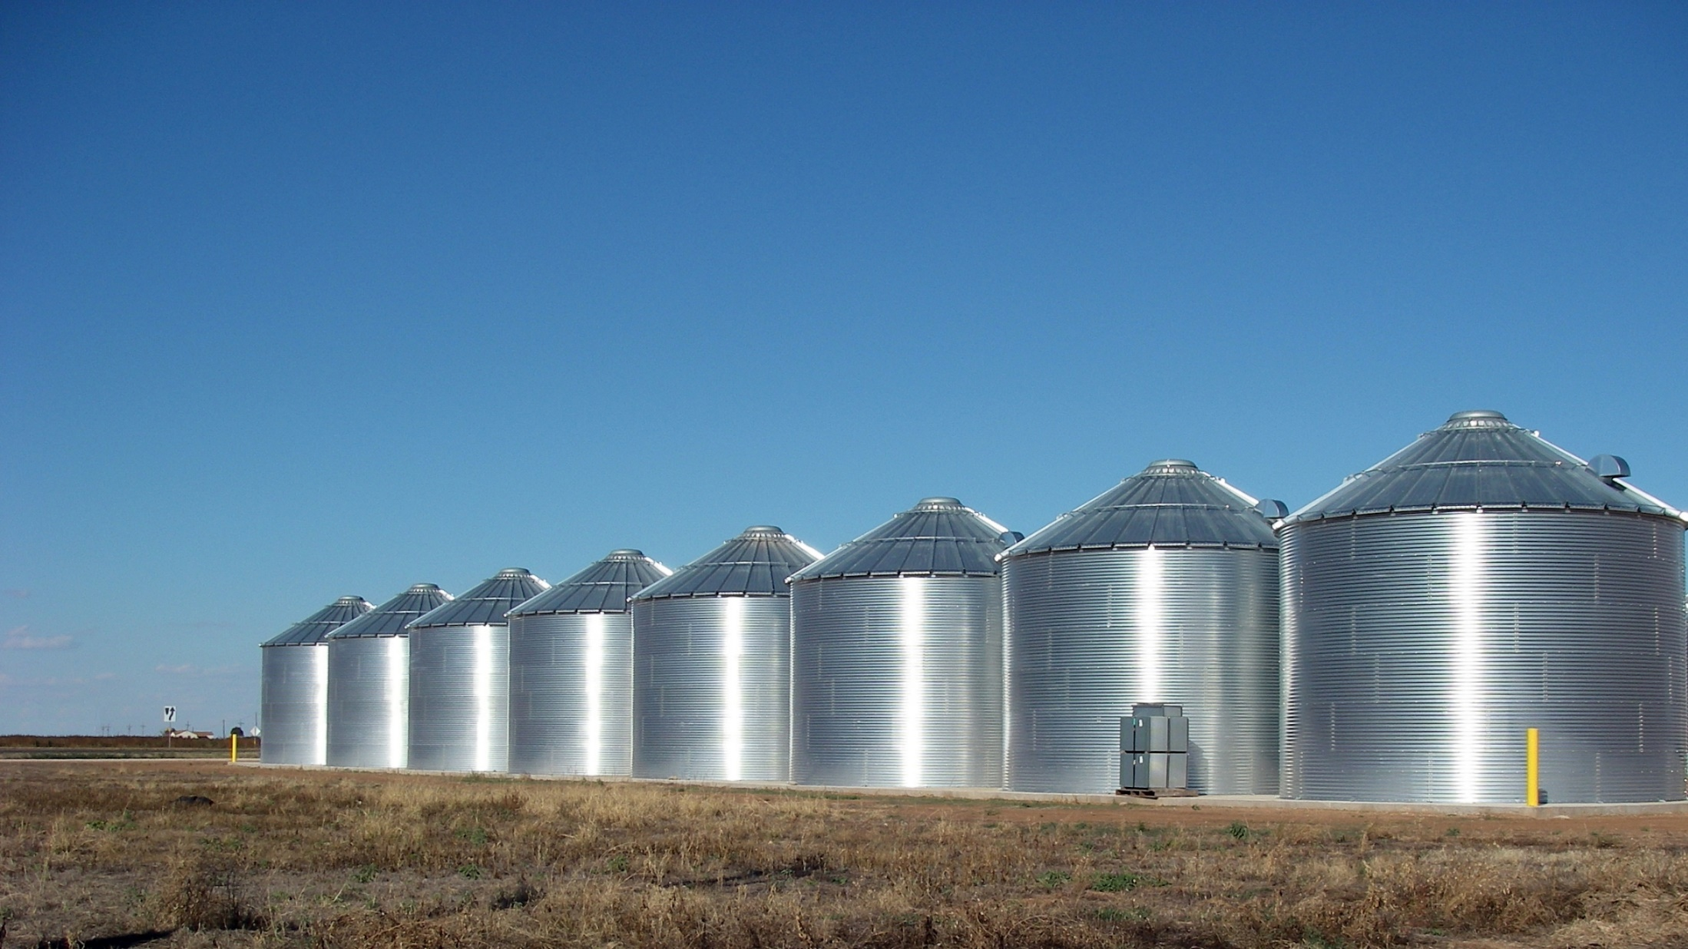
SeveraL USAGES
Marketing, Commerce, Logistic…
Ralls, Texas – Grain silos
Notes:
Existing Problem
Silos

Slide 8

SEVERAL TECHNOLOGIES
QR, DM, UPC, NFC…
Babel Tour, Pieter Bruegel
Notes:
La Tour de Babel (1 563) de Pieter Bruegel
Existing problems
Online offline
No network
Performances

Slide 9
About mobiLead
Smart and Unique Identifiers
Where…
Geocoding
Region
What…
Label Signature
Product Signature
URL based
Unique ID
When…
Timestamp
Period of Time
What…
ERP Identifier,
GTIN Identifier
With…
Visual Identifier
Exist…
Blockchain
public ledger
xTag Coded
Cyphered

Slide 10
xTag in the packaging ecosystem
Brand
Product
Batch
Unit
SKU / GTIN
Ingredients
Allergens
sGTIN
UUID
Exp.
Every
Each
Cold Data
Warm Data
Variable Printing
Unitary
Tagging

Slide 11
from mobiLead’s Smart and Unique Identifiers to fTag as a solution
Patents, Brands, Know-how
Prototypes, Proof of Concept
8Tag
blockchain
mTag
tracking
fTag
food allergens
zTag
security
jTag
anticounterfeiting

Slide 12
Food allergy and intolerance a serious medical issue
Food allergy is a serious medical issue
15 million people in the US
17 million people in Europe
3.5 million are younger than 25 years
Number of people who have a food allergy is growing
Rates among children increased +50% between 1997 and 2011
fTag

Slide 13
Food allergy and intolerance management
INCO – European Union (EU)'s 1169/2011 regulation
The European Union (EU)'s 1169/2011 regulation, commonly referred to as INCO (Information to Consumers), makes mandatory for brands to provide consumers with clearer information about the food products.
fTag is the optimal solution
to help brand owners to be compliant with the regulation
to provide convenience to users, consumers and patients
Information on products with an allergenic or intolerance effect should be given to enable consumers, to make informed choices which are tailored and safe for them.
fTag

Slide 14
Printed information vs Digital mobile comparaison
Limited space on pack
Few languages
Generic
Hard to read
Complex
Legal
Unlimited space on mobile
Unlimited languages
Tailored
Easy to read
Trivial
Legal with fTag
(data are also local)
Packaging or Label
Mobile content
fTag

Slide 15
Food allergy and intolerance management fTag – as easy as ABC
Scan or Tap a Product Pack
or Label
Scan or Tap your Profile card
the Product info
is displayed
no network required
your Profile
is displayed
2017 Innovation
fTag
Notes:
ISO, W3C

Slide 16
Food allergy and intolerance management fTag – as easy as ABC
Your profile
is known for
few hours…
after
few hours…
Scan or Tap a Product Pack
or Label
Scan or Tap a Product Pack
or Label
the Tailored info
is displayed
no network required
your Profile
is gone
2017 Innovation
fTag
Notes:
ISO, W3C

Slide 17
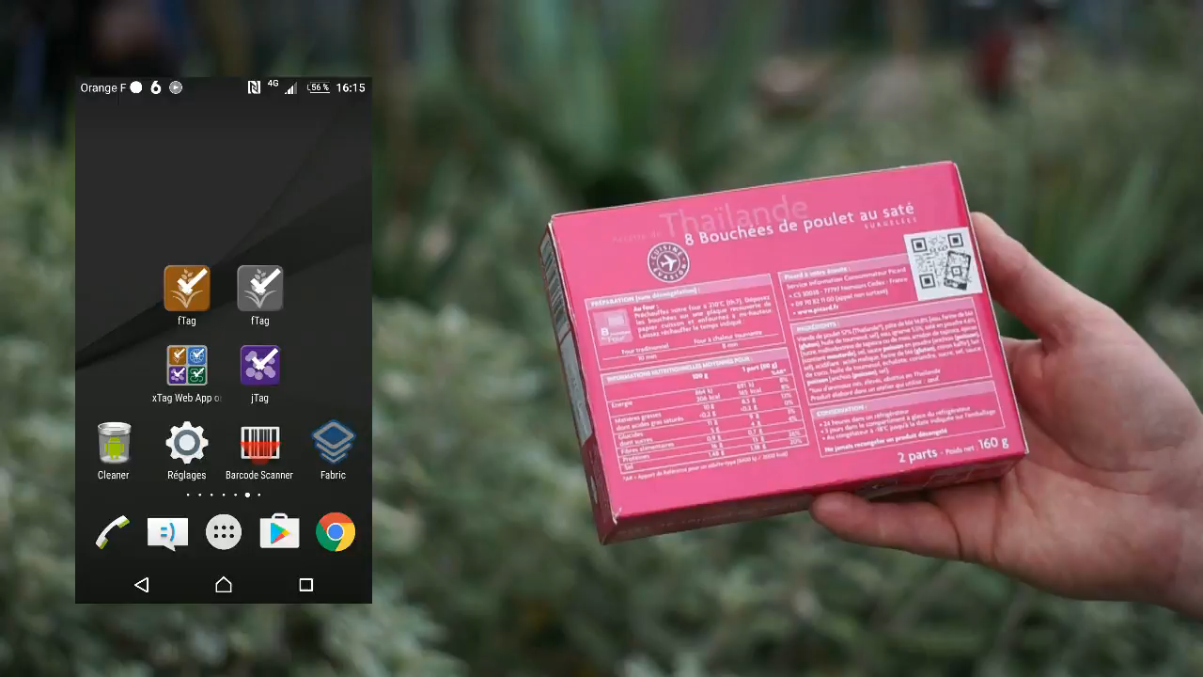
MPEG video
fTag
Notes:
ISO, W3C

Slide 18
Colloque de l’Etiquette Numérique
Sécurité et Valeur ajoutée
fTag
fTag
food allergens
2017, March 23rd

