Slide 1
2D Barcode in China
QIU Jiangfeng，GS1 China
October 23, 2019

Slide 2
A Set of Data…
As of the end of December 2018, the scale of:
Internet Users
82851
Online Shopping Users
61011
Mobile Shopping Users
59191
Mobile Internet Users
81698
≈
The number of Internet users is almost equal to that of mobile phone users.
≈
Almost everyone who surfs the Internet is using mobile phone shopping.
Unit: 10,000 persons
Source: CNNIC

Slide 3
2D Barcode is Everywhere in China

Slide 4
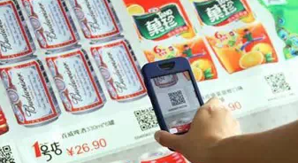
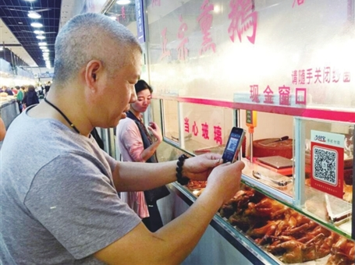
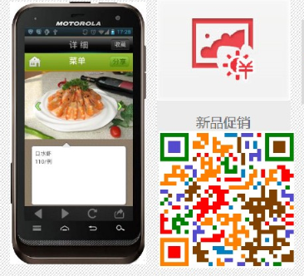
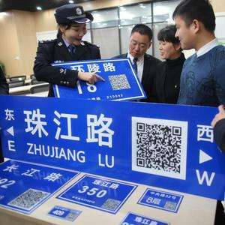
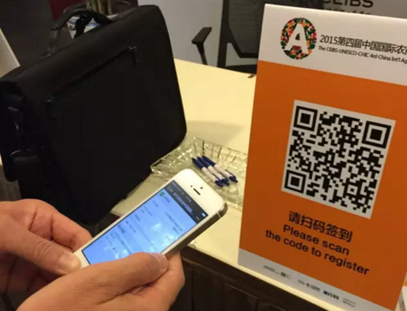
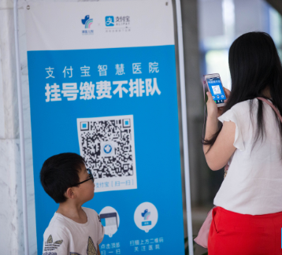
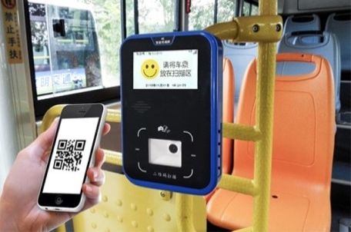
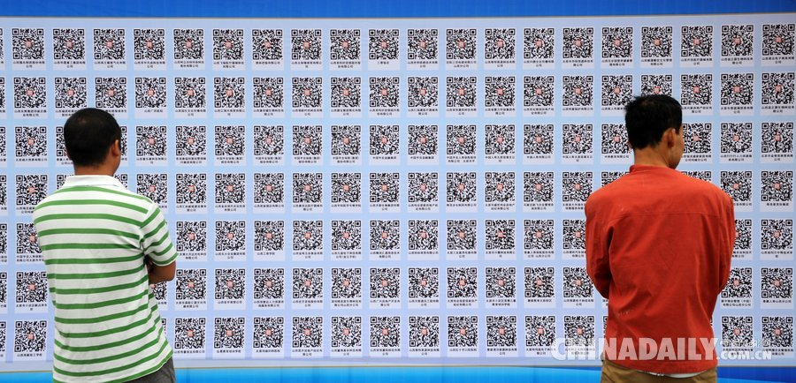
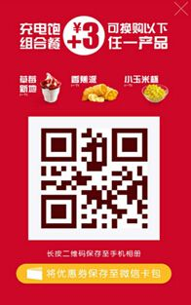
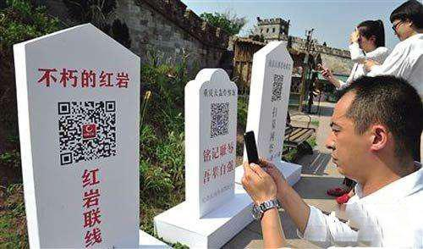
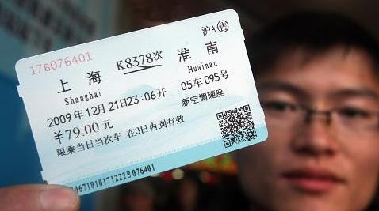
Strong Congnitive Foundation of 2D Barcode
Online sales
Scan for shopping
Mobile payment
Scan and pay
Marketing
Scan and order/get coupons/discounts
Track & trace
Scan and get traceability info
Anti-counterfeiting
Scan and get validation info
Mobile law enforcement inspection
Scan and get info to help with law enforcement
Social
Scan and add friends
Sign-in for meeting
Scan and sign in
Tools
Scan and download APP
Electronic ticket
Scan and go through metro gate/take a bus
Recruitment
Scan and see the job info
Service
Scan to see what happened to the deceased
Chinese people from all parties in China generally recognize 2d barcode.
Most of the 2d barcodes do not use GS1 KEYs

Slide 5
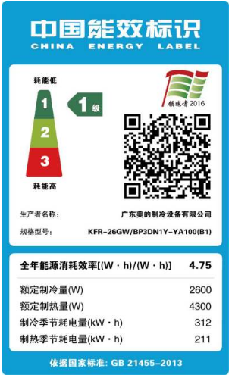
Most of 2D Barcodes Do Not Use GS1 KEYs
Application Status
Data type: internal codes and URLS
Technical venders: closed systems
Application mode:
Track & Trace
Law and regulation
Extend package information
Marketing
Anti-counterfeiting

Slide 6
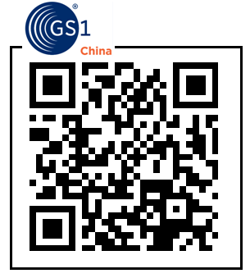
Need a Standard 2D Barcode on the Pack
More 2D barcode for more applications?
We need a standard 2D barcode to bind various applications.
Extend package information
Track & Trace
Marketing
Anti-counterfeiting
Law & regulation
…
解决方案是产品的统一二维码标识

Slide 7
The China National Standard
“2D Code for Commodity”

Slide 8
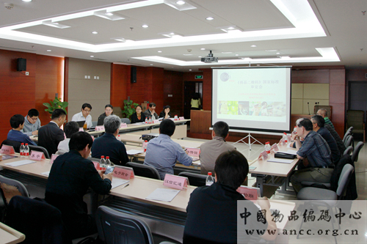
1. Standardization Process
Application: apply to SAC in 2013
Ratified：2015.5 （The national standard Plan code: 20150572-T-469）
Content：Data structure, information services, symbologies and symbol print qualities
Technical committee：TC267
Participant：25 entities includes GS1 China、Baidu、Sunning、China Unicom、China Telecomm, New Land…
2016.5，The technical audition meeting was held
2017.7.12，GB/T 33993 《Two dimensional code for commoditiy》was issued by SAC

Slide 9
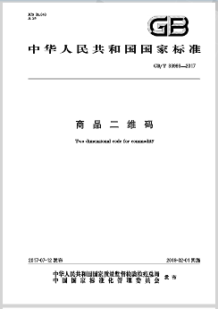
2. Data Structure
GS1 data structure (编码数据结构)
(01)06901234567892(10)A1000B0000(21)C51031902101083826
Note：GTIN＋lot no.＋serial no.
the short URI (国家平台网址数据结构)
http://2dcode.org/0106901234567892OXjVB3
Note：GTIN＋identified code
GTIN on the web structure (开放网址数据结构)
http://www.example.com/gtin/06901234567892/bat/Q4D3/ser/32a
Note：GTIN＋search key＋code

Slide 10
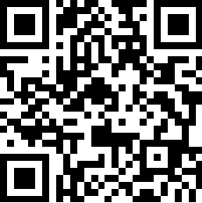
3. Optional Code System
Adopt Han Xin code, QR code or Data Matrix code with GS1 or FNC1 mode, and have the 2d code system of China national standard or ISO standard.
The compaction of URI
the URI mode of Han Xin Code.
Encoding the Same URI
Han Xin Code URI mode is more efficient (25*25 <26*26<29*29)

Slide 11
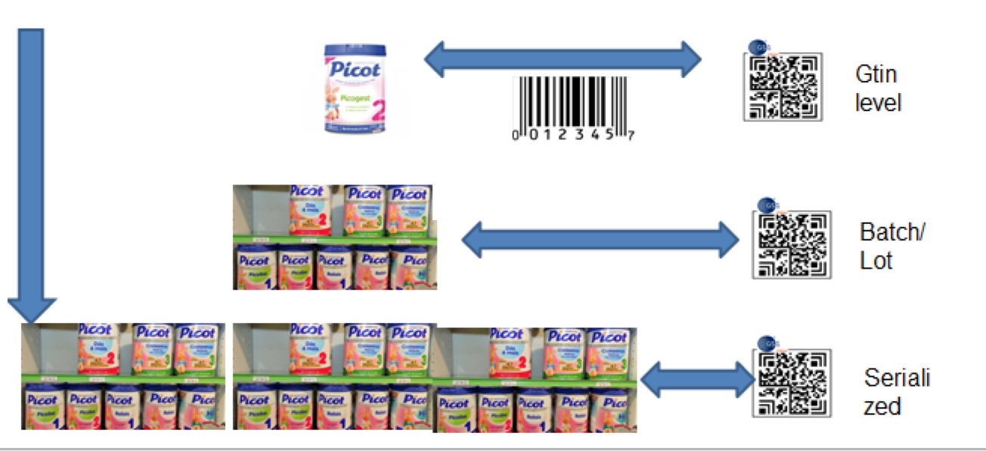
4. Unique ID
Expansion and supplement of the barcode of retail commodities
Core function: to realize the unique identification of commodities
The ODS services (Data and URI) , support various granularity ID

Slide 12
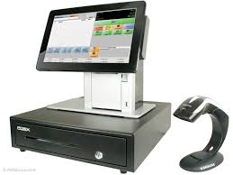
5. The standard Mobile Service
Compatible with various online and offline APPs.
Through the post-binding function, manufacturers can specify different APP scanning one to skip to different mobile services.
GTIN
JD.com https://mall.jd.com/index-1000013402.html
Tmall.com
https://yili.tmall.com/?spm=a1z10.3-b-s.w5001…
Yili website http://www.yili.com/cms/index
Online
GTIN
Offline
GTIN

Slide 13
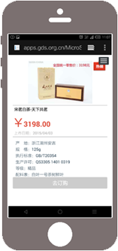
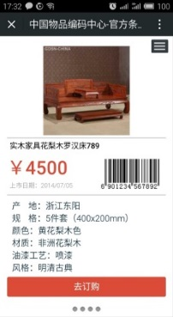
6. Barcode WeSite
One-stop integrated service platform of 2D code for commodity
Consumer
Develop by GS1 China based on product information
For GS1 member companies: a value-added service and mobile micro portal, and further help to achieve anti-counterfeiting, online sales and so on.
For consumers: convenient to view the production info anytime and anywhere
Main Function
2D Code for Commodity
Manufactory
Front-end Display
Display Product Information
Background Function
Generate 1D&2D barcode online
Output
Generate
Print
register
scan
Mini Program Function
e-Card
Community
etc.
Source of Data
Generate based on source of data (GTIN)
Mobile Display

Slide 14
6. Barcode WeSite
Comprehensive solution of 2D code for commodity, that can be flexibly customized according to the needs of users
Company e-Card
2D Code
Compliance with the China national standard“2D code for commodity”
Flexible customization according to enterprise requirements
Quick correlation after pre-printing
Big data services, statistical analysis and reports
Product e-Card
2D Code
Batch/Lot 2D Code
GTIN Level 2D Code
Comprehensive solution
Of 2D code for commodity
Beautify 2D code
……

Slide 15
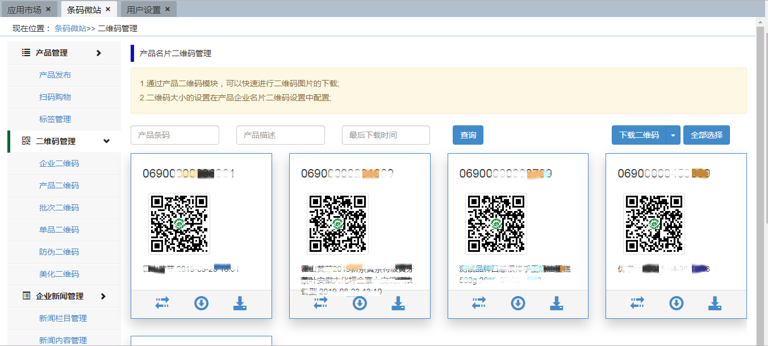
6. Barcode WeSite
Background management of 2D code for commodity
Simple and easy to use
Quick edit production information
Automatically generate 2D code
management of navigation
generate
download

Slide 16
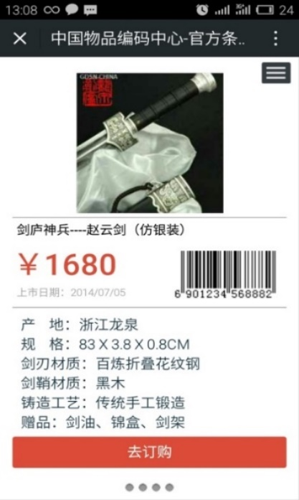
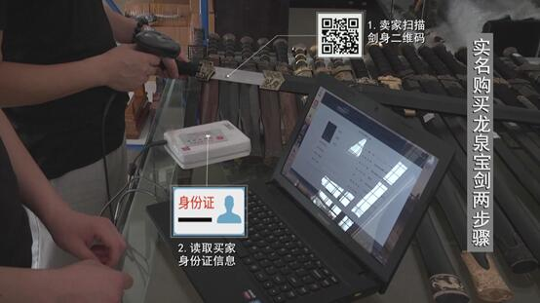
6. Barcode WeSite
APPLICATION: Longquan Sword Tracing and Control
Key driver: the Longquan Sword, named after its birthplace in Longquan of Zhejiang province, the techniques of Longquan Sword making were included on China’s list of national intangible cultural heritages in 2006.
Counterfeit - the sword products made in other regions are sold under the brand of Longquan sword.
Shoddy - there are many small and extensive workshops in Longquan local sword industry, resulting in uneven product quality
2D code for Longquan Sword: GTIN⁺
1. Plain code
printed on the edge of trademark for scanning
Front-end data acquisition and scanning entry
2. Secret code
Invisible , laser etching in the darkness of the hilt, life-long preservation
Used for police query & verification
GS1 China
Longquan Sword
Research
Pilot
Implementation
QR Code
GS1 Datamatrix
Other:_______
Open ecosystem
Closed ecosystem
# Company
+150

Slide 17
6. Barcode WeSite
APPLICATION: Longquan Sword Tracing and Control
Result: nearly 160 Longquan sword manufacturers registered GTIN, and all parties benefit from the project.
Longquan sword manufacturers
Input the information of each sword product to Barcode WeSite before selling, including the materials used, forging person, manufacturer and so on.
Longquan Sword Seller
Only need to install APP with real-name and take photos during sales to be able to fully traceability Longquan swords.
Longquan Public Security Bureau
It can directly and effectively manage the sword products and maintain social security.
Longquan Administration for Market Regulation
It can effectively fight against fake Longquan sword brand products into the market, and better protect the consumers.
Consumer
When buying, it can easily know the sword information via scanning the 2D code in the Longquan sword.

Slide 18
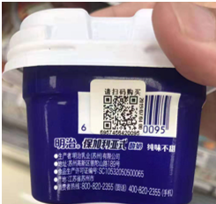
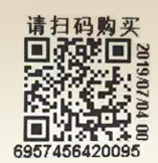
7. Use Case
Bianlifeng： Expiry Date Management
Key Driver: to ensure food safety, fight against professional counterfeit or malicious claims, and desire to enable 2D symbol read and traceability information by customers via smartphones (Bianlifeng APP)
Print “2D code for commodity” (QR Code) on the food package with the expiry date of 30 days
Data encoded:
GTIN
Batch/Lot no.
Best before date
…
Please scan to buy!
Customer: scan and pay by themselves
Checker: scan to complete "read information - automatic record - sales check"
GS1 China
Food within 30 days of expiry date
Research
Pilot
Implementation
QR Code
GS1 Datamatrix
Other:_______
Open ecosystem
Closed ecosystem
# Products
1
10
100
1k
10k+
746

Slide 19
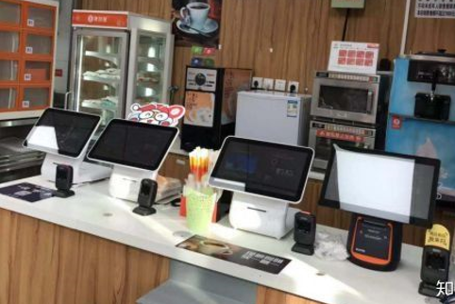
7. Use Case
Bianlifeng： Expiry Date Management
Key Learnings
7 months from start to implementation (1-7, 2019)
746 foods which expiry date is within 30 days adopt 2D code for commodity, and realize the source tracing.
Print quality control issues required development to improve symbol quality.
Staff confused by multiple barcodes (additional education was needed)
More manufacturers and retailers need to be involved.
Self-service scanning area

Slide 20
Jiangfeng QIU
THANK YOU ！
GS1 China 中国物品编码中心
5F, Wing B, Imperial International Bldg., No.138 Andingmenwai Street, Dongcheng District, Beijing 100011, P.R.China
T +86 010 8429 5523
E qiujf@gs1cn.org
qiujf@ancc.org.cn
www.gs1cn.org

