Slide 1
Sealvectorized Qr code
CONFIDENTIAL
Patrick Battistini
24 January 2022

Slide 2
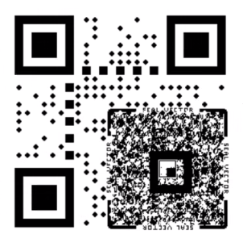
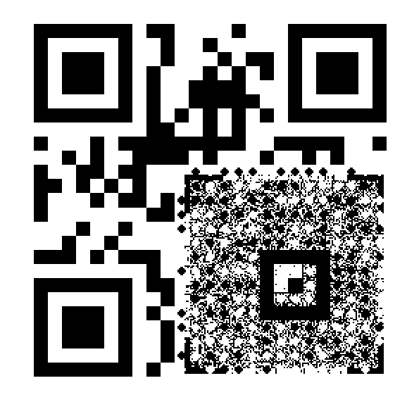
QR code SV Bottom right
PROS:
Footprint
SV latitude
QR Payload
QR code size
Resolutions support
TO TEST:
QR code reading (to test)
SV payload (To test)
SV reading (To test)
QR code reading (to test)
Logo support seems feasible (to test)

Slide 3
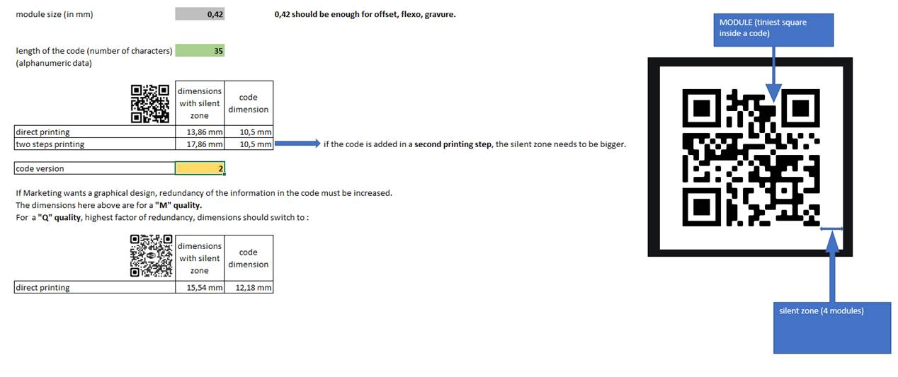
L’Oréal Not Serialized QR Code

Slide 4
L’Oréal Not Serialized QR Code
Requirements:
Module size 0.42mm
Length of the alphanumerical code = 35
QR Code size without logo = 10.5mm Version 2 25x25
QR Code size with logo = 12.18 mm Version 3 29x29
2 steps printing: can we print the QR Code after the SV? (Generic packaging)
Printing technology Offset, Flexography, Silkscreen, others (gravure?)
Smartphone reading without add-on

Slide 5
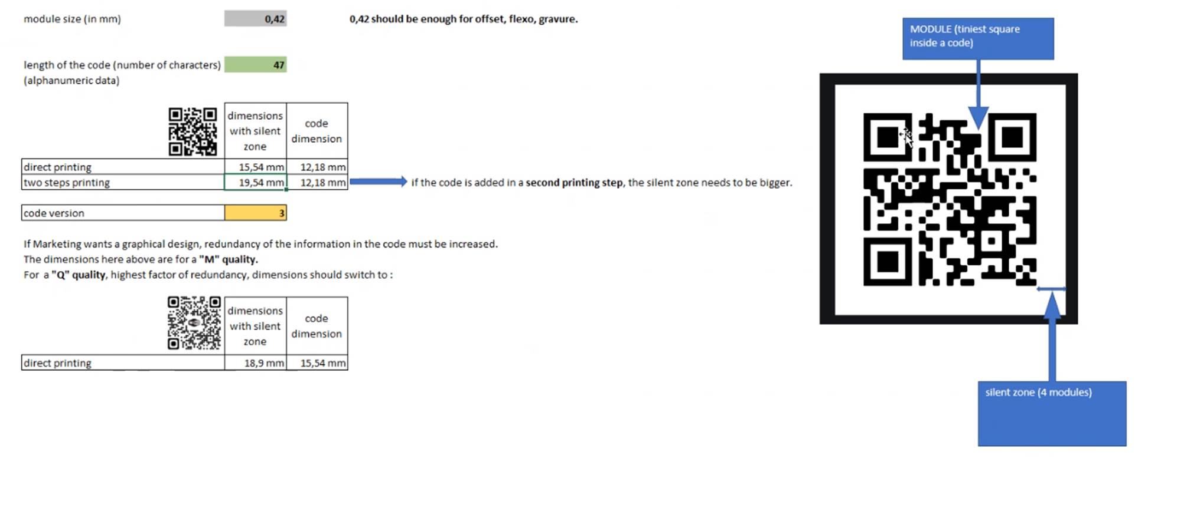
L’Oréal Serialized QR Code

Slide 6
L’Oréal Serialized QR Code
Requirements:
Module size 0.42mm
Length of the alphanumerical code = 47
QR Code size without logo = 12.18 mm Version 3 29x29
QR Code size with logo = 13.86 mm Version 4 33x33
2 steps printing: can we print the QR Code after the SV?
Digital Printing technology: 600dpi inkjet minimum
Smartphone reading without add-on

Slide 7
L’Oréal focus points
Logo
2 steps printing
Digital printing resolution
Risk to validate: QR Code readability on curve surface

